Slide 1
What goes around, comes around: Cases that keep me going
Laura A. Janda
Threat-Defuser
(Norwegian Research Council)

Slide 2
Overview
Linguistic theory and description
Case Semantics
Two Tools
The Russian Constructicon https://constructicon.github.io/russian/
The Strategic Mastery of Russian Tool (SMARTool) https://smartool.github.io/smartool-rus-eng/
Putin Makes His (Grammatical) Case
Pedagogical applications
Analysis of political discourse

Slide 3
Case Semantics

Slide 4
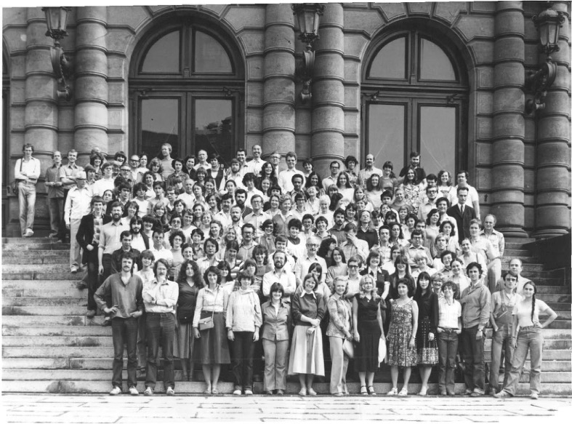

Slide 5
Textbooks cite seemingly random long lists of prepositions and verbs to memorize for each case – but that can’t be the whole story!

Slide 6
Philosophical questions
Are grammar and lexicon really distinct?
Does grammar have meaning?
If grammar has meaning, how does it work?
Answers from the perspective of Cognitive Linguistics

Slide 7
Are grammar and lexicon really distinct?
Grammar and lexicon form a continuum
Many functions are expressed grammatically in some languages, but lexically in others
case affixes vs. adpositions
aspect/tense/mood affixes vs. adverbs
in/definiteness affixes vs. articles
comparative/superlative affixes vs. adverbs
No clear boundary separating functions expressed
synthetically vs. analytically

Slide 8
Does grammar have meaning?
PURPOSE of all language phenomena is to convey meaning
THEREFORE: all morphemes, including grammatical ones, convey meaning
BUT: grammatical meaning does tend to be more abstract, schematic, polysemous

Slide 9
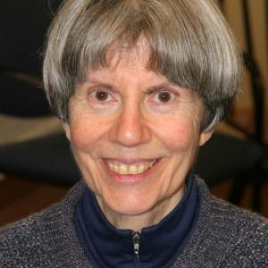
If grammar has meaning, how does it work?
Homonymy vs. structured polysemy
meanings are not random lists of disconnected items
meanings are related to each other
Aristotelian categories vs. radial categories
meaning is not “+” vs. “-”
meaning is not about sets and boundaries
meaning is about prototypes and extensions from/relations to prototypes
Eleanor Rosch on
Human Natural Categories

Slide 10
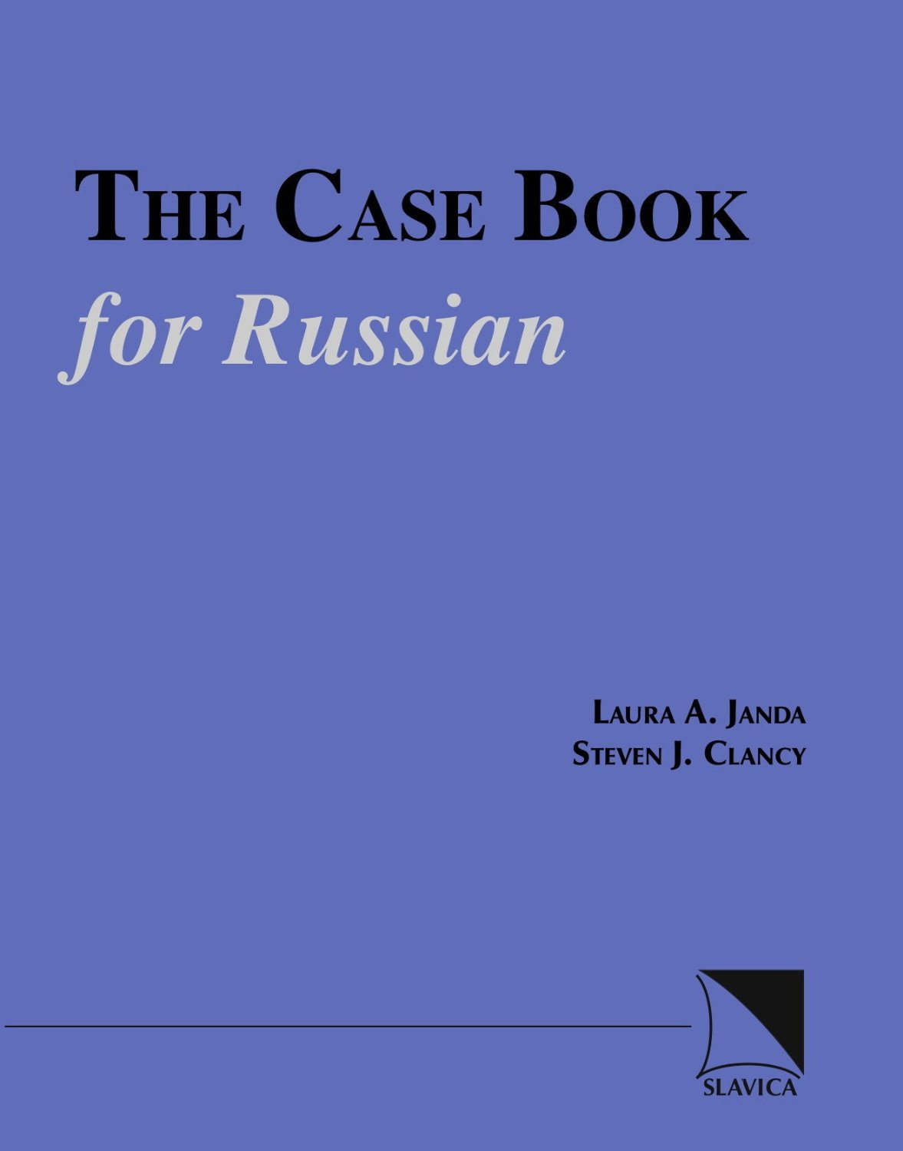
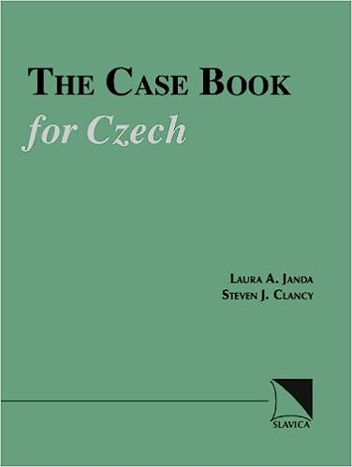
Case Meanings in Russian (and Czech)
Janda, Laura A. 1993. A Geography of Case Semantics: The Czech Dative and the Russian Instrumental (=Cognitive Linguistics Research, v. 4). Berlin: Mouton de Gruyter.
Janda, Laura A. 1999. Peircean semiotics and cognitive linguistics: a case study of the Russian genitive. In: The Peirce Seminar Papers, ed. by Michael Shapiro. New York/Oxford: Berghahn Books, 441–466.
Janda, Laura A. 2000. A cognitive model of the Russian accusative case. In: Trudy meždunarodnoj konferencii Kognitivnoe modelirovanie, No. 4, part I, ed. by R. K. Potapova, V. D. Solov’ev and V. N. Poljakov. Moscow: MISIS, 20–43.
Janda, Laura A. & Steven J. Clancy. 2002. The Case Book for Russian. Bloomington, IN: Slavica Publishers.
Janda, Laura A. & Steven J. Clancy. 2006. The Case Book for Czech. Bloomington, IN: Slavica Publishers.

Slide 11
Overview of the case meanings (Russian)
For each case:
Schematic meaning
Abstract overall idea
Network of 1 to 4 meaning nodes
Structured polysemy: meanings are related to each other
Metaphorical and metonymic extensions, usually from space to other domains: time, purpose, etc.

Slide 12
Nominative: Identification
NOMINATIVE: A NAME
Used to point out an item or call someone
The grammatical subject, the active agent in a situation.
NOMINATIVE: AN IDENTITY
With verbs meaning ‘be’ as in ‘X is Y’ (Ivan xorošij student ‘Ivan is a good student’), where “X” (Ivan) is NOMINATIVE: A NAME as the grammatical subject, while “Y” (good student) is NOMINATIVE: AN IDENTITY.

Slide 13
Genitive: Backgrounded with respect to something in proximity
GENITIVE: A SOURCE
Point of departure specified by prepositions meaning ‘from’ (iz, s, ot…), verbs expressing withdrawal (izbegat’ ‘avoid’, bojat’sja ‘be afraid of’…); extended metaphorically to time, cause, human relationships.
GENITIVE: A GOAL
Point of attainment specified by prepositions (do ‘up to, until’, dlja and radi ‘for’, protiv ‘against’…), verbs and adjectives expressing (mostly metaphorical) approach (ždat’ ‘wait for’, želat’ ‘wish’…); extended metaphorically to time, purpose, states of being.
GENITIVE: A WHOLE
Part of a larger unit; ‘of’; participant in a nominalized event (poterja žizni ‘loss of life’); complex prepositional phrases; quantification (sto studentov ‘one hundred students’); partitive expressions (vypit’ čaju ‘drink some tea’).
GENITIVE: A REFERENCE
Proximal landmark (u ‘by, at’ and other prepositions); temporal setting; lack, as in the Genitive of negation, and verbs, nouns, and adjectives expressing lack, as well as the preposition bez ‘without’; standard of comparison (Ivan starše menja ‘Ivan is older than I am’).

Slide 14
Dative: Capacity to interact with surroundings
DATIVE: A RECEIVER
indirect object (Ivan podaril mame knigu ‘Ivan gave his mother a book’), includes many verbs without an overt direct object, such as verbs of communication and payment.
DATIVE: AN EXPERIENCER
With words denoting harm, benefit, belonging to, and needing; age; experience of environment, emotions, limitations on capacity (modals).
DATIVE: A COMPETITOR
With words expressing matched competition or submission to a greater force; k ‘toward’ and po ‘along’ which identify a person or entity that exerts influence.

Slide 15
Accusative: Path toward a destination
ACCUSATIVE: A DESTINATION
Direct object; path specified by prepositions (v ‘into’, na ‘onto’, za ‘beyond’, pod ‘under’…); metaphorical extensions to domains such as time, purpose, change of state, mathematics, human relationships (joining of groups).
ACCUSATIVE: A DIMENSION
Distance or size (rasstojanie v dva kilometra ‘a distance of two kilometers’), duration (interval v dve nedeli ‘an interval of two weeks’); prepositions specify path contours (skvoz’ ‘through’, čerez ‘across’).
ACCUSATIVE: AN ENDPOINT
Final point of a path (v and za, both indicating the end of a distance or duration) and postpositions (nazad ‘ago’).

Slide 16
Instrumental: Peripheral conduit or attachment
INSTRUMENTAL: A MEANS
Conduit for an action (idti lesom ‘go through/by means of the forest’); instrument that makes an action possible (rezat’ xleb nožom ‘slice bread with a knife’); with verbs signifying control and evaluation (vladet’ anglijskim jazykom ‘have mastery of the English language’); passive agent (Mašina kuplena Ivanom ‘The car was bought by Ivan’); facilitator in a sentence lacking a grammatical subject (Ivana zabilo molniej ‘Ivan was killed by lightning’).
INSTRUMENTAL: A LABEL
With verbs denoting being, becoming, and seeming to identify a category that something belongs to (koška javljaetsja mlekopitajuščim ‘a cat is a mammal’).
INSTRUMENTAL: AN ADJUNCT
Preposition s ‘with’ (Marija přišla s Ivanom ‘Marija came with Ivan’).
INSTRUMENTAL: A LANDMARK
Prepositions nad ‘above’, pod ‘under’, pered ‘in front of’, za ‘behind’, meždu ‘between’.

Slide 17
Locative: Location
LOCATIVE: A PLACE
Locations in space or other domains specified by prepositions v ‘in’, na ‘on’, pri ‘at’, o ‘about’, po ‘after’ (v Moskve ‘in Moscow’, v mae ‘in May’).

Slide 18
Two Tools

Slide 19
https://constructicon.github.io/russian/

Slide 20
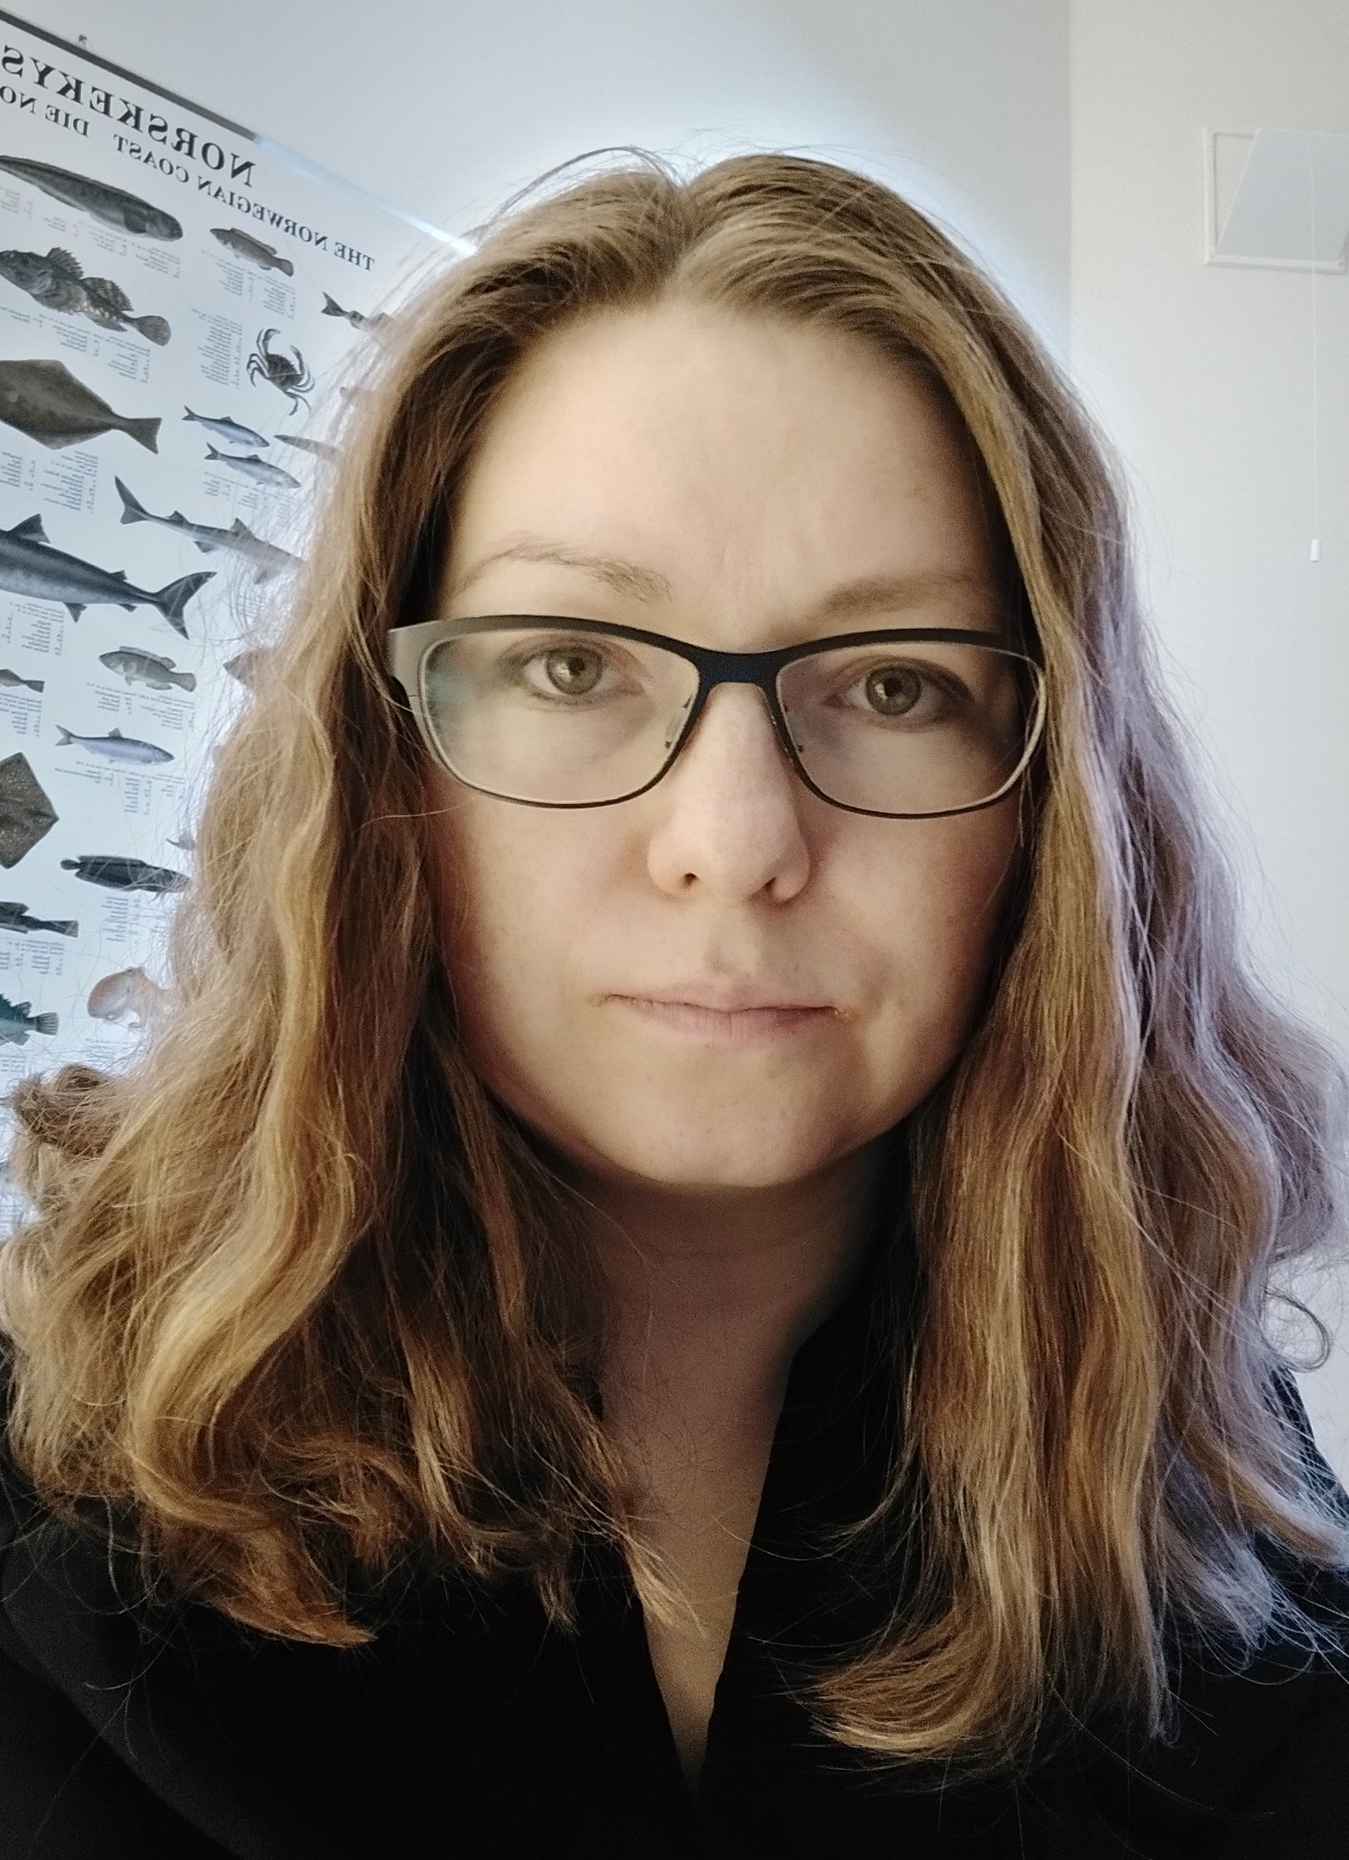
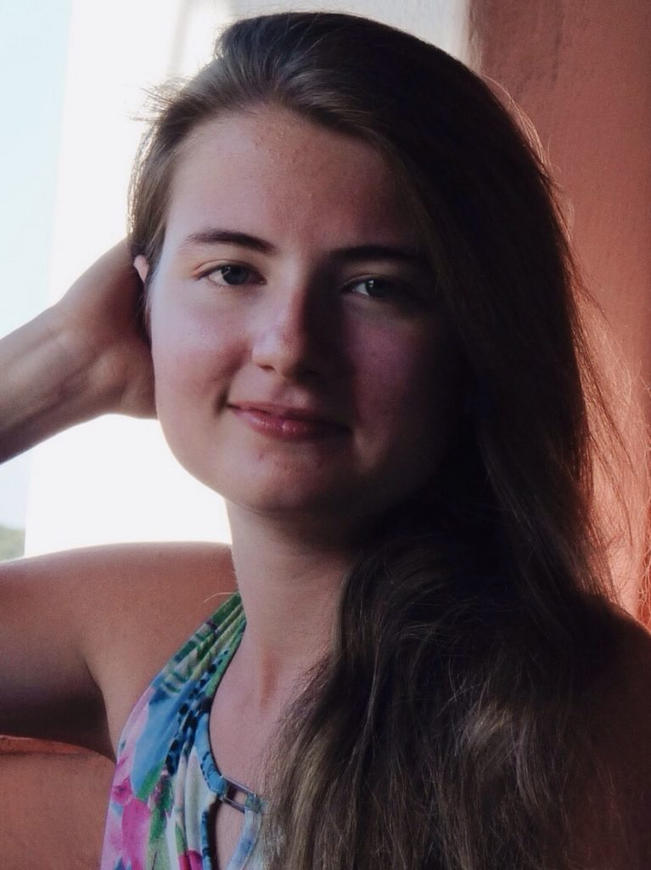
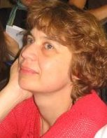
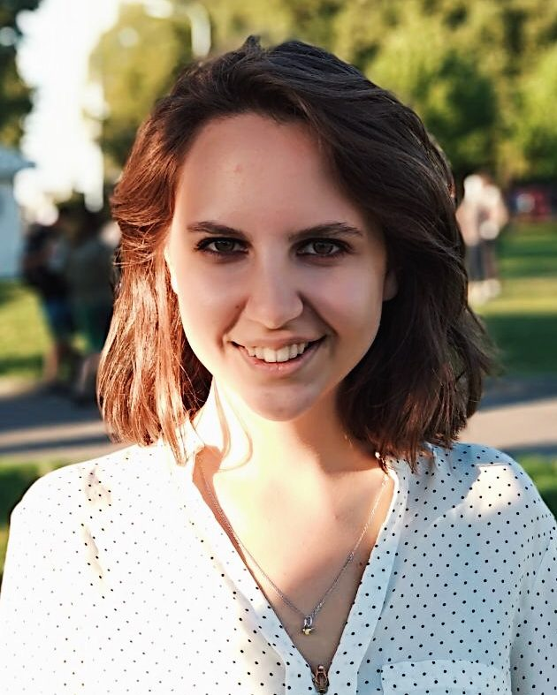
Financing and collaboration
Team
Anna Endresen
Daria Mordashova
Ekaterina Rakhilina
Valentina Zhukova
Plus: over 40 students

Slide 21
What is a construction?
A construction is:
any conventionalized form-meaning pairing in a language, at any level of complexity, from morpheme through lexeme through phrase to discourse structure (Goldberg 2006, 5)
the basic (though not elementary) unit that structures language
A construction may be compositional or non-compositional
All meaningful units of a language are constructions
An entire language can be described in terms of constructions

Slide 22
Examples of Russian constructions
morphemes
-t’ = INF
lexemes
tancevat’ ‘dance’
multi-word idioms where all slots are fixed
tancevat’ ot Adama ‘start from the very beginning’
multi-word expressions with open slots
VP pod NP-Acc
Ona tancevala pod muzyku ‘She danced to the music’
larger discourse units
Our project focuses mainly on this type of construction

Slide 23
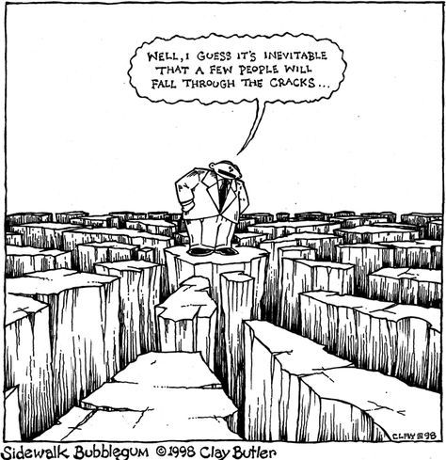
Filling in the gaps
It seems that a few things
just fall through the cracks
Dictionaries, grammars, and textbooks focus primarily on lexemes, lexicalized idioms, inflectional paradigms,and grammatical patterns
Multi-word expressions with open slots are less reliably represented in standard resources
TEXTBOOK
PHRASE
BOOK
GLOSSARY
DICTIONARY
We need a relatively large inventory of constructions of a single language, and a detailed description of this inventory, a constructicon.
REFERENCE
GRAMMAR

Slide 24
What is a constructicon?
A constructicon is:
a structured inventory of constructions in a given language
Constructicons exist for:
English
German
Swedish
Japanese
Brazilian Portuguese
The Russian Constructicon is by far the largest,
with over 2200 constuctions

Slide 26
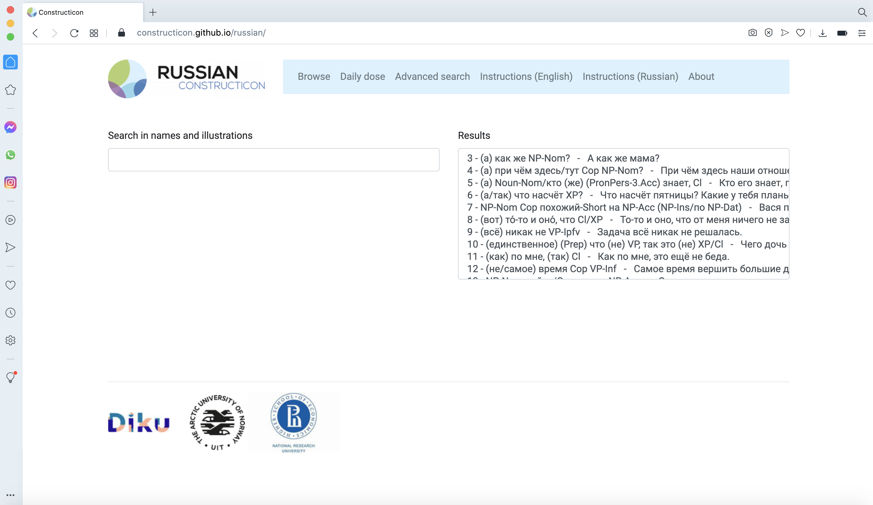
Browse a list of over 2200 constructions
Select any construction, click on it and the description will appear at the bottom of the same page

Slide 27
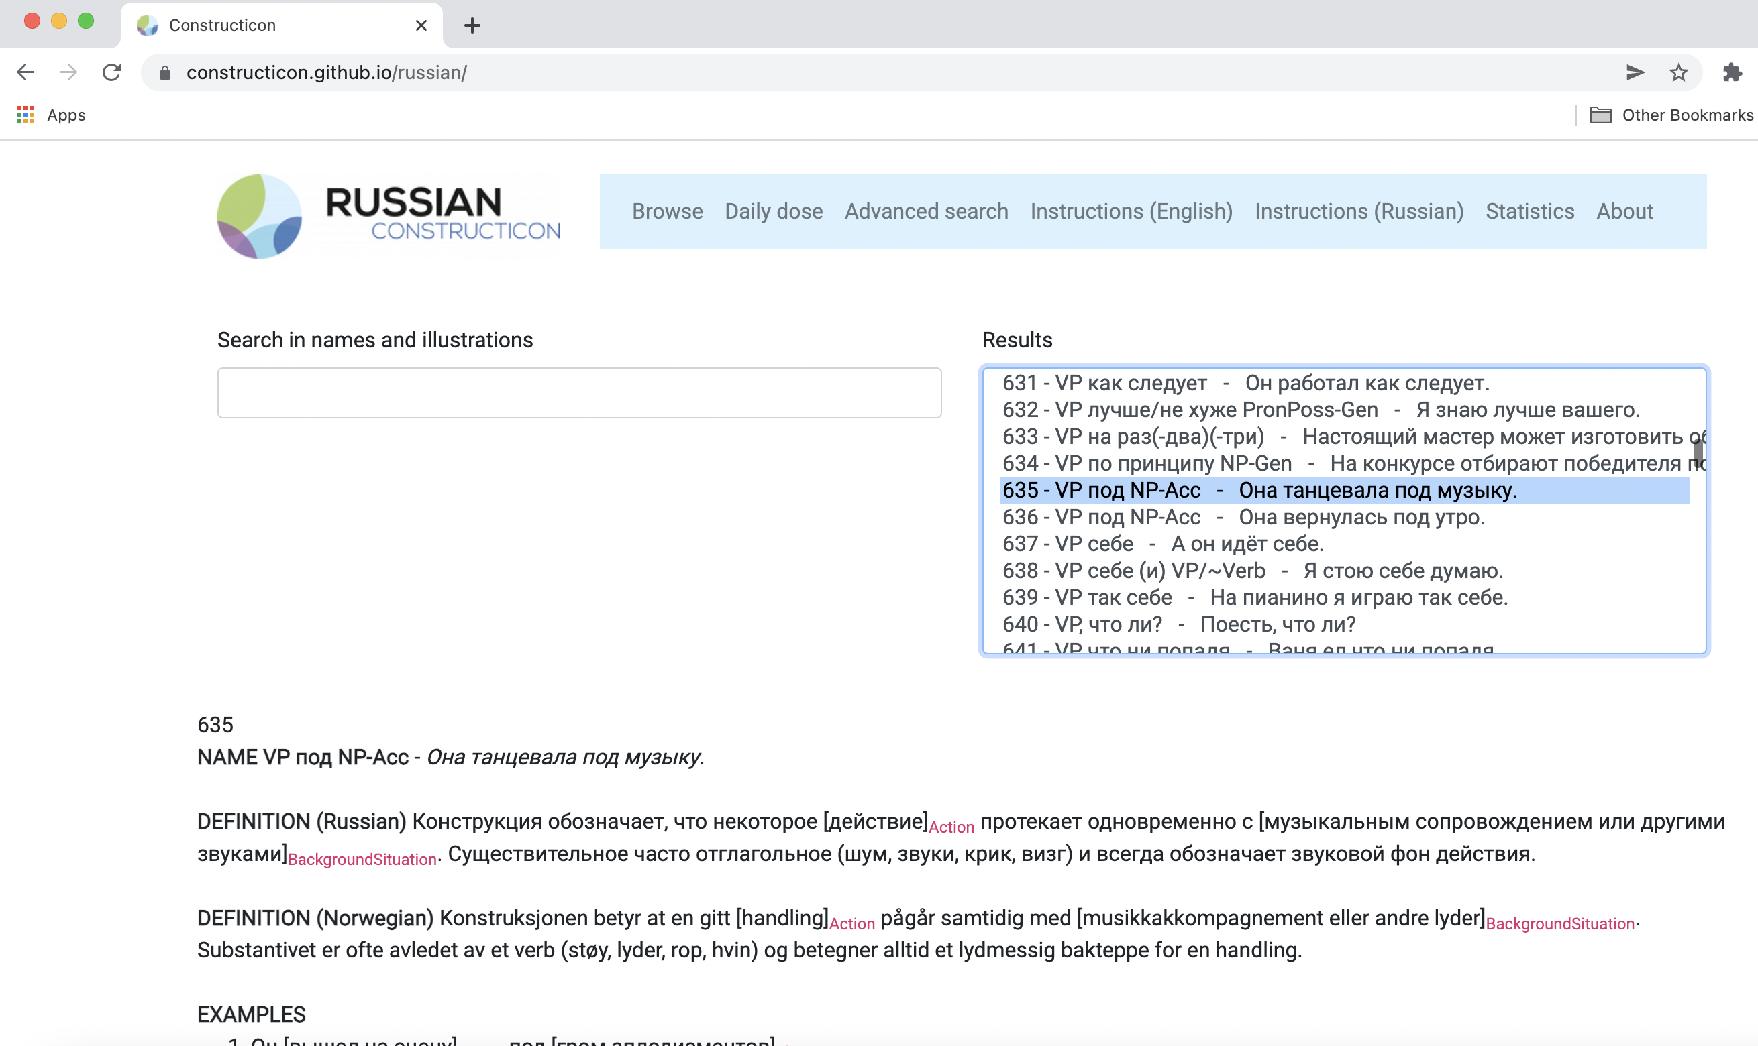
Name
Illustration
ID-number
For each construction we have an ID number, a name (a general morphosyntactic formula) and a short recognizable illustration.

Slide 28
Launch of a new educational resource for learning Russian
https://constructicon.github.io/construxercise-rus/

Slide 29
database with over 2200 Russian grammatical constructions
https://constructicon.github.io/russian/
practical exercises for students learning Russian https://constructicon.github.io/construxercise-rus/
built in 2016-2021 / 2022,
launched in September 2021
built in January - June 2022,
launched in June 2022
The exercises are aimed at the strategic groups of 57 Russian constructions
All constructions included in the exercises are carefully described and illustrated in the Russian construction

Slide 30
Our choice: discourse constructions
ID | Construction | Illustration
1087 | иными/другими словами, XP/Cl | Наш корреспондент выехал в аэропорт, чтобы взять интервью. Другими словами, задать несколько вопросов.
1840 | к примеру, Cl/XP | Вот, к примеру, мне нравится Мерилин Монро.
1872 | (и) кстати (говоря), Cl | И кстати, он пришёл без подарка.
6 | (а/так) что насчёт XP? | Что насчёт пятницы? Какие у тебя планы?
2273 | в-NumOrd-ых, XP/Cl | Во-первых, я бы хотел поблагодарить своего тренера.
1839 | таким образом, Cl | Таким образом, наша команда за год добилась важных результатов.
11 | (как) по мне, (так) Cl | Как по мне, это ещё не беда.
2281 | Cl, не правда ли? | Интересный художник, не правда ли?
1133 | мягко говоря, Cl | Он, мягко говоря, не подарок.
Clarify your point
Give an example
Add information
Introduce a topic
Structure your argument
Draw a conclusion
Express your opinion
Ask someone for their opinion
Hedge
Notes:
simple to use because most of them are Clause + Modifier constructions, meaning that the fixed lexical element of the construction is an adverbial that modifies an entire clause. The fixed lexical elements in these constructions are mostly parenthetical (the Russian term вводные слова) and do not disturb the overall syntactic structure of a sentence they are inserted in. This makes these constructions relatively easy to learn even at early stages of L2 acquisition. At the same time, these constructions are widely used and can express a variety of pragmatic and semantic nuances. Moreover, they can function to scaffold text, by providing milestones or control points in text production.

Slide 31
Notes:
There is also a drop-down menu next to ”leesons” button, which is available from every page of the website. One can also access any lesson this way.

Slide 32
Spin-offs from the Russian Constructicon
Also under construction: Hill Mari, Persian

Slide 33
Construxercise: Important points
We propose a construction-based approach to learning and teaching L2-Russian via the Russian Constructicon and Construxercise!
The outcome product is multifunctional because it serves the needs of different types of users and offers educational materials that can be used as either a central or complementary teaching resource, and either in class or for self-guided study.
The focus on highly frequent and widely encountered constructions equips students with ready-to-use communicative units presented in the shape of clear sentence structures and phrase patterns.
Сonstructions can be easily combined into strategic sets, or templates, that make the task of generating any text, oral or written, much easier.

Slide 34
The Strategic Mastery of Russian Tool
https://smartool.github.io/smartool-rus-eng/

Slide 35
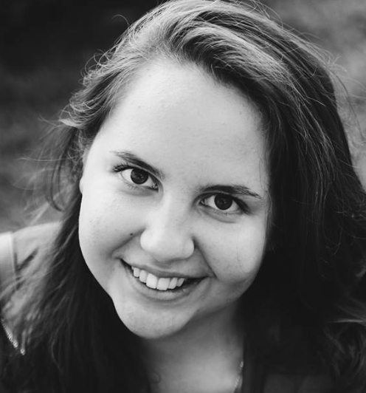
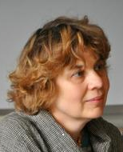
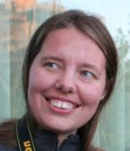
Team
Radovan Bast
Tore Nesset
Francis Tyers
Mikhail Kopotev
Financing and collaboration
Valentina
Zhukova
Elizaveta
Kibisova
Svetlana Sokolova
Evgeniia Sudarikova
Ekaterina Rakhilina
Olga
Lyashevskaya
James
McDonald

Slide 36
SMARTool: Empirical Basis
Russian has rich inflectional morphology
Nouns, adjectives, and verbs have many forms
Even a small vocabulary of a few thousand words has >100,000 potential forms
But 90% of these forms are rarely used
Machine learning indicates that focus on the most frequent word forms is the best path to full mastery
Language technology resources make it possible to identify the most frequent word forms and the grammatical constructions and collocations that motivate their use
The SMARTool presents over 3000 words at the A1 through B2 levels
Freely available: http://uit-no.github.io/smartool/

Slide 37
Computational Learning Experiment
Learning is potentially enhanced by focus only on the most typical wordforms attested for each lexeme: accuracy increases and severity of errors decreases
This finding is consistent with a usage-based cognitively plausible model

Slide 38
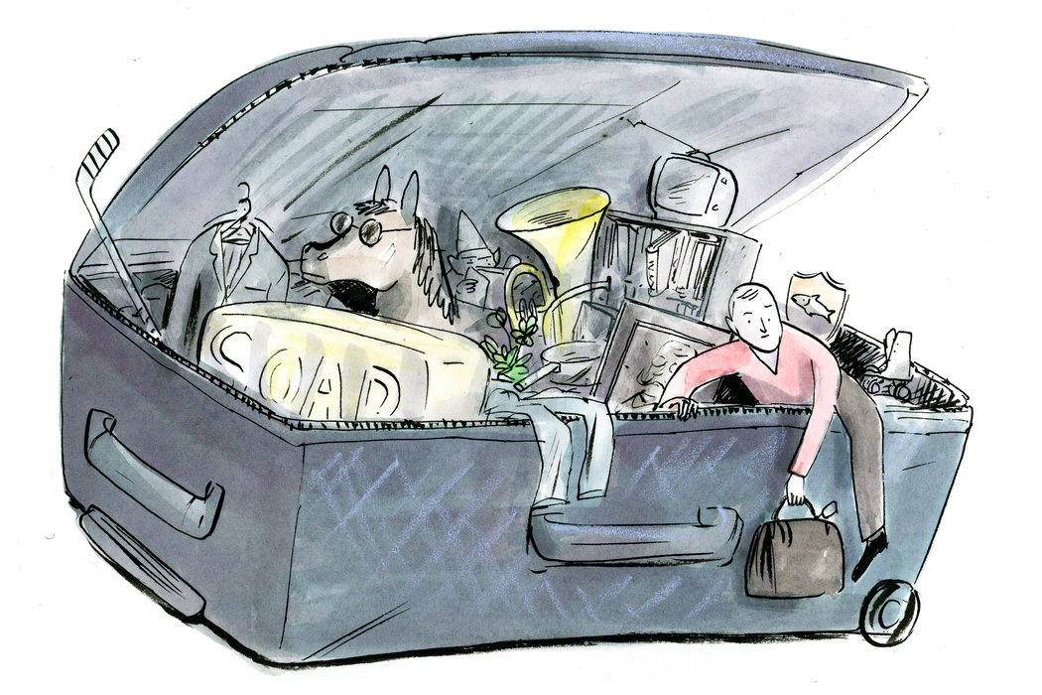
How Can We Escape From Overstuffed Paradigms?
Textbooks have always focused on certain forms and constructions
Now we can do this in a scientific, consistent way

Slide 39
Introducing the SMARTool
Strategic Mastery of Russian Tool
The user can browse 3000 Russian words according to proficiency level, topic, and grammatical categories.
For each word, the SMARTool provides the three most common forms, plus example sentences that show typical collocations and grammatical constructions.

Slide 40
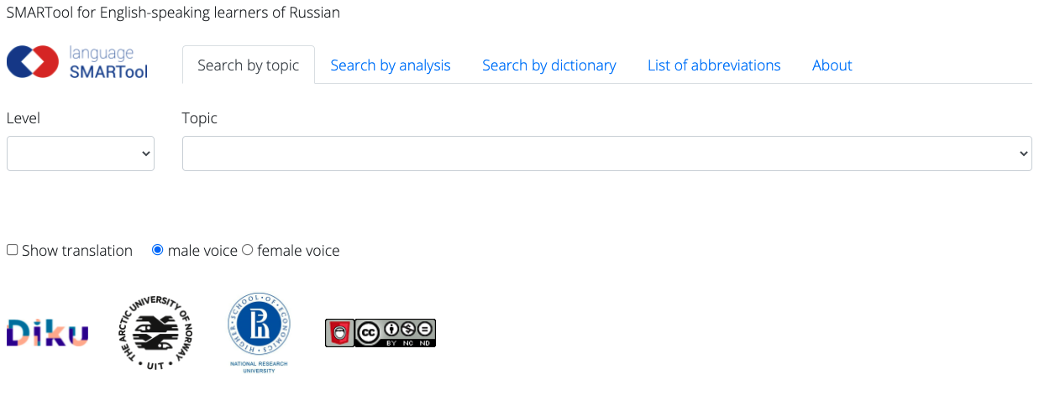
Find the SMARtool here:
https://smartool.github.io/smartool-rus-eng/

Slide 41
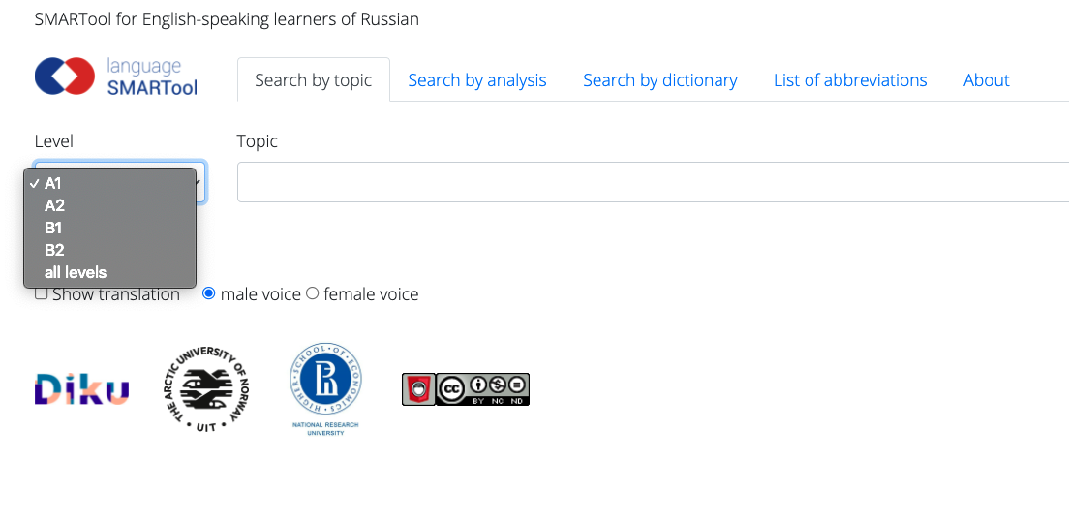
First, choose a Level

Slide 42
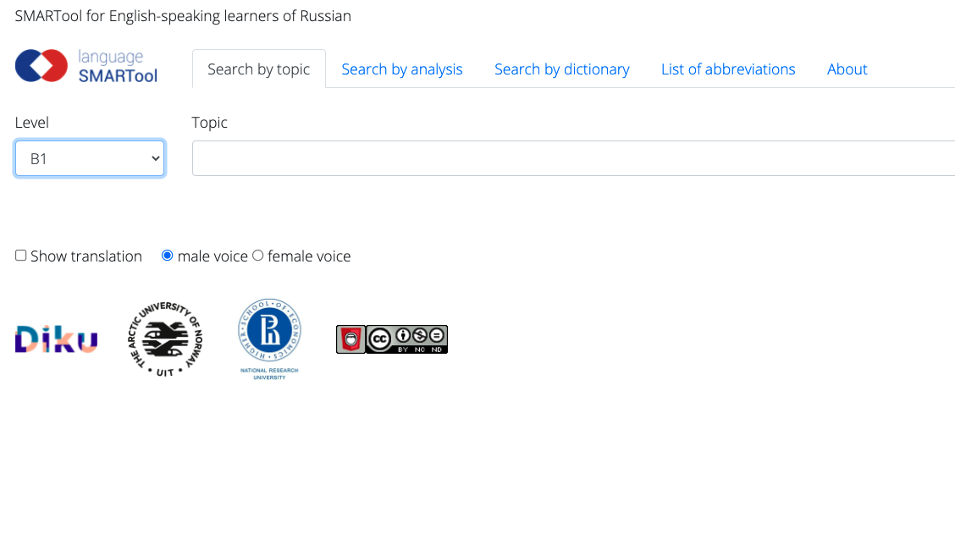
Next, you can search by topic, analysis, or dictionary

Slide 43
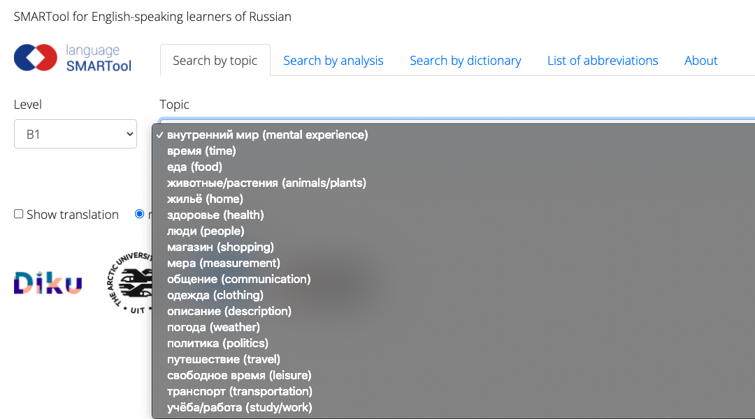

Slide 44
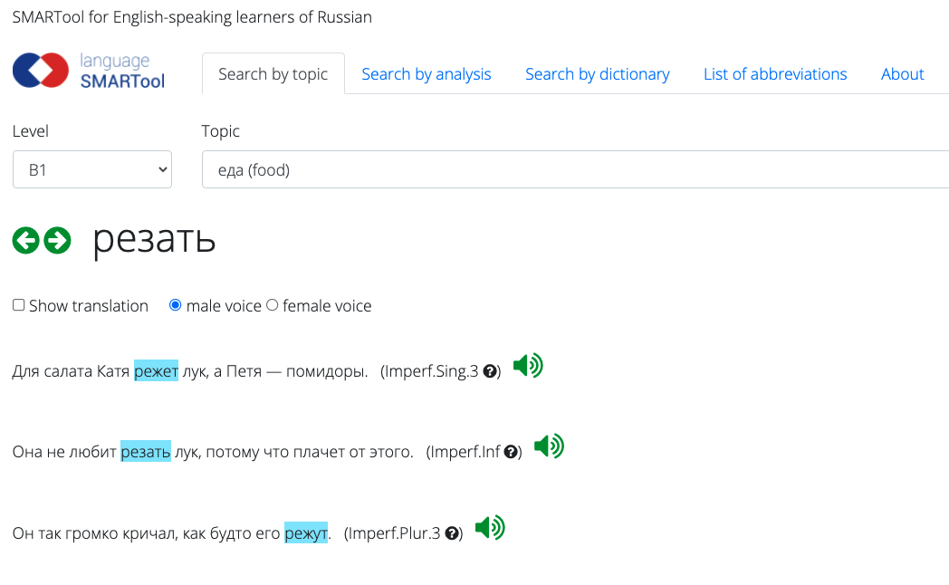

Slide 46
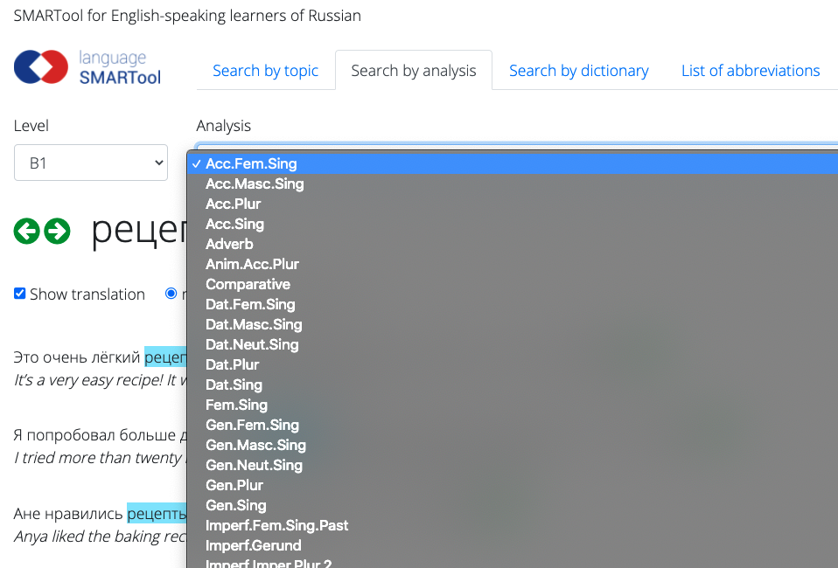

Slide 47
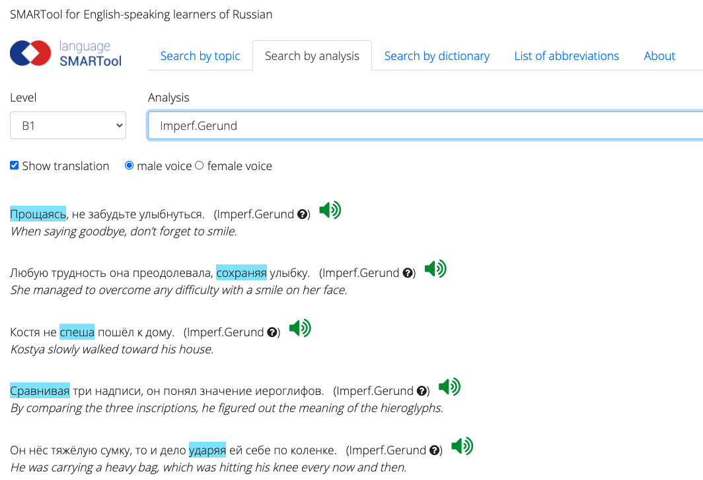

Slide 48
https://smartool.github.io/exercises/

Slide 49
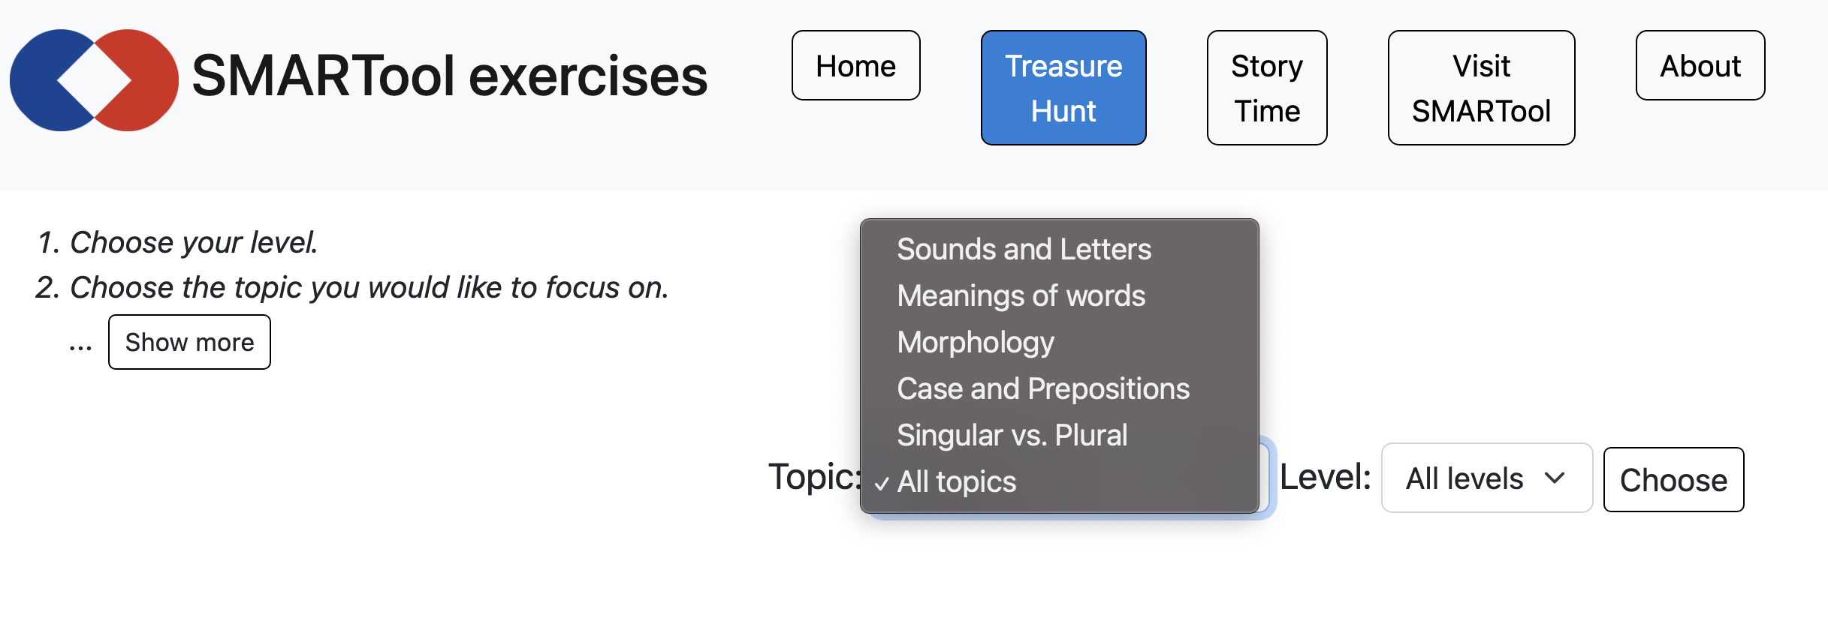

Slide 51
Putin Makes His (Grammatical) Case

Slide 52
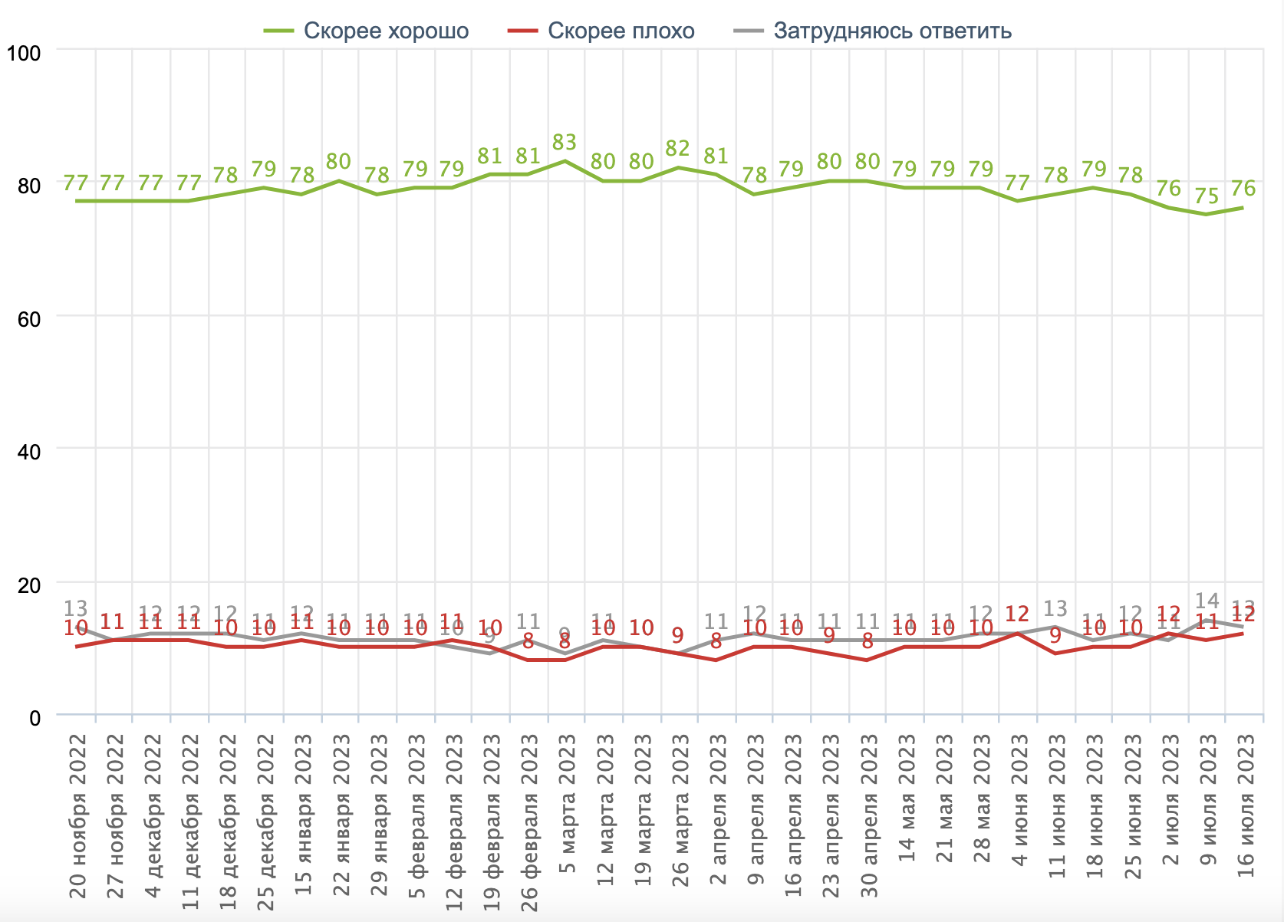
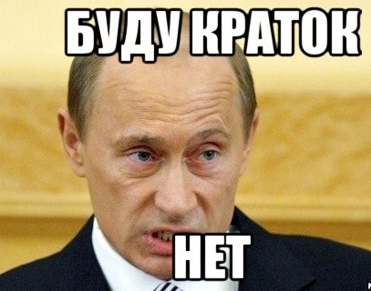
Why is Putin so popular? Why do Russians find him convincing?
Russians are usually skeptical of their government
Public opinion polls not entirely reliable, but a lot of people support Putin, at least passively
Sociologists say people are “hypnotized”
Independent media shut down, replaced by 24-hour TV propaganda
Putin is not a brilliant orator, but his speech consistently deviates from norms
“Do you think V. Putin is doing a good job or a bad job?”
(Nov 20 2022 – July 16 2023)
Data from:
Фонд Общественное Мнение
(Public Opinion Foundation)

Slide 53
Philosophical issues: norms, meaning, and grammar
A corpus as a proxy for experience and expectations of native speakers
Speakers may be sensitive to deviations from norms
Words can be consciously chosen, grammar less under conscious control and more systematic
Grammar and meaning: the semantic continuum lexicon – grammar

Slide 54
Overview
Keymorph Analysis as an extension of Keyword Analysis
Meanings of Russian grammatical cases
2022 “The case for case in Putin’s speeches” https://link.springer.com/article/10.1007/s11185-022-09269-2
Macro-level quantitative comparison: Putin’s use of case vs. reference corpus
Micro-level qualitative interpretation of Putin’s use of case
2023 Comparison with Putin’s speech Feb 21, 2023
Media have reported that this speech was more of the same
But we found some stark differences

Slide 55
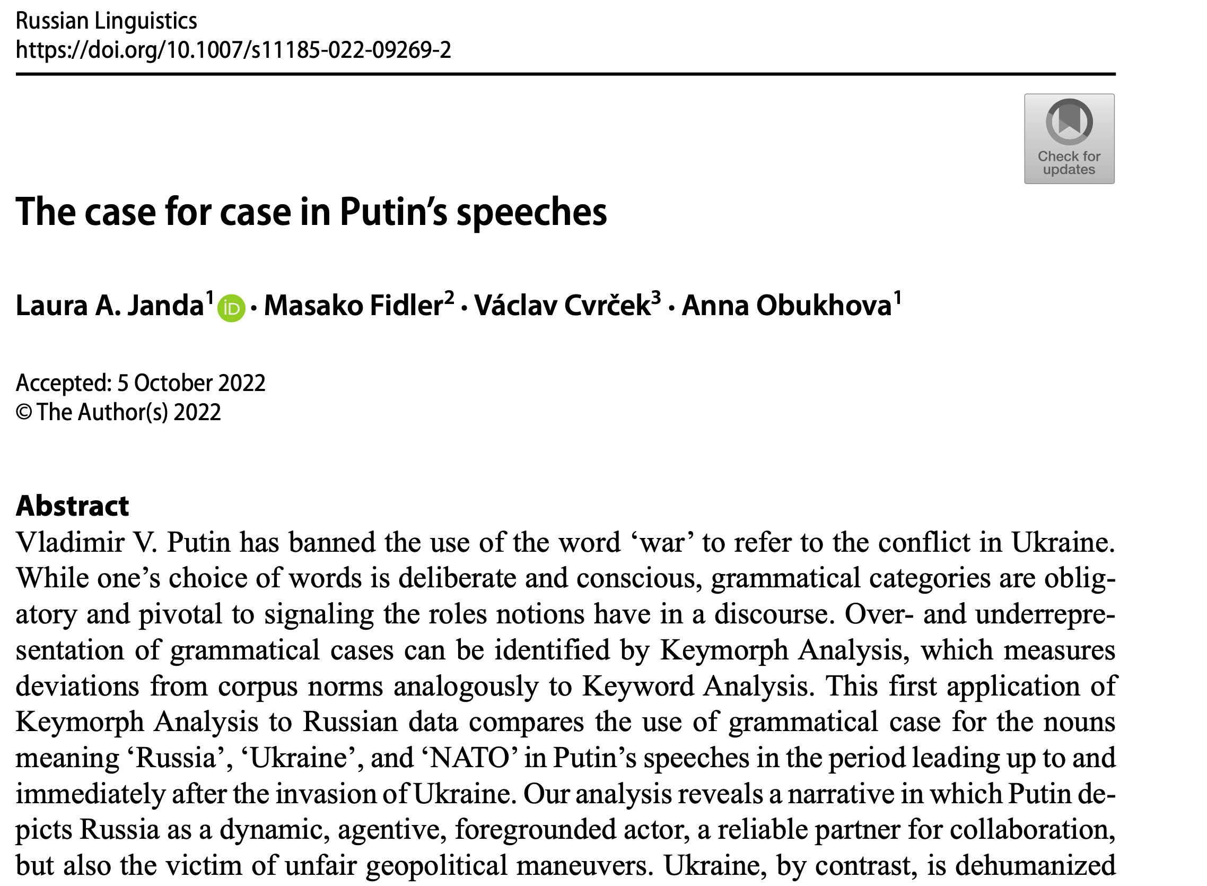
2022

Slide 56
Keymorph Analysis as an extension of Keyword Analysis
Keyword Analysis (cf. Egbert & Biber 2023):
widely used in corpus-assisted discourse analysis
focus on the distribution of words, identifying as “keywords” those that are unusually frequent in a target text vs. reference corpus
Keywords reveal the “Aboutness” of a text
mostly used with English, which has little morphology
it is customary to remove English function words, also known as “stopwords”
Keymorph Analysis:
takes advantage of the morphological expression of grammatical categories
developed by Fidler & Cvrček (2017, 2018, and Cvrček & Fidler 2019) on the material of Czech
this is the first pilot study/proof-of-concept using Russian data

Slide 57
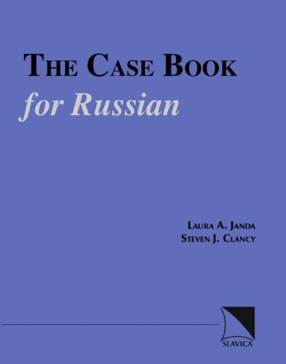
Meanings of Russian grammatical cases
Based on previous publications (Janda 1993, 1999, 2000, Janda & Clancy 2002 )
Meanings most relevant for analysis of Putin’s speeches in 2022
Nominative (NOM): agent (subject); label
Genitive (GEN): agent or patient; possession
Dative (DAT): potential agent (usually human)
Accusative (ACC): patient (direct object); destination
Instrumental (s + INS): collaborator
Locative (LOC): a place

Slide 58
Macro-level quantitative comparison: Putin’s use of case vs. reference corpus
Data: scope and source
Raw data
Difference Index keyed to frequency (DIN*)
Visualizations

Slide 59
Data: Putin’s speeches 10.02.-02.03.2022
10.02.2022: Russia launched its “largest military exercise since the Cold War, holding joint maneuvers with Belarus, close to the Belarus/Ukrainian border” (Walker 2022: 27).
02.03.2022: height of the first phase of invasion when Russian forces in Ukraine moved “to tighten their siege of key cities, including the capital, Kyiv, and the southern port of Mariupol” (Walker 2022: 39)
Size of target corpus: 34,720 tokens
Focus on three words:
Россия ‘Russia’
Украина ‘Ukraine’
НАТО ‘NATO’
Reference corpus:
Russian InterCorp (Czech National Corpus www.korpus.cz) 20.1 M tokens

Slide 60
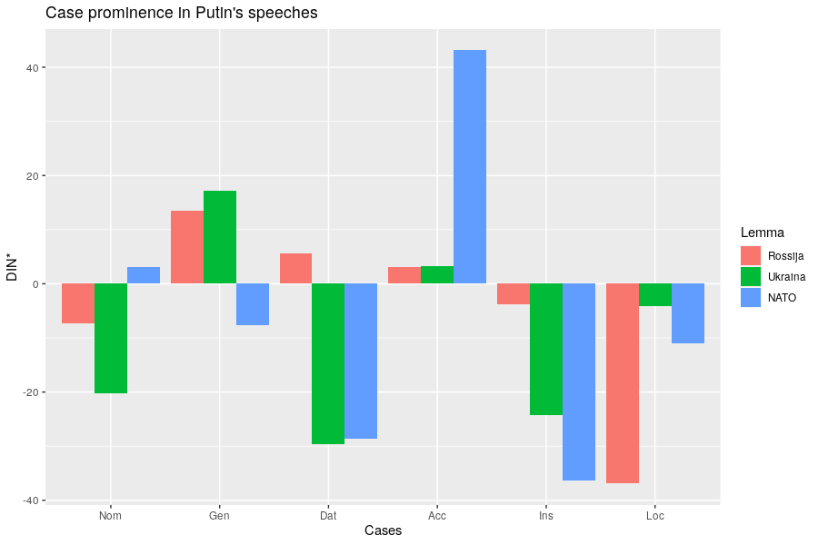
Comparison with reference corpus
2022
MORE than in corpus
SAME as in corpus
LESS
than in corpus
Notes:
Comparison is with reference corpus, we are looking at significant deviations.

Slide 61
Micro-level qualitative interpretation of Putin’s use of case
Representation of
NATO
Ukraine
Russia
Every example manually tagged for case submeaning

Slide 62
NATO in 2022
NATO represented as
just a label, not an agent (NOM)
a threat (GEN)
a destination or container (ACC, LOC)
not a collaborator, dehumanized (little INS and DAT)

Slide 63
Ukraine in 2022
Ukraine represented as
passive (NOM with stative verbs)
manipulated (ACC)
dehumanized (little DAT)
not a collaborator (little s + INS)
just a location, a region (na + LOC, GEN)

Slide 64
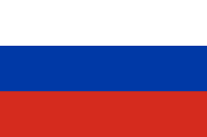
Russia in 2022
Russia represented as
a dynamic agent (NOM)
a collaborator (INS)
treated unfairly (ACC) and therefore in need of a strong leader
humanized, inspires empathy (DAT)

Slide 65
Putin’s speech to the Federal Assembly Feb 21, 2023: 10,538 tokens

Slide 66
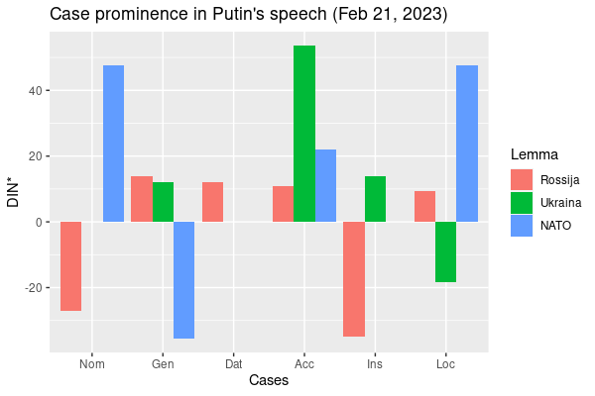
2022
Caveat: some distortion due to much smaller dataset
No data for
‘Ukraine’ Nominative, Dative
‘NATO’ Dative, Instrumental

Slide 67
NATO in 2023
NATO represented as
an aggressor, placing weapons on Russia’s borders, directly stating that it wishes to defeat Russia, equated with USA and the West (NOM)
having expanded to Russia’s borders and having representatives who are liars and deceivers (GEN, ACC)
the location of multiple nuclear arsenals (LOC)
strongly dehumanized (no s + INS, no DAT)

Slide 68
Ukraine in 2023
Ukraine represented as
non-existent as an actor (no NOM)
entirely manipulated, the destination of NATO’s weapons (ACC, na)
dehumanized (no DAT)
not a collaborator (no s + INS), a name rendered "just for now" (subject to change) (INS)
the location of a conflict and a neonazi regime (na + LOC)

Slide 69
‘Ukraine’ appears only 12 times in 2023 speech:
Мы не воюем с народом Украины...
‘We are not fighting with the people of Ukraine (GEN)...’
А в наше время из Украины они стали делать <<анти-Россию>>.
‘At present they have started to make Ukraine (GEN) into an “Anti-Russia”’
этот проект ... с одной целью - оторвать эти исторические территории, которые сегодня называются Украиной , от нашей страны.
‘this project ... [has] one goal – to tear away from our country the historical territories that are now called Ukraine (INS)’
Запад использует Украину и как таран против России, и как полигон.
‘The West is using Ukraine (ACC) both as a battering ram against Russia, and as an artillery range.’

Slide 70
Russia in 2023
Russia represented as
an agent that helps others, remembers, depends on its citizens, an open country (NOM)
a land of great potential and people, unfairly targeted (GEN)
united (s + INS)
being exploited but cannot be defeated, the place to invest (ACC)
humanized and victimized, in no need of cooperation with western economies (DAT)
a place with a strong economy and values (LOC)

Slide 71
Putin 2022 vs. Putin 2023: What has changed?
NATO
no longer the destination of Ukraine
foregrounded as the aggressor
Ukraine
sinks further into background
Russia’s “historical territories”, the West’s “Anti-Russia”
Russia
self-sufficient economy with great potential
unfairly targeted by the West

Slide 72
What does this buy us?
Proof-of-concept for Keymorph Analysis applied to Russian data
Keymorph Analysis is unique, can complement Keyword Analysis and other traditional methods of discourse analysis
Analysis of grammatical case reveals roles of social actors in discourse
Consistent deviation from norms likely has an impact on hearers
Useful not only for linguistics, but for history, political science, and other disciplines in the social sciences
Invites further comparisons (Putin vs. other politicians, etc.)
Method could be used to analyze other types of manipulative texts

Slide 73
Thank you!
Threat-Defuser: https://threat-defuser.org/
Funded by the Norwegian Research Council
CLEAR: Cognitive Linguistics: Empirical Approaches to Russian: https://site.uit.no/clear/

