Slide 1
Grammar in the service of ideological messaging: Putin’s speeches 2022-2024
Laura A. Janda (UiT)
Gunhild Hoogensen Gjørv (UiT)
Václav Cvrček (Univerzita Karlova)
Masako Fidler (Brown University)
Anna Obukhova
Threat-Defuser
(Norwegian Research Council)

Slide 2
Does grammar mean anything?
Is grammar mere “plumbing”?
Or is it more like a sound track?

Slide 3
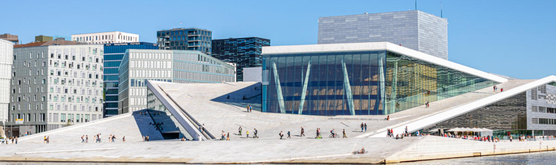
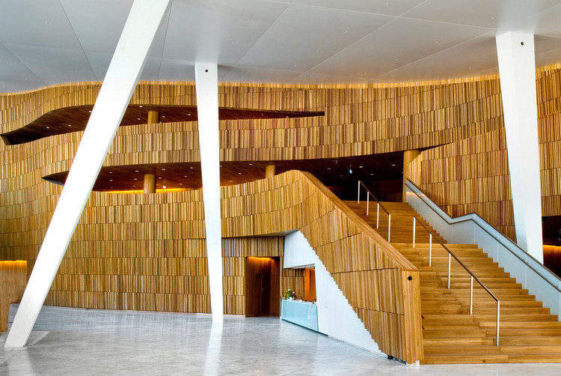
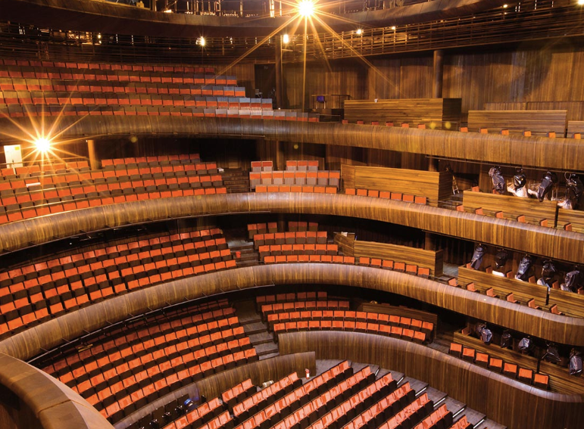
Perception of architecture

Slide 4
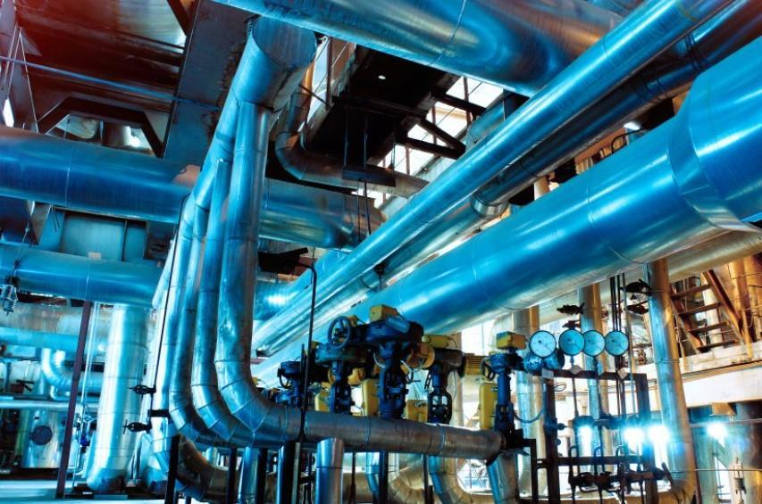
Perception of architecture

Slide 5
Perception of film
Voice
+
Soundtrack
“Background music”
is an important part of the message

Slide 6
Grammar as a drumbeat
Grammar is obligatory, systematic
Grammar reveals the conceptual landscape of discourse
Russian nouns are obligatorily marked with one of six cases
Cases bear abstract meanings
We compare the distribution of case in a target text (Putin’s speeches) with a reference corpus (large representative sample showing expected distribution in Russian)
3 words: ‘Russia’, ‘Ukraine’, ‘NATO’

Slide 7
Philosophical issues: norms, meaning, and grammar
Corpus as a proxy for experience and expectations of native speakers
Speakers are sensitive to deviations from norms
Words can be consciously chosen, grammar is less under conscious control and more systematic

Slide 8
Overview
Keymorph Analysis as an extension of Keyword Analysis
Meanings of Russian grammatical cases
Longitudinal study of Putin’s use of case
Feb-March 2022
Feb
2023
Feb
2024
Dec
2024

Slide 9
Keyword Analysis >> Keymorph Analysis
Keyword Analysis (cf. Egbert & Biber 2023):
focus on the distribution of words, identifying as “keywords” those that are unusually frequent in a target text vs. reference corpus
widely used in corpus-assisted discourse analysis
mostly used with English, which does not mark case on nouns
Keymorph Analysis:
takes advantage of grammatical case (expressed by morphemes)
developed by Fidler & Cvrček (2017, 2018, and Cvrček & Fidler 2019) on the material of Czech
ours is the first pilot study/proof-of-concept using Russian data

Slide 10
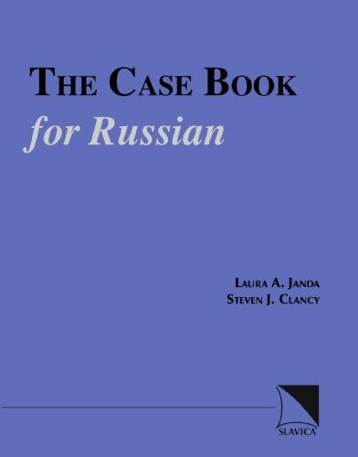
Meanings of Russian grammatical cases
Meanings most relevant for analysis of Putin’s speeches
Nominative (NOM): agent (subject); label
Genitive (GEN): agent or patient; possessor; goal
Dative (DAT): potential agent, experiencer or competitor (usually human); contours of a space
Accusative (ACC): patient (direct object); destination
Instrumental (s + INS): collaborator
Locative (LOC): a place

Slide 11
Target texts and Reference Corpus
Target texts = Putin’s speech
Feb-Mar 2022: all of Putin’s output from 10.02. (joint maneuvers with Belarus) through 02.03.2022 (height of first phase of invasion)
Feb 2023: Putin’s address to the Federal Assembly 21.02.2023
Feb 2024: Putin’s address to the Federal Assembly 29.02.2024
Dec 2024: Putin’s speech at Direct Line / Year-end Summary 19.12.2024
Reference Corpus = Representative sample of Russian norms
Russian InterCorp (Czech National Corpus www.korpus.cz) 20.1 M tokens

Slide 12
Putin at the time of full-scale invasion 10.02.2022 - 02.03.2022

Slide 13
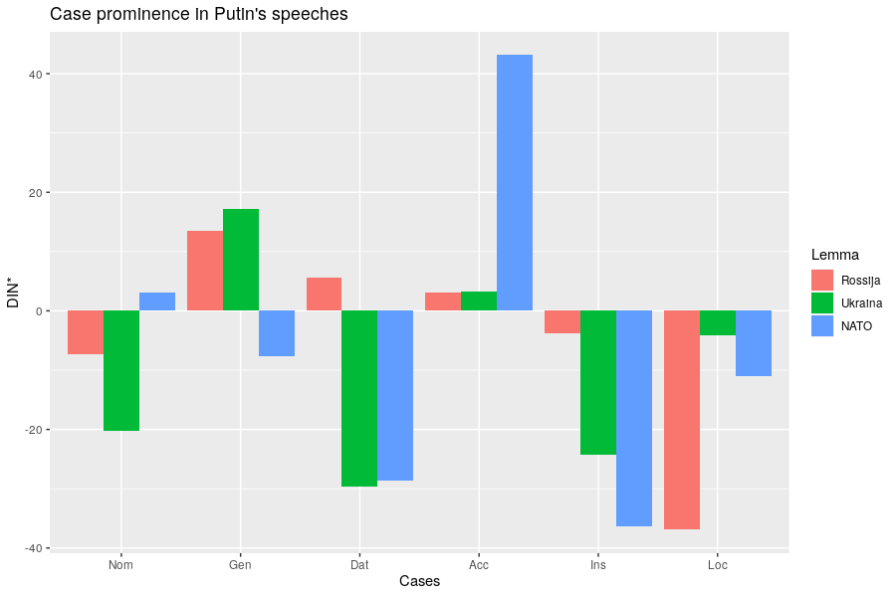
Comparison with reference corpus
28,518 words
2022
MORE than in corpus
SAME as in corpus
LESS
than in corpus
Notes:
Comparison is with reference corpus, we are looking at significant deviations.

Slide 14
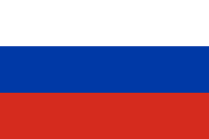
Russia in 2022
Russia represented as
a dynamic agent (NOM)
a collaborator (INS)
treated unfairly (ACC) and therefore in need of a strong leader
humanized, inspires empathy (DAT)

Slide 15
Ukraine in 2022
Ukraine represented as
passive (NOM with stative verbs)
manipulated (ACC)
dehumanized (little DAT)
not a collaborator (little s + INS)
just a location, a region (na + LOC, GEN)

Slide 16
NATO in 2022
NATO represented as
just a label, not an agent (NOM)
a threat (GEN)
a destination or container (ACC, LOC)
not a collaborator, dehumanized (little INS and DAT)

Slide 17
Putin’s speech to the Federal Assembly Feb 21, 2023

Slide 18
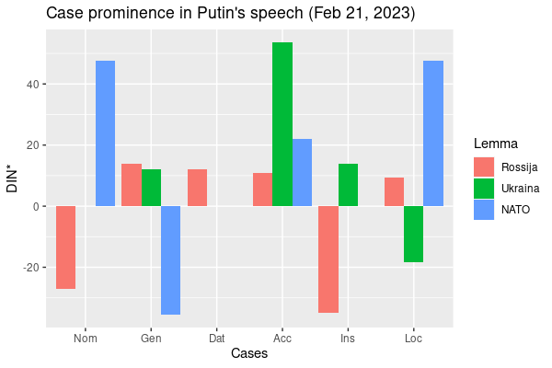
Caveat: some distortion due to much smaller dataset
10,538 words
MORE than in corpus
SAME as in corpus
LESS
than in corpus

Slide 19
Russia in 2023
Russia represented as
an agent that helps others, remembers, depends on its citizens, an open country (NOM)
a land of great potential and people, unfairly targeted (GEN)
united (s + INS)
being exploited but cannot be defeated, the place to invest (ACC)
humanized and victimized, in no need of cooperation with western economies (DAT)
a place with a strong economy and values (LOC)

Slide 20
Ukraine in 2023
Ukraine represented as
non-existent as an actor (no NOM)
entirely manipulated, the destination of NATO’s weapons (ACC, na)
dehumanized (no DAT)
not a collaborator (no s + INS), a name rendered "just for now" (subject to change) (INS)
the location of a conflict and a neonazi regime (na + LOC)

Slide 21
‘Ukraine’ appears only 12 times in 2023 speech:
Мы не воюем с народом Украины...
‘We are not fighting with the people of Ukraine (GEN)...’
А в наше время из Украины они стали делать <<анти-Россию>>.
‘At present they have started to make Ukraine (GEN) into an “Anti-Russia”’
этот проект ... с одной целью - оторвать эти исторические территории, которые сегодня называются Украиной , от нашей страны.
‘this project ... [has] one goal – to tear away from our country the historical territories that are now called Ukraine (INS)’
Запад использует Украину и как таран против России, и как полигон.
‘The West is using Ukraine (ACC) both as a battering ram against Russia, and as an artillery range.’

Slide 22
NATO in 2023
NATO represented as
an aggressor, placing weapons on Russia’s borders, directly stating that it wishes to defeat Russia, equated with USA and the West (NOM)
having expanded to Russia’s borders and having representatives who are liars and deceivers (GEN, ACC)
the location of multiple nuclear arsenals (LOC)
strongly dehumanized (no s + INS, no DAT)

Slide 23
Putin’s speech to the Federal Assembly Feb 29, 2024

Slide 24
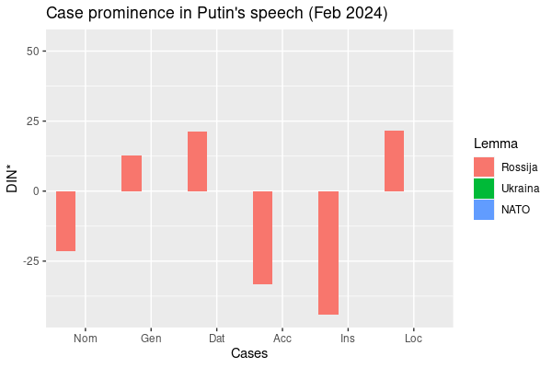
12,660 words
MORE than in corpus
SAME as in corpus
LESS
than in corpus

Slide 25
Speech Feb 2024: Focus is just on Russia
Russia is in possession of political, economic and scientific achievements, industry, resources
У России давние, хорошие отношения с арабскими государствами.
‘Russia (GEN) has long-standing, good relations with the Arab states.’
В прошлом году экономика России росла темпами выше мировой.
‘Last year, Russia’s (GEN) economy grew at a rate higher than the world's.’
Things are happening in Russia and all across Russia
В прошлом году в России было построено свыше 110 миллионов квадратных метров жилья.
‘Last year, over 110 million square meters of housing were built in Russia (LOC).’
В целом по России за шесть лет благоустроим более 30 тысяч общественных пространств.
‘Across Russia (DAT) as a whole, we will improve more than 30 thousand public spaces in six years.’
Lacking mention of Russia as collaborator

Slide 26
Speech Feb 2024: Focus is just on Russia
‘NATO’ appears only once as a noun (+ once as adjective, below):
угрозы, связанные с очередным расширением НАТО на восток
‘threats associated with further expansion of NATO (GEN) to the east’
‘Ukraine’ appears only five times, always with preposition на ‘on’:
4 times as a mere location of conflicts:
Запад спровоцировал конфликты на Украине
‘The West has provoked conflicts in Ukraine (LOC)’
once as a destination
Заговорили о возможности отправки на Украину натовских военных контингентов.
‘There was talk about the possibility of sending NATO military contingents to Ukraine (ACC).’

Slide 27
Putin’s answers, Direct Line/Year-end Summary Dec 19, 2024

Slide 28
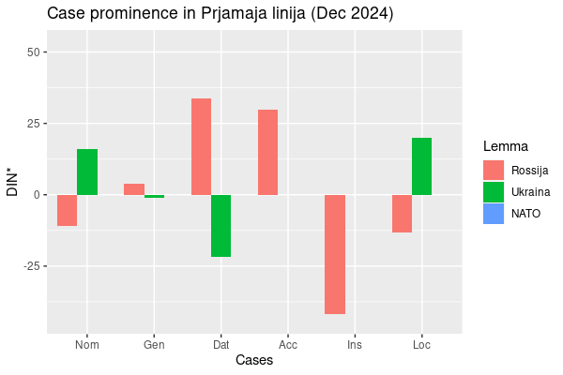
20,930 words
MORE than in corpus
SAME as in corpus
LESS
than in corpus

Slide 29
Direct Line/Year-end Summary Dec 2024
Russia humanized
Я сказал сейчас про то, что отношусь к России, как к своей семье.
‘I just said that I treat Russia (DAT) as my family.’
Russia rated highly by experts, a desirable destination
Международные финансово-экономические институты поставили Россию на первое место в Европе
‘International financial and economic institutions put Russia (ACC) in first place in Europe’
И мы заинтересованы в привлечении именно высококвалифицированных специалистов в Россию
‘And we are interested in attracting highly qualified specialists to Russia (ACC)’
Lacking mention of Russia as collaborator

Slide 30
Direct Line/Year-end Summary Dec 2024
Ukraine is mostly a place
Примерно то же самое сейчас происходит на Украине по линии этого жульничества.
‘About the same thing is now happening in Ukraine (LOC) through this scam.’
Ukraine is at fault for negative actions
Но это не наша проблема, это Украина перекрыла поставки нашего газа европейским потребителям.
‘But this is not our problem, it is Ukraine (NOM) that has cut off the supply of our gas to European consumers.’
NATO mentioned only twice, both times: страны НАТО ‘countries of NATO (GEN)’

Slide 31
Putin 2022 vs. 2023 vs. 2024: What has changed?
Feb-March 2022
Feb
2023
Feb
2024
Dec
2024
Russia: dynamic collaborator, humanized, victimized
Ukraine: manipulated, location
NATO: threat, destination for Ukraine
Russia: great potential, humanized, victimized, strong economy & values
Ukraine: manipulated, location
NATO: expanding threat
Russia: great potential, place where thigs are happening
Ukraine: location
NATO: expanding
Russia: highly rated, desirable destination, humanized
Ukraine: location, negative actions
NATO: group of hostile countries
Over time:
Russia’s role as a collaborator decreases while focus on its assets increases, victimization reduced in Feb 2024
Ukraine and NATO increasingly marginalized

Slide 32
What else does this buy us?
Proof-of-concept for Keymorph Analysis applied to Russian data
Keymorph Analysis complements Keyword Analysis and other traditional methods of discourse analysis
Analysis of grammatical case reveals roles of social actors in discourse
Consistent deviation from norms likely has an impact on hearers
Useful for social science disciplines
Invites further comparisons (Putin vs. other politicians, etc.)
Method could be used to analyze other types of manipulative texts

Slide 33
Thank you!
Threat-Defuser: https://threat-defuser.org/
Funded by the Norwegian Research Council
CLEAR: Cognitive Linguistics: Empirical Approaches to Russian: https://site.uit.no/clear/

