Slide 1


Putin makes his case
Laura A. Janda
Anna Obukhova
Václav Cvrček (Univerzita Karlova)
Masako Fidler (Brown University)
Threat-Defuser
(Norwegian Research Council)

Slide 2
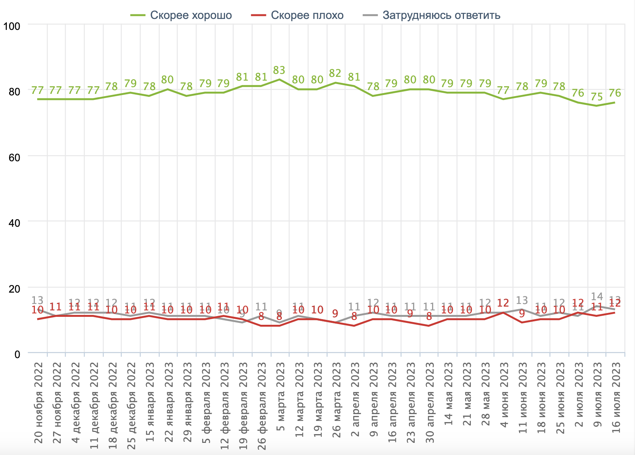
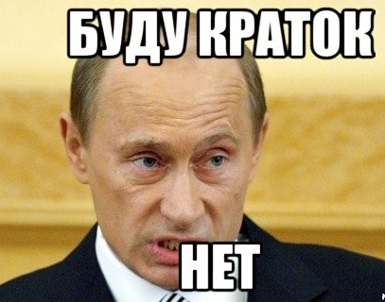
Why is Putin so popular? Why do Russians find him convincing?
Russians are usually skeptical of their government
Public opinion polls not entirely reliable, but a lot of people support Putin, at least passively
Sociologists say people are “hypnotized”
Independent media shut down, replaced by 24-hour TV propaganda
Putin is not a brilliant orator, but his speech consistently deviates from norms
“Do you think V. Putin is doing a good job or a bad job?”
(Nov 20 2022 – July 16 2023)
Data from:
Фонд Общественное Мнение
(Public Opinion Foundation)

Slide 3
Philosophical issues: norms, meaning, and grammar
A corpus as a proxy for experience and expectations of native speakers
Speakers may be sensitive to deviations from norms
Words can be consciously chosen, grammar less under conscious control and more systematic
Grammar and meaning: the semantic continuum lexicon – grammar

Slide 4
Overview
Keymorph Analysis as an extension of Keyword Analysis
Meanings of Russian grammatical cases
2022 “The case for case in Putin’s speeches” https://link.springer.com/article/10.1007/s11185-022-09269-2
  Macro-level quantitative comparison: Putin’s use of case vs. reference corpus
  Micro-level qualitative interpretation of Putin’s use of case
2023 Comparison with Putin’s speech Feb 21, 2023
  Media have reported that this speech was more of the same
  But we found some stark differences

Slide 5
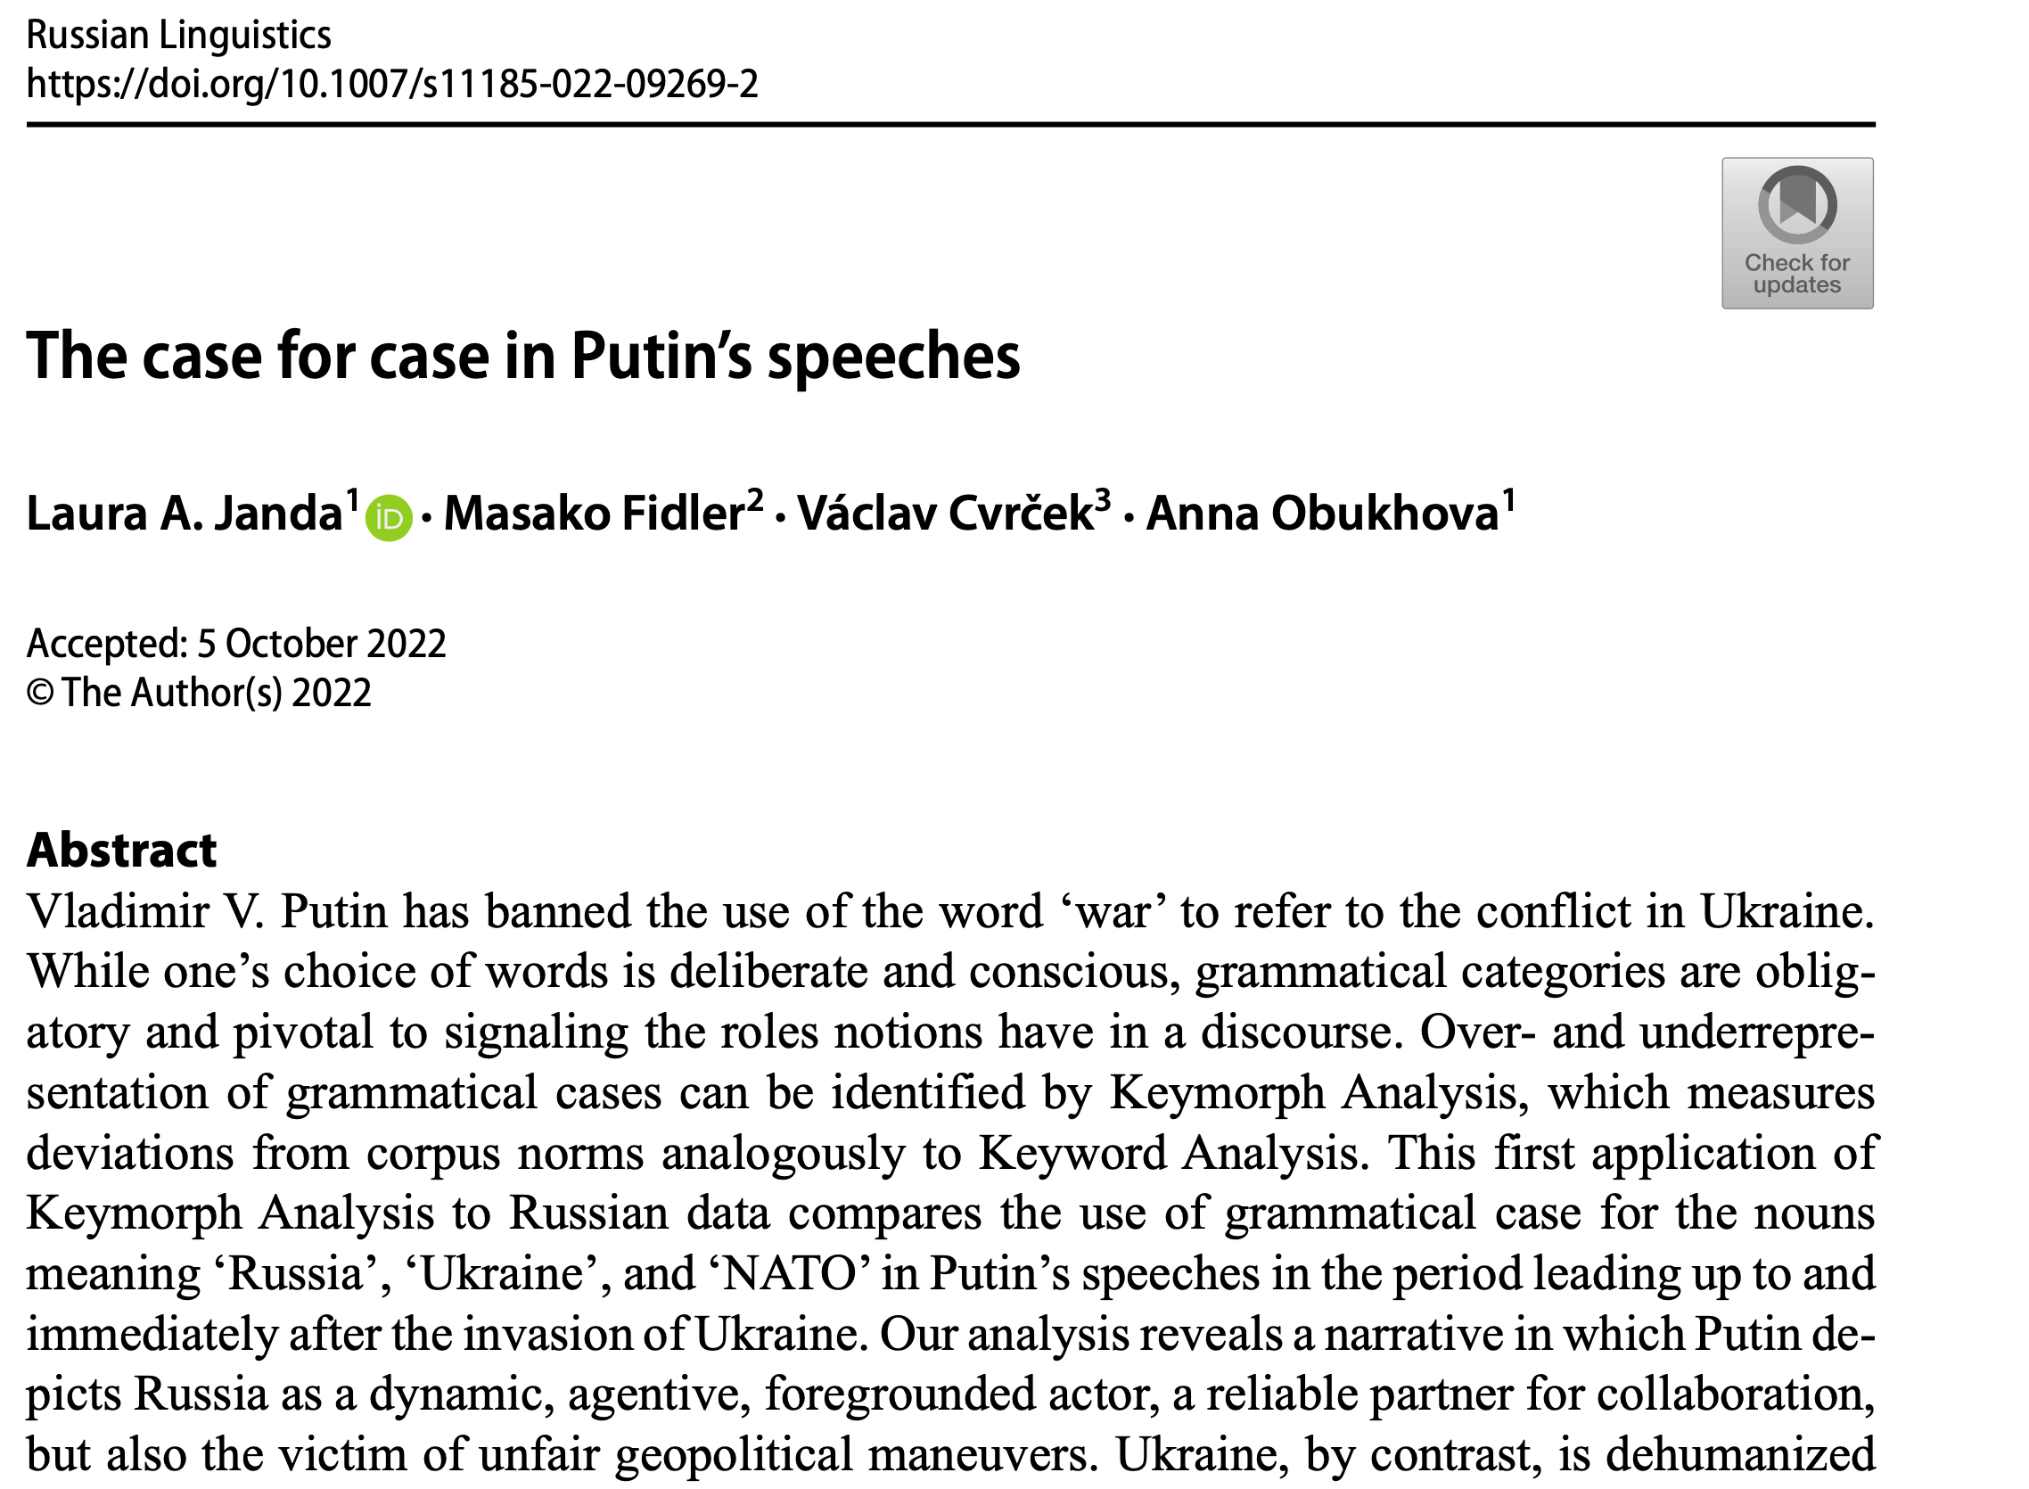
2022

Slide 6
Keymorph Analysis as an extension of Keyword Analysis
Keyword Analysis (cf. Egbert & Biber 2023):
  widely used in corpus-assisted discourse analysis
  focus on the distribution of words, identifying as “keywords” those that are unusually frequent in a target text vs. reference corpus
  Keywords reveal the “Aboutness” of a text
  mostly used with English, which has little morphology
  it is customary to remove English function words, also known as “stopwords”
Keymorph Analysis:
  takes advantage of the morphological expression of grammatical categories
  developed by Fidler & Cvrček (2017, 2018, and Cvrček & Fidler 2019) on the material of Czech
  this is the first pilot study/proof-of-concept using Russian data

Slide 7
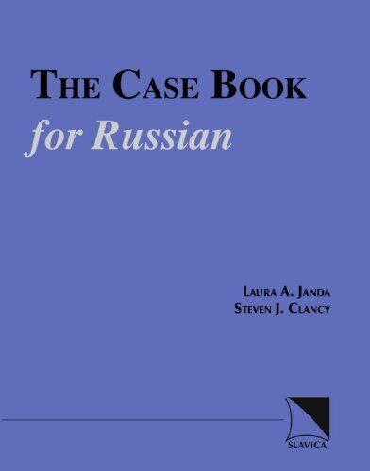
Meanings of Russian grammatical cases
Based on previous publications (Janda 1993, 1999, 2000, Janda & Clancy 2002 )
Meanings most relevant for analysis of Putin’s speeches in 2022
  Nominative (NOM): agent (subject); label
  Genitive (GEN): agent or patient; possession
  Dative (DAT): potential agent (usually human)
  Accusative (ACC): patient (direct object); destination
  Instrumental (s + INS): collaborator
  Locative (LOC): a place

Slide 8
Macro-level quantitative comparison:
Putin’s use of case vs. reference corpus
Data: scope and source
Raw data
Difference Index keyed to frequency (DIN*)
Visualizations

Slide 9
Data: Putin’s speeches 10.02.-02.03.2022
10.02.2022: Russia launched its “largest military exercise since the Cold War, holding joint maneuvers with Belarus, close to the Belarus/Ukrainian border” (Walker 2022: 27).
02.03.2022: height of the first phase of invasion when Russian forces in Ukraine moved “to tighten their siege of key cities, including the capital, Kyiv, and the southern port of Mariupol” (Walker 2022: 39)
Size of target corpus: 34,720 tokens
Focus on three words:
  Россия ‘Russia’
  Украина ‘Ukraine’
  НАТО ‘NATO’
Reference corpus:
  Russian InterCorp (Czech National Corpus www.korpus.cz) 20.1 M tokens

Slide 10
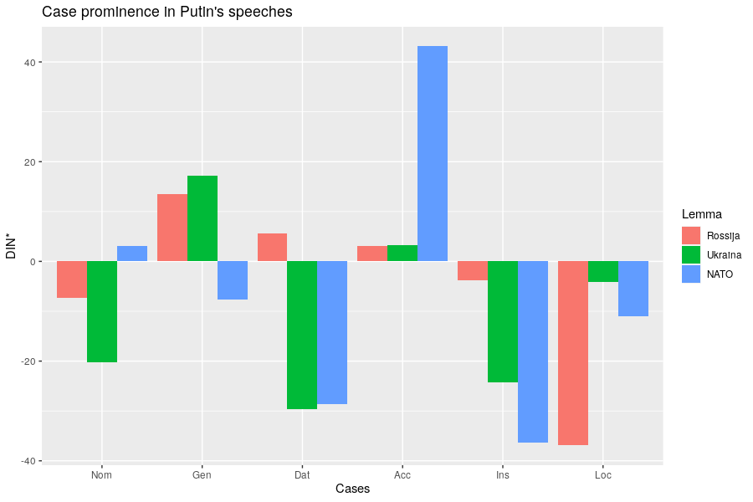
Comparison with reference corpus
2022
MORE than in corpus
SAME as in corpus
LESS
than in corpus
Notes:
Comparison is with reference corpus, we are looking at significant deviations.

Slide 11
Micro-level qualitative interpretation of Putin’s use of case
Representation of
  NATO
  Ukraine
  Russia
Every example manually tagged for case submeaning

Slide 12

NATO in 2022
NATO represented as
  just a label, not an agent (NOM)
  a threat (GEN)
  a destination or container (ACC, LOC)
  not a collaborator, dehumanized (little INS and DAT)

Slide 13
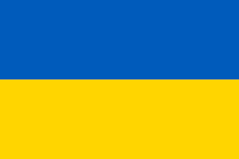
Ukraine in 2022
Ukraine represented as
  passive (NOM with stative verbs)
  manipulated (ACC)
  dehumanized (little DAT)
  not a collaborator (little s + INS)
  just a location, a region (na + LOC, GEN)

Slide 14
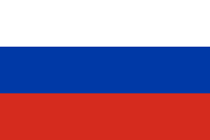
Russia in 2022
Russia represented as
  a dynamic agent (NOM)
  a collaborator (INS)
  treated unfairly (ACC) and therefore in need of a strong leader
  humanized, inspires empathy (DAT)

Slide 15
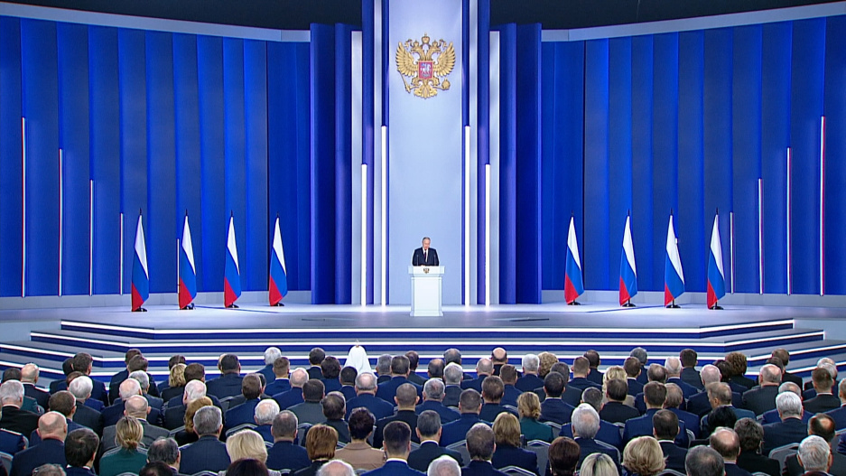
Putin’s speech to the Federal Assembly
Feb 21, 2023: 10,538 tokens

Slide 16
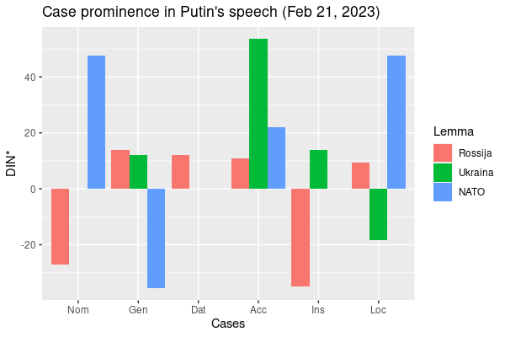
2022
Caveat: some distortion due to much smaller dataset
No data for
‘Ukraine’ Nominative, Dative
‘NATO’ Dative, Instrumental

Slide 17
NATO in 2023
NATO represented as
  an aggressor, placing weapons on Russia’s borders, directly stating that it wishes to defeat Russia, equated with USA and the West (NOM)
  having expanded to Russia’s borders and having representatives who are liars and deceivers (GEN, ACC)
  the location of multiple nuclear arsenals (LOC)
  strongly dehumanized (no s + INS, no DAT)

Slide 18
Ukraine in 2023
Ukraine represented as
  non-existent as an actor (no NOM)
  entirely manipulated, the destination of NATO’s weapons (ACC, na)
  dehumanized (no DAT)
  not a collaborator (no s + INS), a name rendered "just for now" (subject to change) (INS)
  the location of a conflict and a neonazi regime (na + LOC)

Slide 19
‘Ukraine’ appears only 12 times in 2023 speech:
Мы не воюем с народом Украины...
‘We are not fighting with the people of Ukraine (GEN)...’
А в наше время из Украины они стали делать <<анти-Россию>>.
‘At present they have started to make Ukraine (GEN) into an “Anti-Russia”’
этот проект ... с одной целью - оторвать эти исторические территории, которые сегодня называются Украиной , от нашей страны.
‘this project ... [has] one goal – to tear away from our country the historical territories that are now called Ukraine (INS)’
Запад использует Украину и как таран против России, и как полигон.
‘The West is using Ukraine (ACC) both as a battering ram against Russia, and as an artillery range.’

Slide 20
Russia in 2023
Russia represented as
  an agent that helps others, remembers, depends on its citizens, an open country (NOM)
  a land of great potential and people, unfairly targeted (GEN)
  united (s + INS)
  being exploited but cannot be defeated, the place to invest (ACC)
  humanized and victimized, in no need of cooperation with western economies (DAT)
  a place with a strong economy and values (LOC)

Slide 21
Putin 2022 vs. Putin 2023: What has changed?
NATO
  no longer the destination of Ukraine
  foregrounded as the aggressor
Ukraine
  sinks further into background
  Russia’s “historical territories”, the West’s “Anti-Russia”
Russia
  self-sufficient economy with great potential
  unfairly targeted by the West

Slide 22
What does this buy us?
Proof-of-concept for Keymorph Analysis applied to Russian data
Keymorph Analysis is unique, can complement Keyword Analysis and other traditional methods of discourse analysis
Analysis of grammatical case reveals roles of social actors in discourse
Consistent deviation from norms likely has an impact on hearers
Useful not only for linguistics, but for history, political science, and other disciplines in the social sciences
Invites further comparisons (Putin vs. other politicians, etc.)
Method could be used to analyze other types of manipulative texts

Slide 23

Thank you!
Threat-Defuser: https://threat-defuser.org/
Funded by the Norwegian Research Council
CLEAR: Cognitive Linguistics: Empirical Approaches to Russian: https://site.uit.no/clear/

