Slide 1
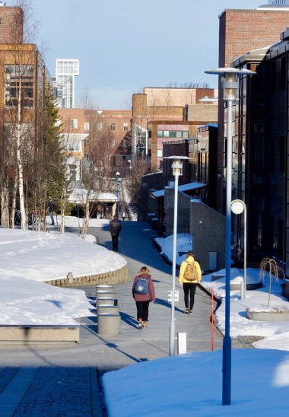

Finding the “Fun” in External Funding
Laura A. Janda
laura.janda@uit.no

Slide 2



Notes:
Poster for rooms etc or use it as a screensaver slide, also video start or end slide or both

Slide 3
Overview
Part I: A conversation
Part II: You be the judge
  Who are we?
  How do we feel about the process?
  Alphabet soup: Acronyms
  Success rates
  More about success
  Vocabulary Quiz
  The process
Evaluate one of seven proposals using standard ERC criteria

Slide 4


Introduction: Advice on advice
Baby
Advice from:
  doctors, books, magazines, relatives, friends, podcasts…
Project
Advice from:
  colleagues, administrators, grantwriting professionals…

Slide 5

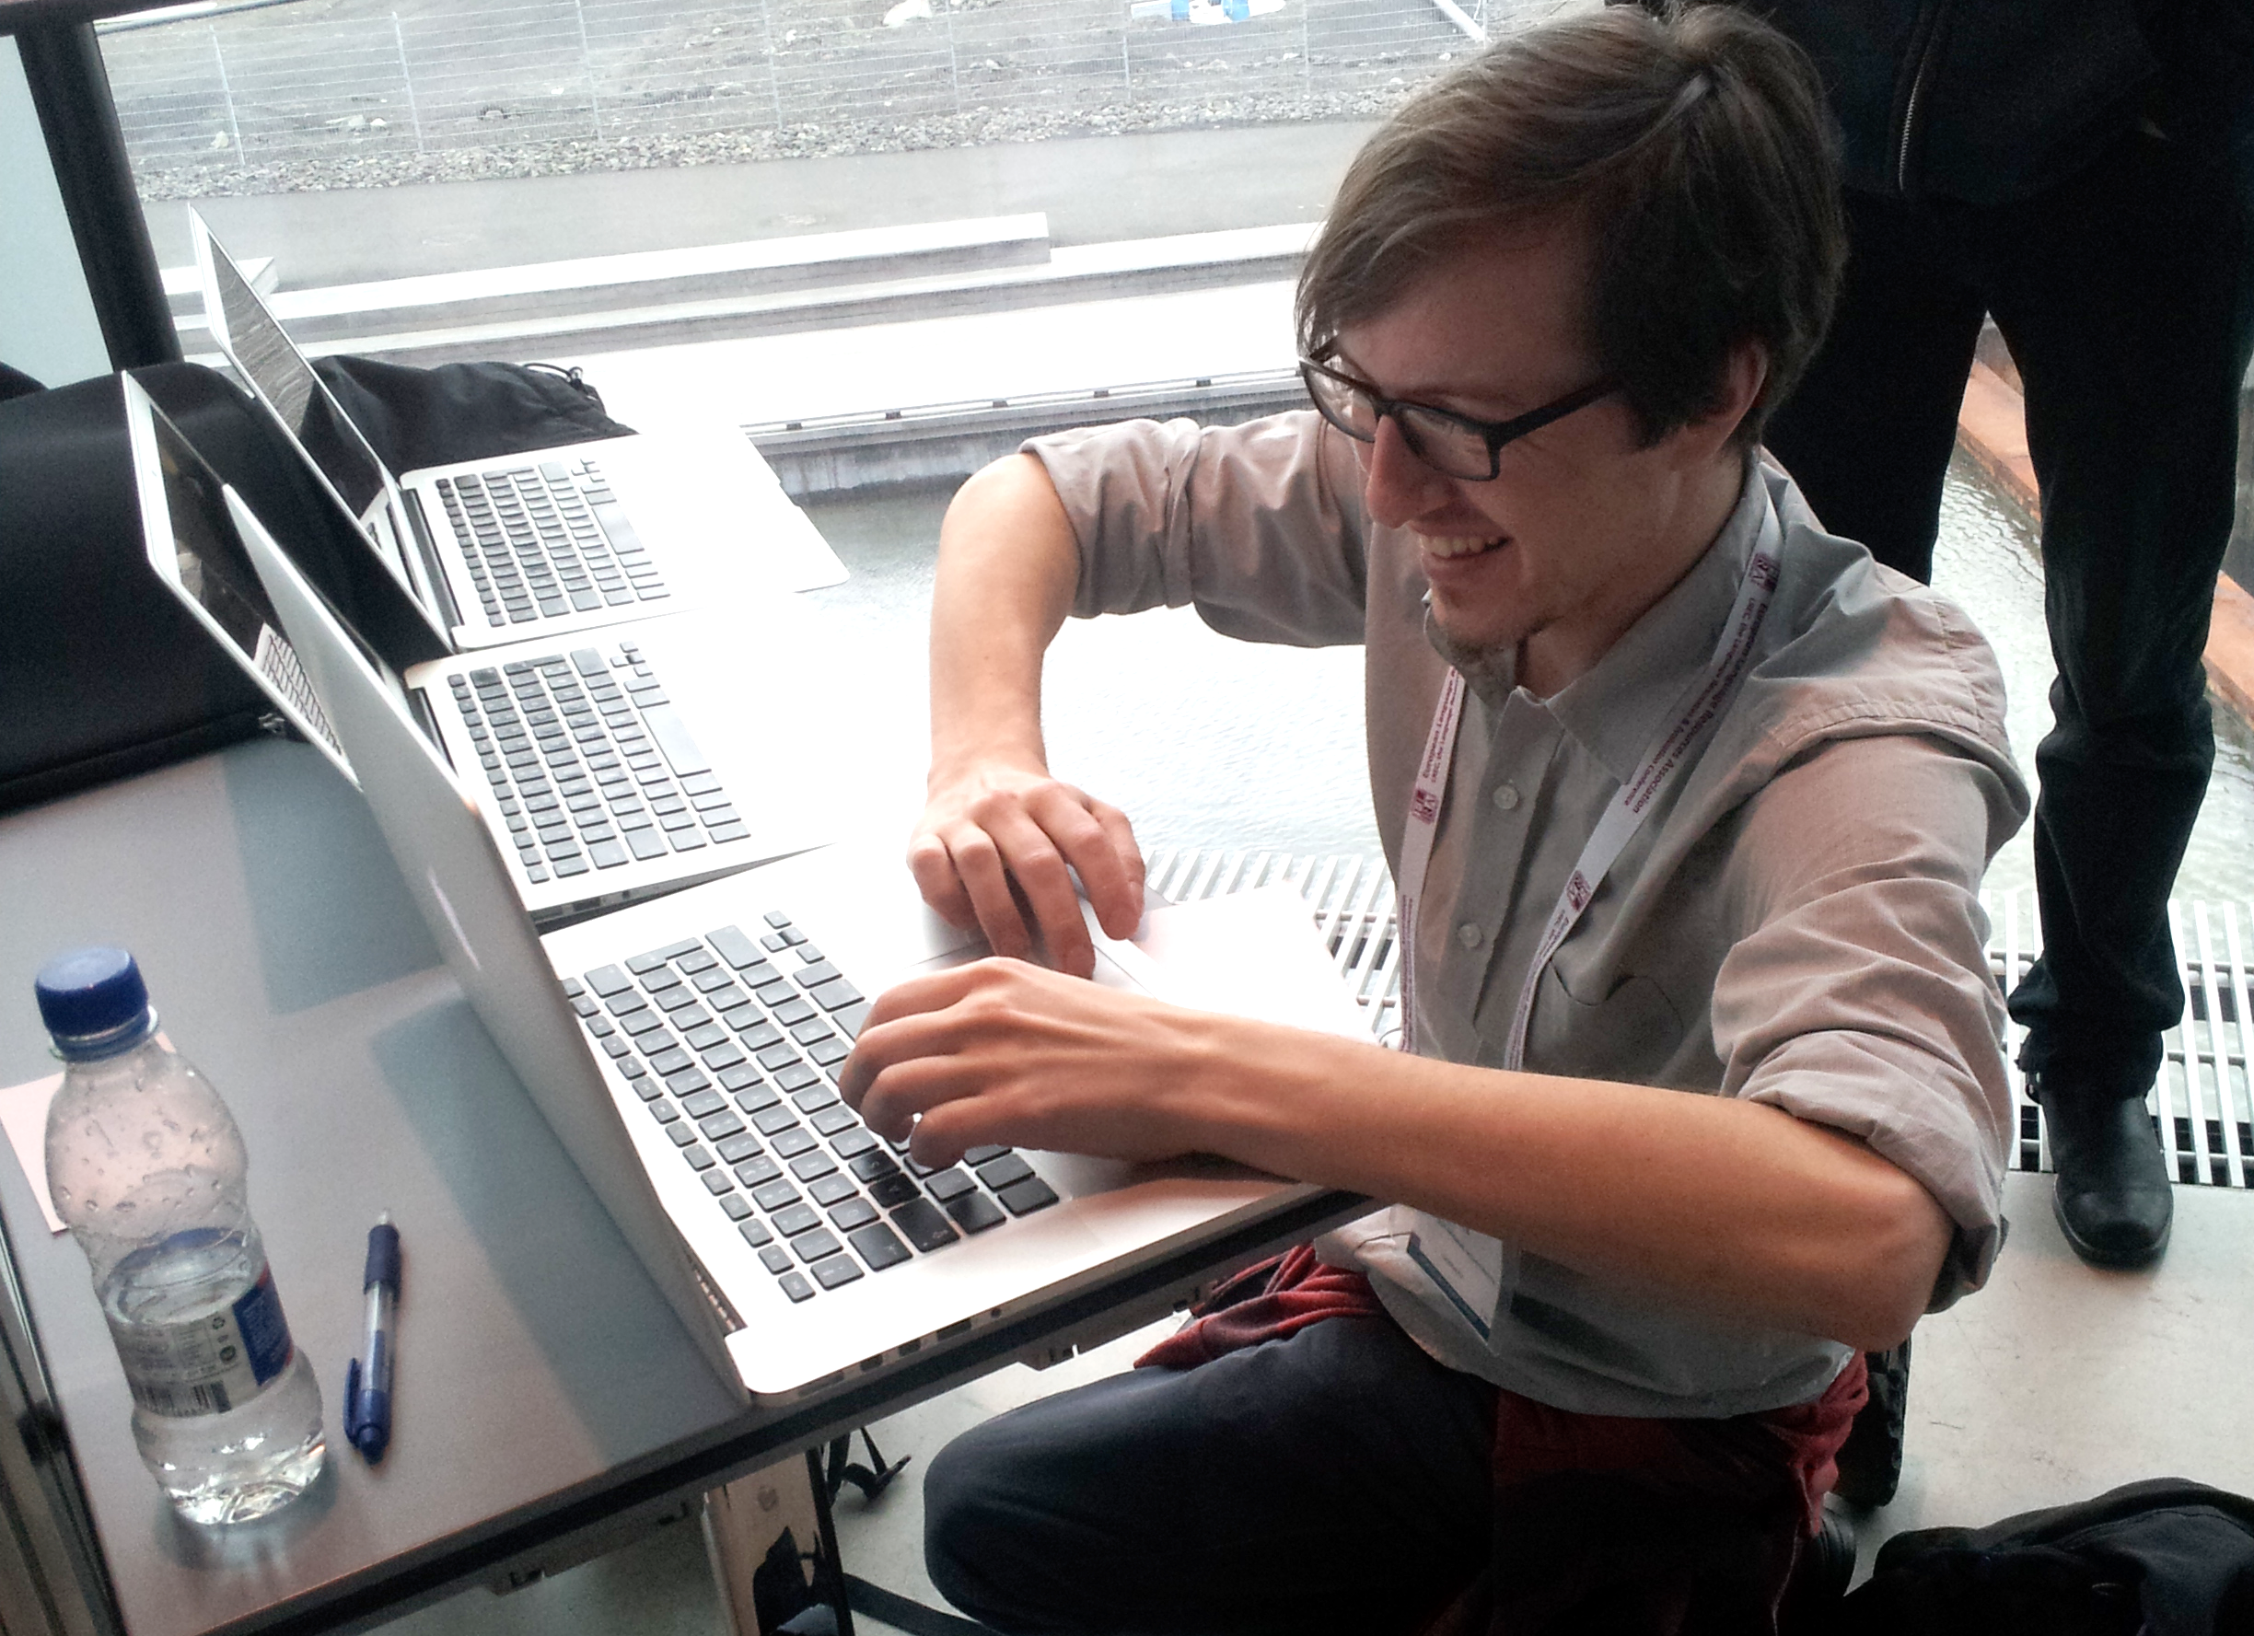

All you need is love (and a bit more)
Baby
  Love it
  Feed it
  Protect it
Project
  Love it
  Follow the template
  Don’t exceed page #/font size

Slide 6
Part I: A conversation
Group A: Who are we?
1. What is my discipline?
Linguistics
Language pedagogy
Other humanities
Other
2. What kind(s) of grant proposal(s) have we/are we planning to submit?
Grants internal to my university
Estonian Research Council
Other grants at national level
ERC (Starting Grants, Consolidator Grants, Advanced Grants and Synergy Grants)
Marie Skłodowska-Curie Actions
Other grants at international level

Slide 7
Part I: A conversation
Group B: How do we feel about the process?
1. Why have/will I submit grant proposals?
I have a great idea
I need a job
My boss or administrator wants me to do it
I want to provide employment for someone else
I have some clever colleagues I want to work with
2. How do I feel about the grantwriting process?
Anxious
Frustrated
Bored
Eager
Curious
3. What part of the grantwriting process do I find the most challenging?
Coming up with an idea
Figuring out what grant to apply for
Writing the proposal
Devising the budget
Interactions with other participants
Interactions with administration

Slide 8
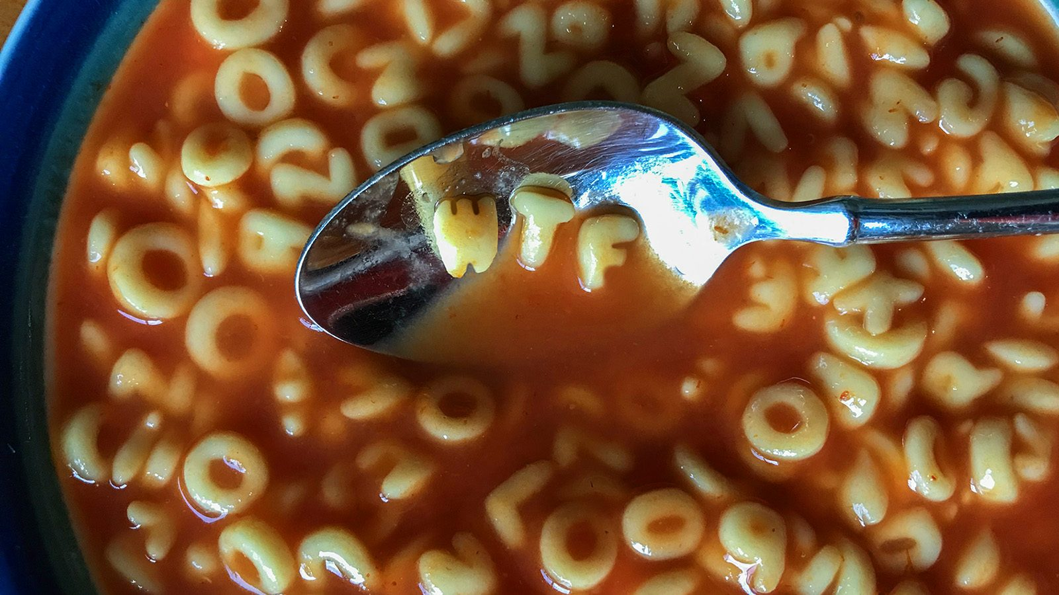
Alphabet soup!
PM
  Project Manager
RFP
  Request for proposals
SDGs
  The UN’s 17 Sustainable Development Goals
WP
  Work Package
CFP
  Call for proposals
FAIR
  Findable, Accessible, Interoperable, and Reusable
MS
  Milestone
OA
  Open Access
PI
  Principle Investigator

Slide 9
Part I: A conversation
Group C: Success rates
1. How many grant proposals have I submitted?
none
1-3
4-9
10+
I have lost count
2. How many grant proposals have I gotten a rejection for?
none, but I haven’t submitted any
none, because all my proposals were funded
1-3
4-9
10+
I have lost count
3. How many grant proposals have I gotten funded?
none, but I haven’t submitted any
none, although I have submitted some
1-3
4-9
10+
I have lost count
4. What is a typical success rate for major grant competitions?
2-5%
6-10%
10-15%
15-25%
Over 25%

Slide 10
Some examples of success rates
ERC Starting Grants 2023 overall success rate was 14.8%
Marie Skłodowska-Curie Actions postdoctoral fellows in 2022 was 17.5%
Estonian Research Council 2021 overall success rate was 22%
Cost Action in 2022 was 39%

Slide 11
Part I: A conversation
Group D: More about success
1. What role does luck play in the success of grant proposals?
None – the best proposal always wins
Excellence is most important, though luck may play a role
Excellence 50% - luck 50%
Beyond a certain threshold, luck plays a large role
It’s all luck
2. What do I do when I get a rejection?
I don’t know, I never get rejected
Complain to the funding agency
Try again with the same project
Try again with a different project or agency
Give up

Slide 12

Vocabulary quiz!
Can we define these terms?
Commercialization
Deliverables
Dissemination
Gantt chart
Leverage
Matching Funds
Overhead
Quarantine
Stakeholders

Slide 13
Part I: A conversation
Group D: The process
1. What criteria can I use to select partners/participants in a grant project?
Suggestions from administration
Scholarly excellence
Seniority
Prior experience with grant projects
Personal compatibility
Responsiveness and reliability
2. When writing a grant proposal, where do I start?
Bibliography and Literature review
Budget
Ethical considerations
Gantt Chart
Project description
Project management
Risk management
Sustainability
3. When working on a grant proposal, I would like to
Read previously funded grant proposals
Get help from professional grantwriting assistant
Show a draft to colleague(s)
See how grant proposals are scored
Find out who will score my proposal

Slide 14
Part II: You be the judge
You will be assigned to a group based on your location (room vs. zoom) and birthday month
Each group judges one grant proposal, giving 1-5 points for each of
  Excellence
  Impact
  Implementation
Submit total scores of 1-15
Go to:
https://lajanda.github.io/MyGrantProposals/MyGrantProposals.html

Slide 15
Part II: You be the judge https://lajanda.github.io/MyGrantProposals/MyGrantProposals.html
If you are in the room:
  Group 1: If your birthday is in January, February, March, April, Choose Birds and Beasts
  Group 2: If your birthday is in May, June, July, August, Choose ChatGPT Meets the Russian Constructicon
  Group 3: If your birthday is in September, October, November, December, Choose In and Out of Context
If you are in zoom:
  Group 4: If your birthday is in January, February, March, Choose STORM
  Group 5: If your birthday is in April, May, June, Choose Threat-Defuser
  Group 6: If your birthday is in July, August, September, Choose TWIRLL
  Group 7: If your birthday is in October, November, December, Weight-Training

Slide 16
ERC EVALUATION FORM
1. Research Project
Ground-breaking nature, ambition and feasibility, potential impact of the research project
To what extent does the proposed research address important challenges? To what extent are the objectives ambitious and beyond the state of the art (e.g., novel concepts and approaches or development between or across disciplines)?
Scientific Approach
To what extent is the outlined scientific approach feasible bearing in mind the ground-breaking nature and ambition of the proposed research (based on the Extended Synopsis)? To what extent are the proposed research methodology and working arrangements appropriate to achieve the goals of the project (based on the research proposal)? To what extent are the proposed timescales, resources, and PI’s commitment adequate and properly justified (based on the research proposal)?
2. Principal Investigator
Intellectual capacity and creativity
To what extent has the PI demonstrated the ability to conduct ground-breaking research? To what extent does the PI provide evidence of creative and original thinking? To what extent does the PI have the required scientific expertise and capacity to successfully execute the project?
See how scoring is done in video tutorial for evaluators:
https://webgate.ec.europa.eu/funding-tenders-opportunities/pages/viewpage.action?pageId=8913424

