Slide 1
Scaling up a constructicon: strategies for semantic classification and data management
Laura A. Janda

Slide 2
Overview
Scaling up a constructicon and semantic classification
The Russian Constructicon
Strategies for data management
FAIR Principles and TROLLing

Slide 3
Scaling up a constructicon and semantic classification
The Russian Constructicon

Slide 4
Russian Constructicon co-authors
Anna Endresen
Daria Mordashova
Ekaterina Rakhilina
Valentina Zhukova

Slide 5
Russian Constructicon: https://constructicon.github.io/russian/
Endresen, Anna, Laura A. Janda, Daria Mordashova, Ekaterina Rakhilina, Valentina Zhukova. From data to theory: an emergent semantic classification based on a large-scale constructicon. Forthcoming in Constructions and Frames. 47pp.
Endresen, Anna, Laura A. Janda, Daria Mordashova, Ekaterina Rakhilina, Valentina Zhukova. 2020. How to build a constructicon in five years: The Russian Example. In: Frank Brisard, Timothy Colleman, Astrid De Wit, Renata Enghels, Nikos Koutsoukos, Tanja Mortelmans, and María Sol Sansiñena (eds.), The Wealth and Breadth of Construction-Based Research = Belgian Journal of Linguistics 34: 161–173.
Endresen, Anna, Laura A. Janda. 2020. Taking Construction Grammar One Step Further: Families, Clusters, and Networks of Evaluative Constructions in Russian. In: Mike Putnam, Matthew Carlson, Antonio Fábregas, Eva Wittenberg, eds. Defining Construction: Insights into the Emergence and Generation of Linguistic Representations (= special issue of Frontiers in Psychology 11). November 2020. 36pp. https://doi.org/10.3389/fpsyg.2020.574353

Slide 6
A multi-year, multi-national project

Slide 7
Overview: the Russian Constructicon
Why and How We Built It
Semantic Classification
A Tour

Slide 8
Overview: the Russian Constructicon
Why and How We Built It
Semantic Classification
A Tour
Main Point:
We take seriously Fillmore’s (2008) claim that a language is a structured inventory of constructions, a constructicon

Slide 9
Why and How We Built It

Slide 10
Why build a constructicon?
For linguists
to achieve improved description of languages
to extend theory of construction grammar
to facilitate cross-linguistic typological comparison
For L2 learners
to achieve greater language proficiency
to motivate use of specific wordforms
to fill in gaps in current language resources and pedagogy

Slide 11
For Linguists: Theoretical premises
CxG: numerous thorough studies of individual constructions found in various languages
Yet little is known about how the semantics of the entire system of constructions unfolds in a single language.
What are the major types of meanings that multi-word grammatical constructions can encode?
What semantic types of constructions are attested more often than others?
Do various types of constructional meaning form a coherent system?
We need a relatively large inventory of constructions of a single language, and a detailed description of this inventory, a constructicon.

Slide 12
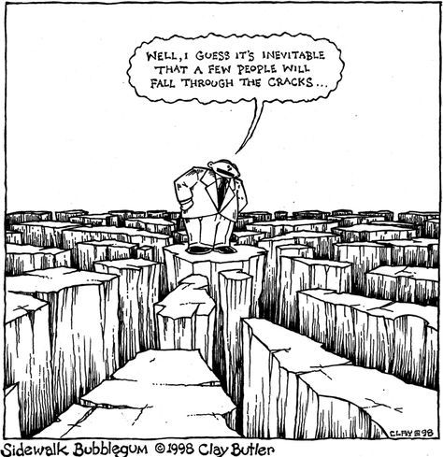
For Learners: Filling in the gaps
It seems that a few things
just fall through the cracks
Dictionaries, grammars, and textbooks focus primarily on lexemes, lexicalized idioms, inflectional paradigms,and grammatical patterns
Multi-word expressions with open slots are less reliably represented in standard resources
TEXTBOOK
PHRASE
BOOK
GLOSSARY
DICTIONARY
REFERENCE
GRAMMAR

Slide 13
Examples of Russian constructions
morphemes
-t’ = INF
lexemes
tancevat’ ‘dance’
multi-word idioms where all slots are fixed
tancevat’ ot Adama ‘start from the very beginning’
multi-word expressions with open slots
VP pod NP-Acc
Ona tancevala pod muzyku ‘She danced to the music’
larger discourse units
Our project focuses mainly on this type of construction

Slide 14
Scaling up our constructicon
Manual collection from textbooks, scholarly literature, crowdsourcing
Extraction from dialogs, spoken discourse, and RNC collocations
Classification of syntactic & semantic types
Searches for synonyms, antonyms and anchor words based on semantic classification

Slide 15
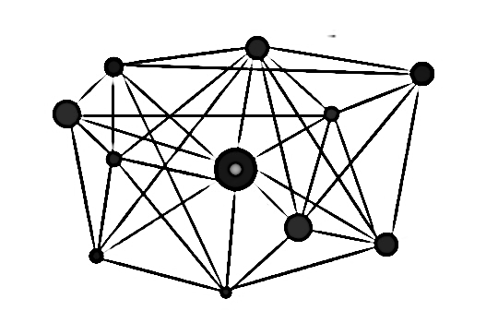
Practical considerations
How exactly to turn a list of collected items into a structured inventory?
This is a practical challenge that all existing constructicons face.
Other constructicons are closely connected to a FrameNet resource and focus on verb argument constructions.
FrameNet has been suggested as an alternative (Fillmore and Atkins 1992; Fillmore et al. 2012).
In other constructicons, constructions are classified semantically according frames they envoke (Ohara 2014, 2018; Boas et al. 2016; Torrent et al. 2014, Lee-Goldman & Petruck 2018).

Slide 16
Why frame semantics is not enough
Frame semantics focuses on Predicate Argument constructions, which constitute only 8% (184 items) of our database
Our Constructicon includes a larger variety of conventionalized form-meaning pairings that can be understood as an early stage in the process of grammaticalization, in which quasigramatical meanings are distributed across constructions and their (partially bleached) anchor words
Classification rests on various classifications of Universal grammatical inventory discussed in a wide range of typological studies (cf. Bybee et al 1994, Melchuk 1993-2000).

Slide 17
Bottom up approach
Our aim
to analyze constructions on their own terms, allowing patterns to emerge from the data, not imposing other models
Methodology
We annotated individual constructions by assigning semantic tags that capture relevant aspects of their meaning
The annotation of constructions was carried out by a panel of three native speakers
The taggers worked together as a team over a long period of time
Reaching a consensus about annotation of each construction

Slide 18
Semantic Classification

Slide 19
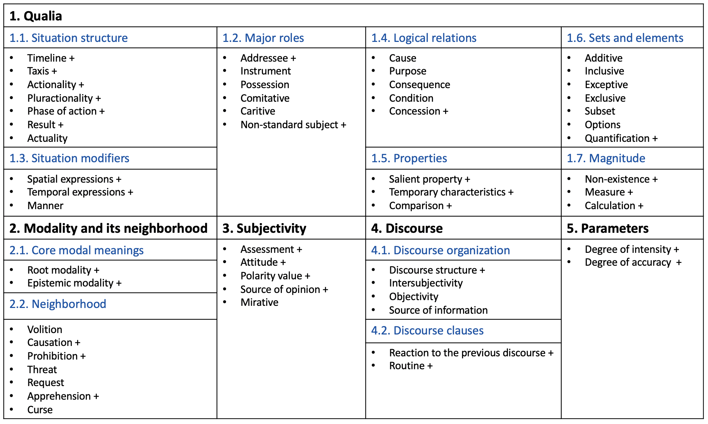
Semantic types of constructions grouped into classes and subclasses
A visualization of 55 semantic types of constructions groupped into subclasses and classes
182 semantic subtypes of constructions

Slide 20
1. Semantic class Qualia
— constructions that describe the properties of the given objective physical world, external to the speaker

Slide 21
2. Semantic class Modality and its neighborhood

Slide 22
3. Semantic class Subjectivity
— constructions that encode the subjective evaluation of a situation, its elements or participants by the speaker.

Slide 23
4. Semantic class Discourse
— constructions that function at the discourse level:
structure the text
organize the communication
refer to a broader context than a single sentence

Slide 24
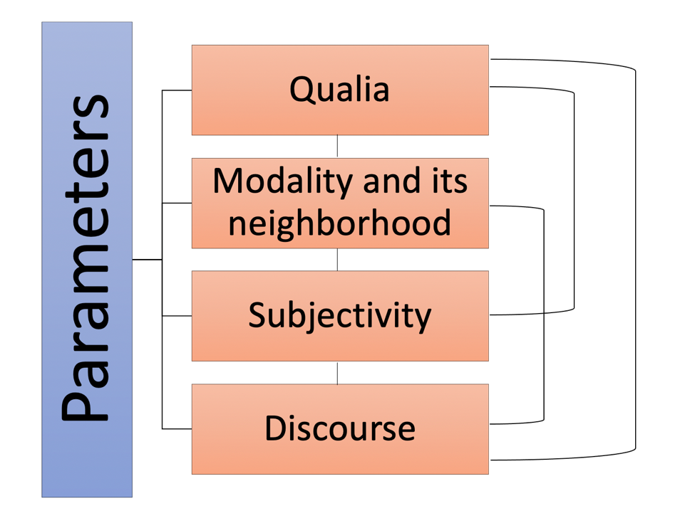
5. Semantic class Parameters
imply a scale that serves as a point of reference for a property or a situation characterized by a construction
can apply to and "build over" other meanings

Slide 25
Classification of constructions
Families
a family is a relatively homogeneous group of approx. 2-9 constructions that share some semantic, syntactic, and/or structural properties
the constructions in a family share various subsets of these properties
semantic and syntactic tags facilitate identification of families
annotation by a panel of three native speakers
Clusters
a cluster is a group of families that are linked through semantic and/or syntactic similarities in a prototypical vs. peripheral distribution, usually corresponding to semantic subtypes in annotation
Networks
a network is a group of clusters that share a general semantic tag
NEXT: Modality and its neighborhood, zooming in on two clusters of Prohibitive constructions

Slide 26
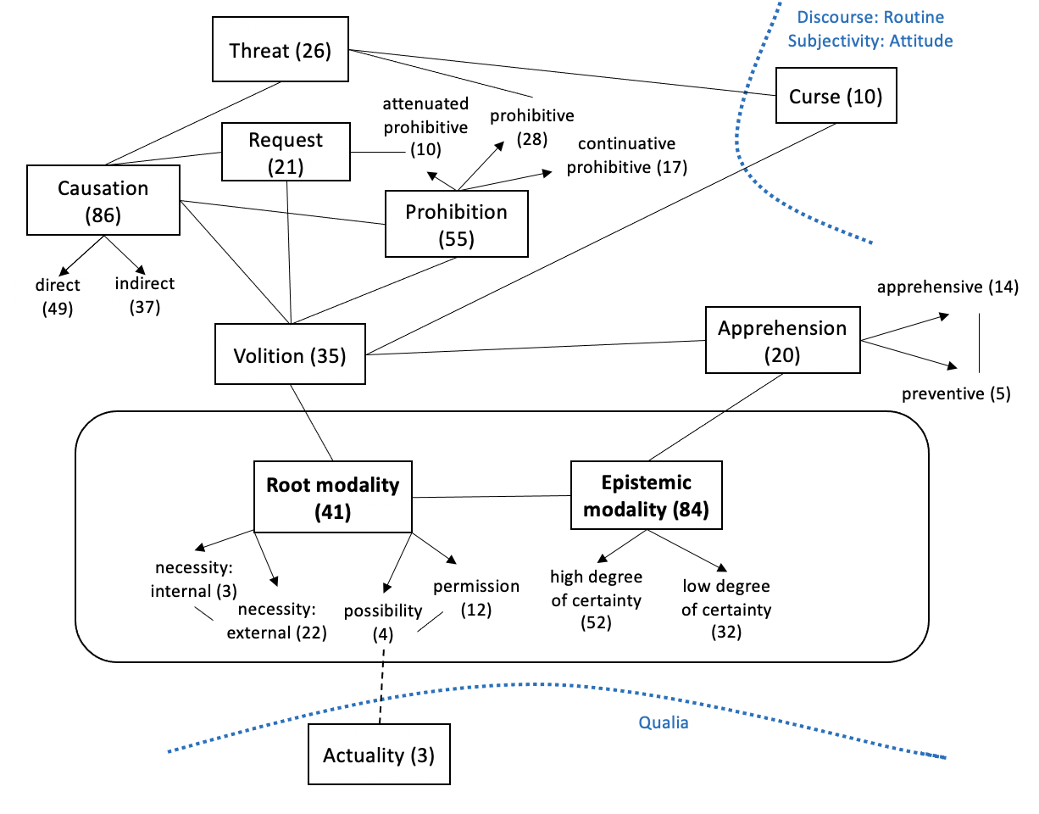
Class of constructions: Modality and its neighborhood
301 constructions
Can be modelled as a radial category – central "core" modal meanings and their neighborhood
Includes 10 semantic types (visualized as boxes)
Arrows indicate subtypes of semantic types
Numbers in ( ) – type frequency of each type in terms of individual constructions
Solid lines – connections between types within this class
Dashed lines – overlaps with other classes (indicated by dotted blue lines)

Slide 27
Vot by (NP-Dat) (nikogda ne/vsegda) VP-Inf!
Vot by nikogda ne rabotat’!
‘Wouldn’t it be great if one never had to work!’
((Ja) bojus’,) kak by ne VP-Pfv.Pst
Kak by Miša ne opozdal!
‘I’m afraid Misha could be late!’
(NP-Dat) Cop možno VP-Inf
Do Moskvy iz Londona možno doletet’ za četyre časa.
‘One can fly to Moscow from London in 4 hours’.
Ne strašno/ničego, esli Cl?
Ne strašno, esli ja zakurju?
‘Would you mind if I smoke?’

Slide 28
Legend:
overlap with Intensity
semantic transitions
syntactic/formal similarities
1:2 (7 constructions)
General rules
Ne VP-Inf!
‘No X-ing!’
weaker relationships
1:4 (7 constructions)
Prohibition of smallest portion
Nikakix NP-Gen!
‘No X-es!’
1:5 (3 constructions)
Anticipation of resistance
Ne VP-Fut.2!
‘You’re not going to do X!’
overlap with other networks of cxns
Cluster 1
predicative
generalization
intensification
opposition to resistance
generalization
option
opposition to repetition
overlap with Request
1:3 (9 constructions)
Milder tone
(NP-Dat) ne stoit VP-Inf
‘There’s no point in X-ing’
1:1 (4 constructions)
Prevention of intended activity
Ne smej VP-Imp.Inf
‘Don’t you dare X’
1:6 (2 constructions)
Prohibition against repeating
Čtob(y) Pron bol’še ne VP-Past!
‘No more X-ing!’
overlap with Warning
attenuation
predicative
continuative
imperative
continuative
continuative
2:2 (7 constructions)
Quantitative, milder tone
Xvatit (Pron.2-Dat) VP-Imp.Inf!
‘Enough X-ing!’
2:1 (4 constructions)
Stop unwanted activity
Brosit’-Imper VP-Imp.Inf
‘Stop X-ing!’
aggression
2:5 (3 constructions)
Prohibition and Threat
Ja Pron-Dat VP-Fut!
‘You do X and you will regret it!’
overlap with Threat
attenuation
imperative
option
Cluster 2
further attenuation
imperative
temporary
Network of Prohibitive constructions
2:3 (2 constructions)
Delimitative
po-VP-Imp.Past i xvatit
‘You’ve done enough X-ing’
imperative
option, po- prefix option
2:4 (3 constructions)
Stop temporarily
Podoždat’-Imper VP-Imp.Inf
‘Stop X-ing for a while’
po- prefix
Notes:
В текст: All CxNs in Cluster 1 contain overt markers of negation, such markers are absent from Cluster 2
Lines represent the relationships that hold among families and are tagged for semantic transitions and shared formal properties – для краткости
В текст в конце: вывод о том, что все семьи связаны

Slide 29
Constructions of this type refer to a successful realization of an action (manage, cf. Plungian & van der Auwera 1998: 104), or “the successful result of the ability” (Aijmer 2004: 62).
Actuality (or acquisitive modality, cf. van der Auwera et al. 2009) as a category lies at the intersection of Modality (Possibility) and Aspect (Perfective).
NP-Dat udalos’ VP-Inf
Miše udalos’ pokurit’.
‘Misha managed to smoke’.

Slide 30
A Tour

Slide 31
https://constructicon.github.io/russian/

Slide 32
The Russian Constructicon
Over 2200 constructions
Arguably the largest openly available constructicon resource for any language
User-friendly for linguists, teachers, learners
Searchable according to semantics, anchor words, syntax
Open-source, publicly archived data
Designed to be portable to other languages, reproducible

Slide 33
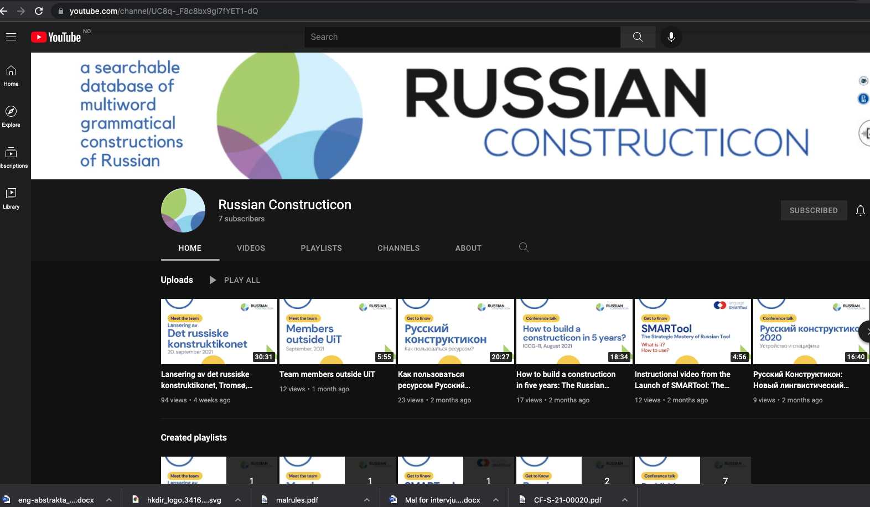
See also instructional videos on our YouTube channel:
https://www.youtube.com/channel/UC8q-_F8c8bx9gI7fYET1-dQ

Slide 34
Strategies for data management
FAIR Principles and TROLLing

Slide 35
Data management and FAIR principles
Janda, Laura A. 2022. Managing data and statistical code according to the FAIR principles. In: Andrea Berez-Kroeker, Brad McDonnell, & Eve Koller (eds.), MIT Open Handbook of Linguistic Data Management. Open Handbooks in Linguistics, Vol 1. Chapter 37, pp. 447–452. 2022. https://doi.org/10.7551/mitpress/12200.003.0042

Slide 36
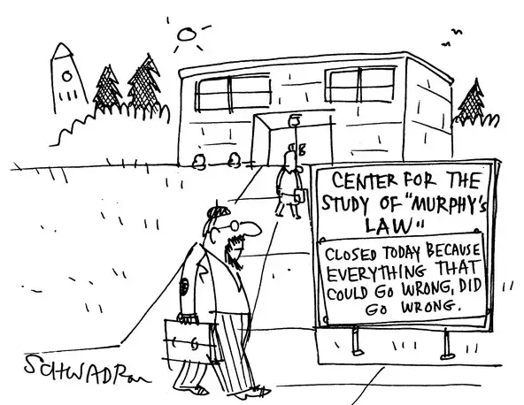
Murphy’s law and data management
All of these things have happened to me
I lost the data
The data got corrupted/uninterpretable
Site-licenses for proprietary software did not get renewed
The software underwent a backward-incompatible upgrade
The meanings of all the abbreviations and code that were so obvious when working on the original project evaporated from my personal memory
In other words, I got permanently separated from my data and analysis…

Slide 37
FAIR principles for data management (Wilkinson et al. 2016)
Findable: Metadata makes it possible for other researchers to find the data and code
Accessible: A publicly available archive makes it possible for other researchers to access the data and code
Interoperable: Persistent open-source file formats make it possible for other researchers to open and use the files
Reusable: Adequate description of the files, their contents, the variables, and their values, as well as annotation for the statistical code, will make it possible for other researchers to understand and reuse the data and code

Slide 38
Findable: Harvestable metadata
Metadata should be built into the archive where your data is stored (see Accessible)
Metadata should be searchable
Examples of types of metadata:
Keywords: “North Saami, possessive suffix, Uralic, S-curve, vocative, possession, language change, complexity”
Topic Classifications: “morphology, diachronic, affixes”
Kind of Data: “corpus, questionnaire, experiment”
Geographic Coverage: “Norway, Sweden, Finland, Sápmi, Northern Scandinavia”

Slide 39
Accessible: Publicly available archive
Data and code should be stored in an archive that is publicly accessible, and preferably both free and searchable without a password
Each set of data and code can be assigned a post and metadata can be attached
Each post should be supplied with a unique identifier and URL (e.g., DOI – digital object identifier)
Mutual co-referencing: If there is a published article, the DOI can be published in the article and the article can be cited in the post
The archive should be professionally curated and maintained

Slide 40
Interoperable: Persistent open-source formats
The use of appropriate formats makes data and code usable across platforms
Data and code should be presented in formats that can be accessed by anyone and at any future time
Examples of persistent non-proprietary open formats: .pdf and .txt
Using such formats can mean losing the direct connection to software that comes along with an item such as an R script. This can be handled by providing duplicate files in different formats.

Slide 41
Reusable: Description and annotation
REAMDME files that fully explain all variables and their values
Assign file names that will organize the files in a logical order when downloaded and are descriptive:
01README.txt
02data.csv
03data.pdf
04code_for_regression_analysis.Rmd
05code_for_regression_analysis.pdf
Annotate every line of code (e.g., with # or in names of R chunks)

Slide 42
Adhering to FAIR principles means extra work for us, so why do it?
For the good of the field
For yourself
Tip: if you have the FAIR principles in mind from the start, and are consistent in documenting and annotating as you go along, it will not be so much of a burden in the end

Slide 43
FAIR for the good of the field
Set ethical standards for best practices in data management and promote collaboration
Improve the overall level of accountability and integrity in the field
Safeguard against research fraud
Foster horizontal learning across the community of researchers, facilitating the propagation of new methods
Eliminate unnecessary duplication of efforts and representation of negative results
Provide data for previously unforeseen uses

Slide 44
FAIR for yourself
Will you remember what the factors and their values are, what all the abbreviations stand for, and how each line of code works:
in a month, in a year, in 5 years?
You never know when you might need to go back to a data set, either to squeeze another analysis out of it or to use it as a recipe for a parallel analysis of new data
Or when someone else might want to do an additional analysis of your data or similar data and might come with questions

Slide 45
A PLACE FOR US:
https://dataverse.no/dataverse/trolling

Slide 46
TROLLing
is an international archive of linguistic data and statistical code
is built on the Dataverse platform from Harvard University and complies with DataCite, the international standard for storing and citing research data
is compliant with CLARIN, the EU research infrastructure for language-based resources
assigns a permanent URL to each post
uses metadata that ensures visability and retrieval through international services
is professionally managed by the University Library of Tromsø and an international steering committee

Slide 47
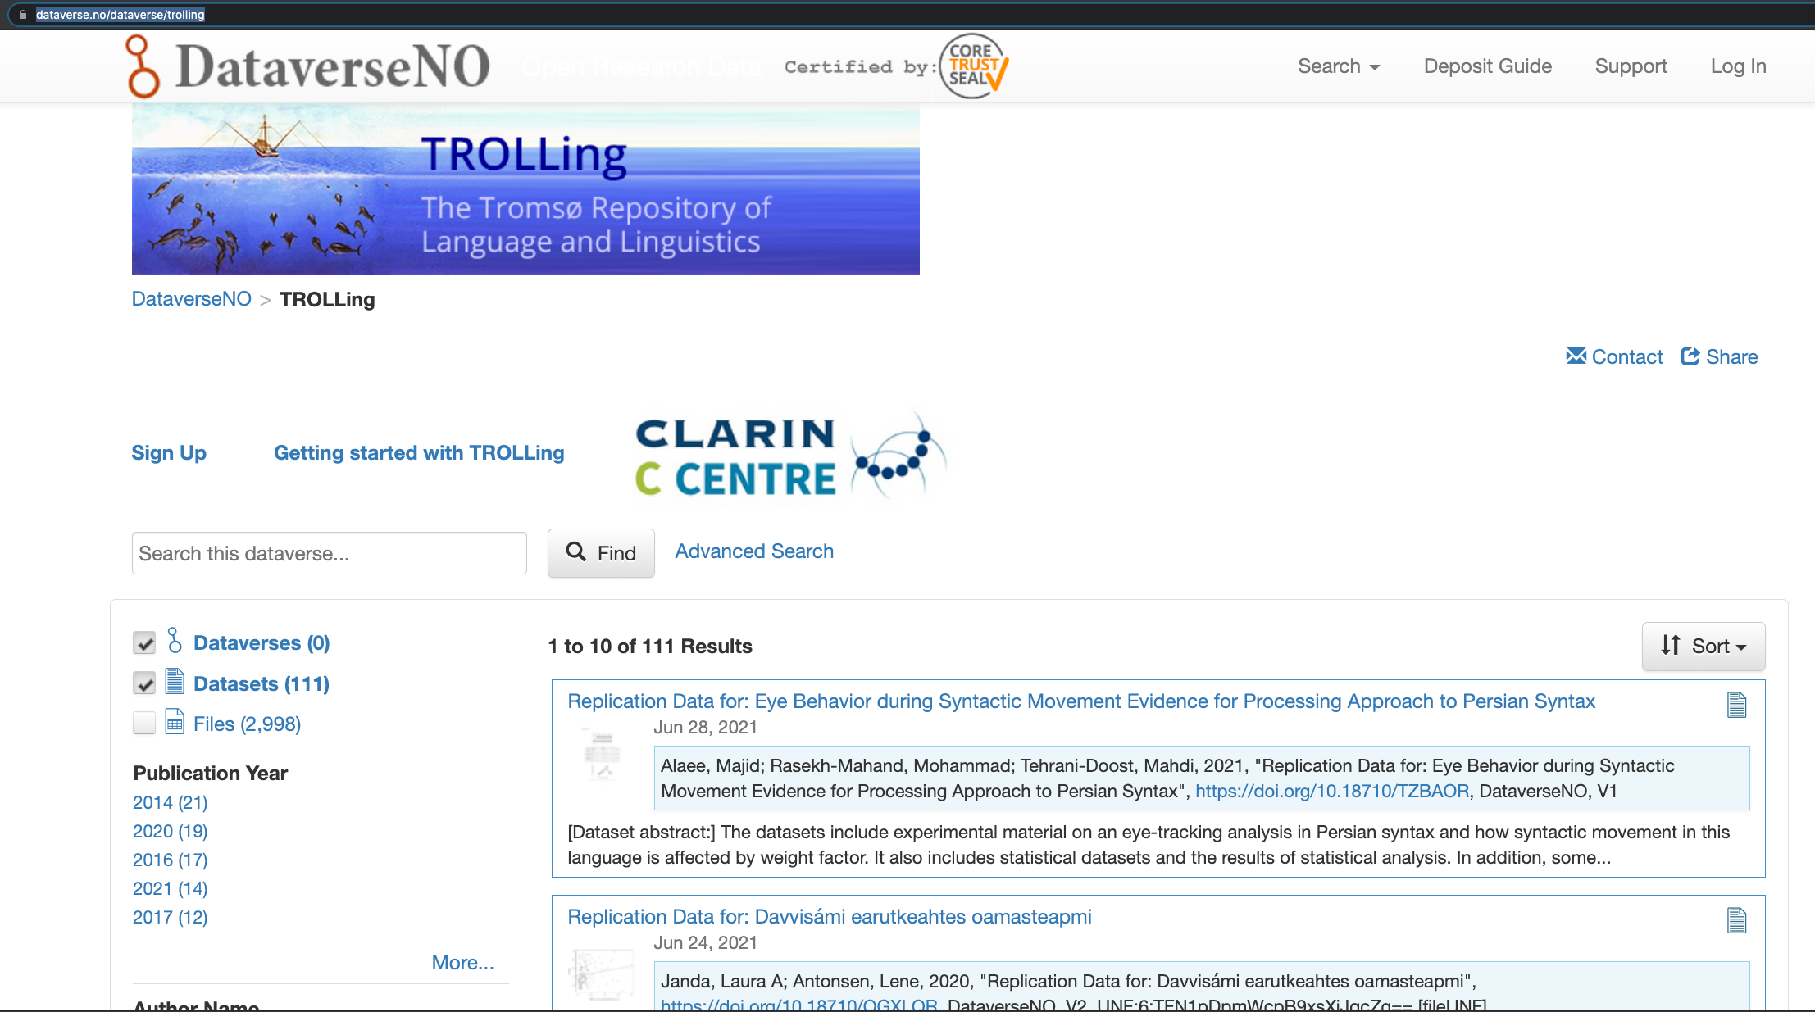

Slide 48
Getting started with TROLLing
http://site.uit.no/trolling/getting-started/
Promotional video
User guide
TROLLing banner

Slide 49
Basic steps in TROLLing
Create an account
Needed only for archiving -- you do not need an account to search or download data
This step is self-explanatory, but there is an instructional video
It may take a day or two for your account to be approved
Create a study
Enter metadata, upload files in persistent formats, get DOI
Search for a study
TROLLing terms of use

Slide 50
After you have uploaded your study...
You submit it for approval and receive an acknowledgement
It will be approved and released by an administrator and you will receive an email
You will be able to edit your study later if needed and resubmit
Previous versions of your study are archived, but only the latest version shows up in initial searches

Slide 51
Search for a study
All of the cataloging information (metadata) is searchable, including:
author
affiliation
country / nation
date of production and distribution
keywords, e.g. language
topic classification
Advanced search
possible to include and exclude combinations of items

Slide 52
Terms of use that users must agree to when downloading files
Affirm that:
You will not use the materials that you downloaded to identify individuals or organizations
You will not download or use materials that would be prohibited by law
You will cite the data as stipulated in the Data Citation Information in any publications or reports that you make using the data
You understand that the distributor makes no warranties about the data

