Slide 1
Out of this world: constructing languages for fiction, film, and fun
Laura A. Janda
Nouns (part 2)
Pronouns
Adjectives
Numerals
February 10, 2023 Session B

Slide 2
Noun Case
“a form of a noun that indicates what role the noun plays in a sentence” (DJP, 120)
English has lost case on nouns and has just a few leftovers on pronouns

Slide 3
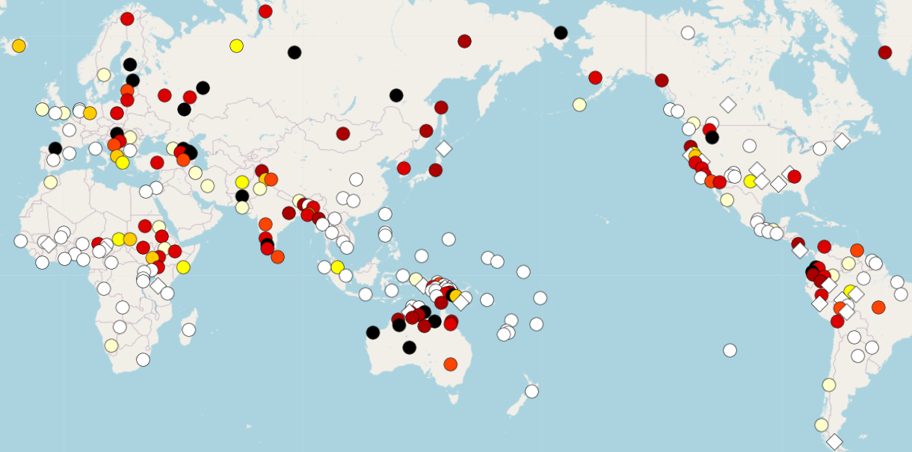
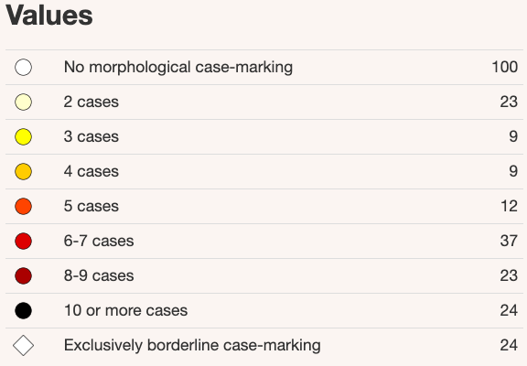
Feature 49A: Number of Cases

Slide 4
Case marks a variety of relationships
Direct arguments of verbs (subjects and objects and the like)
Indirect objects
Possession and other genitive uses
Non-local cases
Local cases
You can make up more cases! Natlangs do it too…
And you can assign different groups of meanings to your cases
  The meanings of cases are not fixed or universal

Slide 5

Sleeping in High Valyrian
Vala ēdrus
[man.NOM.SG sleep.PRS.3.SG]
‘The man sleeps/is sleeping’

Slide 6
Sleeping in High Valyrian
Vala ēdrus
[man.NOM.SG sleep.PRS.3.SG]
‘The man sleeps/is sleeping’
Sleep is an intransitive verb
There is a sleeper = Nominative

Slide 7
Sleeping in High Valyrian
Vala ēdrus
[man.NOM.SG sleep.PRS.3.SG]
‘The man sleeps/is sleeping’
S = the sleeper
the Subject of an intransitive verb

Slide 8
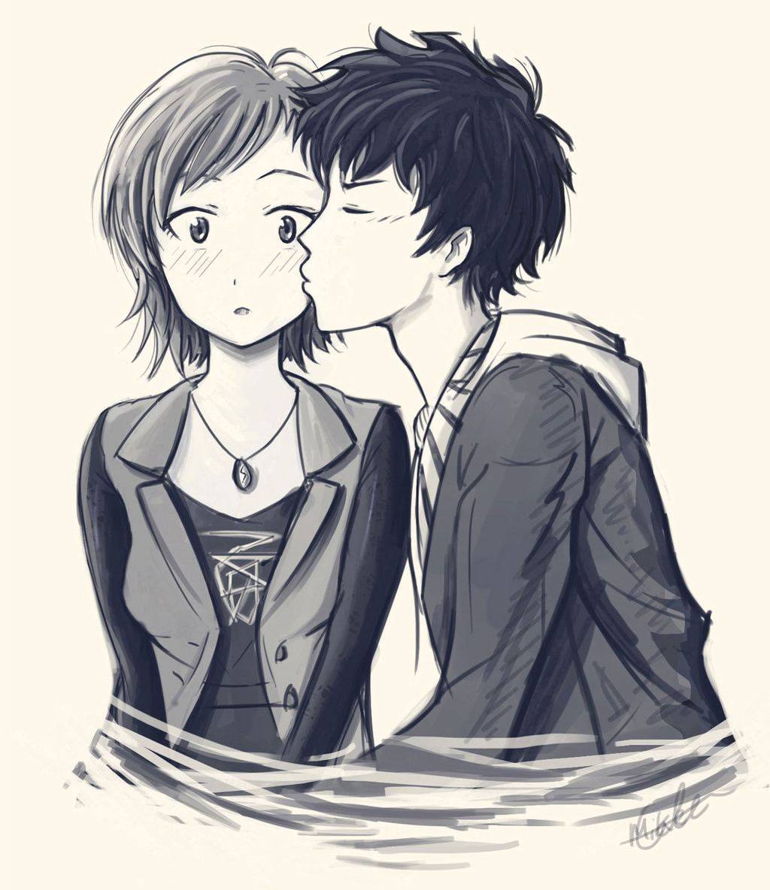
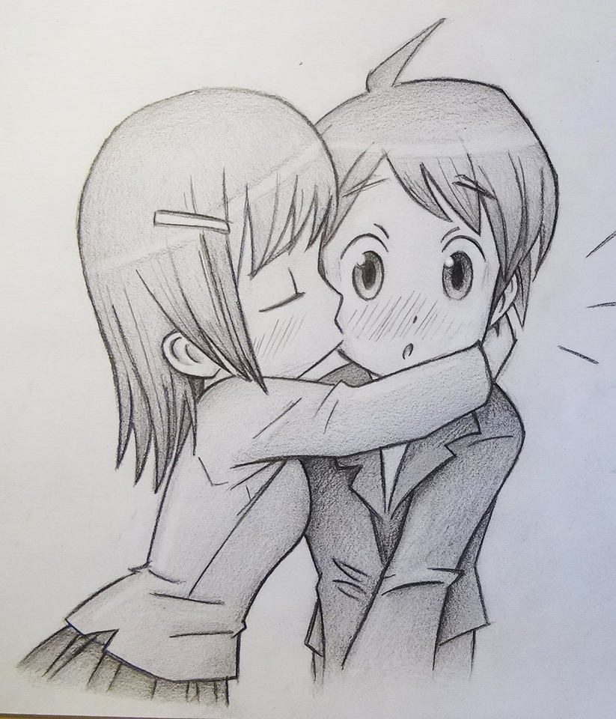
Kissing in High Valyrian
A
B
Val-a abr-e vūjitas
[man-NOM.SG woman-ACC.SG kissed]
‘The man kissed the woman.’
Val-e abr-a vūjitas
[man-ACC.SG woman-NOM.SG kissed]
‘The woman kissed the man.’

Slide 9
Kissing in High Valyrian
Kiss is a transitive verb.
There is a kisser = Nominative
There is a kissee = Accusative
A
B
Val-a abr-e vūjitas
[man-NOM.SG woman-ACC.SG kissed]
‘The man kissed the woman.’
Val-e abr-a vūjitas
[man-ACC.SG woman-NOM.SG kissed]
‘The woman kissed the man.’

Slide 10
Kissing in High Valyrian
A = the kisser, the Agent of a transitive verb
0 = the kissee, the Object of a transitive verb
A
B
Val-a abr-e vūjitas
[man-NOM.SG woman-ACC.SG kissed]
‘The man kissed the woman.’
Val-e abr-a vūjitas
[man-ACC.SG woman-NOM.SG kissed]
‘The woman kissed the man.’

Slide 11
High Valyrian is a
Nominative – Accusative language
S (Subject of an intransitive verb) and A (Agent of a transitive verb) are treated the same, marked with the Nominative case
O (Object of a transitive verb) is treated differently, marked with the Accusative case

Slide 12
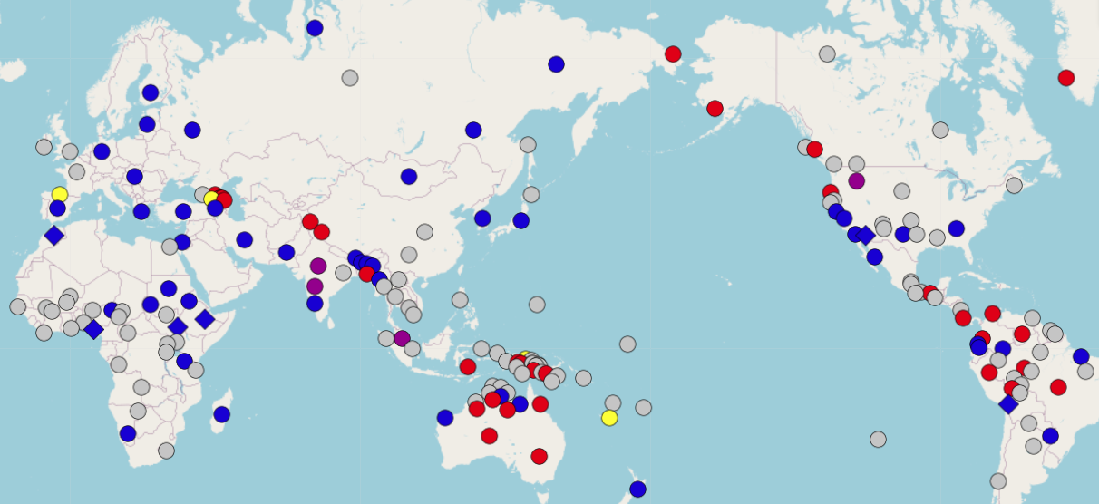
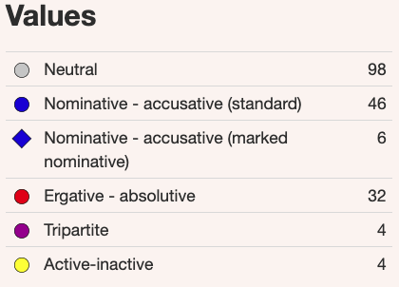
Feature 98A: Alignment of Case Marking of Full Noun Phrases

Slide 13

Questions and Comments?
Clip: Conlanging 46:40-49:16

Slide 14
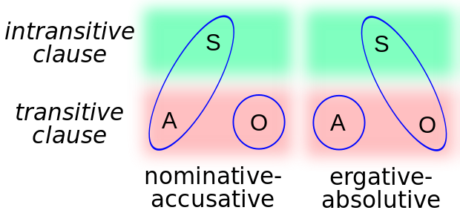
Two ways to mark subjects and objects with case
S = Subject of an intransitive verb
A = Agent of a transitive verb
O = Object of a transitive verb
Nominative-accusative:
S and A are marked Nominative
O is marked Accusative
Ergative-absolutive:
S and O are marked Absolutive
A is marked Ergative

Slide 15
Sleeping in Hindi
admi soja
‘The man slept’
mazdur soja
‘The laborer slept’
S, the subject of an intransitive verb, is unmarked

Slide 16
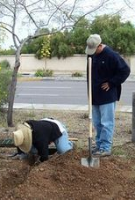
Seeing in Hindi
admine mazdur dekha
‘the man saw the laborer’
mazdurne admi dekha
‘the laborer saw the man’
A, the agent of a transitive verb, is marked with –ne
O, the object of a transitive verb, is unmarked

Slide 17
High Valyrian
Hindi

Slide 18
Questions and Comments?
Clip: Conlanging 37:42-39:20

Slide 19
Other things you can do with an Accusative case
Destinations in space and time (when something happens), including backward destination (‘ago’)
‘to’ and ‘through’ and ‘across’
purpose ‘for’
duration
approximation

Slide 20
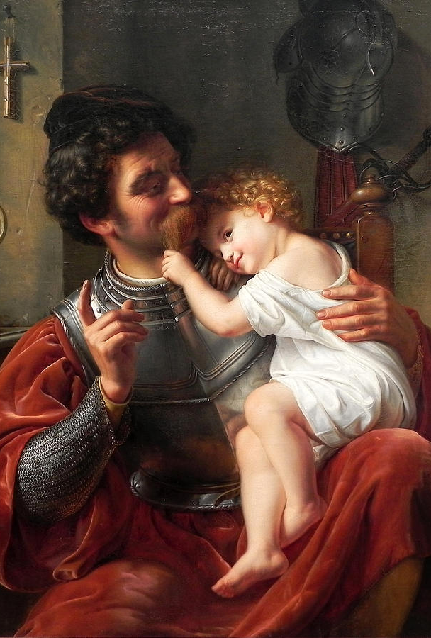
Kir ellenär läini- geil-
I gave child warrior
Kir ellenär läinie geilää
[I gave child.ACC warrior.DAT]
‘I gave a child to the warrior’
Kir ellenär läiniä geilee
[I gave child.DAT warrior.ACC]
‘I gave a warrior to the child’
Indirect objects marked in the Dative in Shiväisith, language of Dark Elves, Thor: The Dark World

Slide 21
Other things that you can do with a Dative case
directions ‘toward’
purpose ‘for’ and ‘against’
beneficiary / maleficiary
addressee of communication and signalling
addressee of punishment
competing forces (domination, subjugation, equal forces)
(reflexive) for one’s own (selfish) benefit

Slide 22
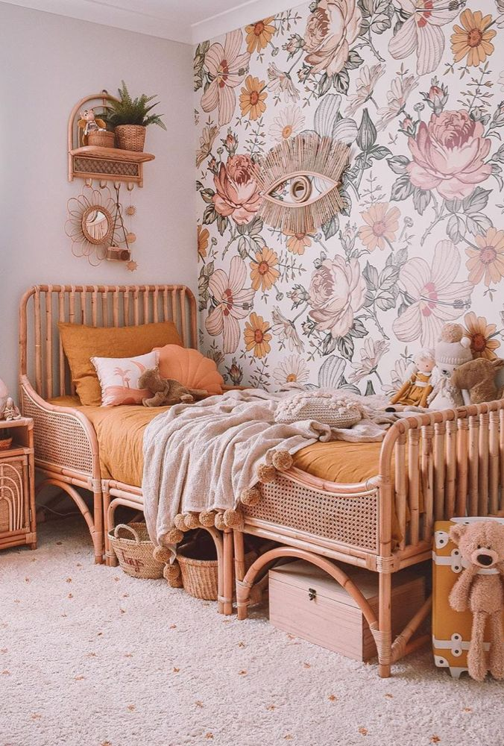
Possession via Genitive case
Russian:
komnata devuški
[room.NOM girl.GEN]
‘the girl’s room’
North Saami:
nieidda latnja
[girl.GEN room.NOM]
‘the girl’s room’

Slide 23
Other things you can do with a Genitive case
goal and source
‘near’
fear, avoidance, withdrawal, and approach
‘for’ and ‘against’
‘of’ chaining
color
quantification and lack of
setting space and time
many adpositions

Slide 24
Reflexive possession in N Saami: ReflN is replacing NPx
Two examples from Elle Márjá Vars’ novel Kátjá
NPx (possessive suffix, HIGH morphological complexity):
(1a) Kátjá... ollii latnjasis
Kátjá.nom reach.ind.pret.3s room.ill.sg.px.3s
‘Kátjá... got to her room’
ReflN (analytic construction with reflexive genitive pronoun):
(1b) Kátjá... ollii iežas latnjii
Kátjá.nom reach.ind.pret.3s refl.gen.3s room.ill.sg
‘Kátjá... got to her room’

Slide 25
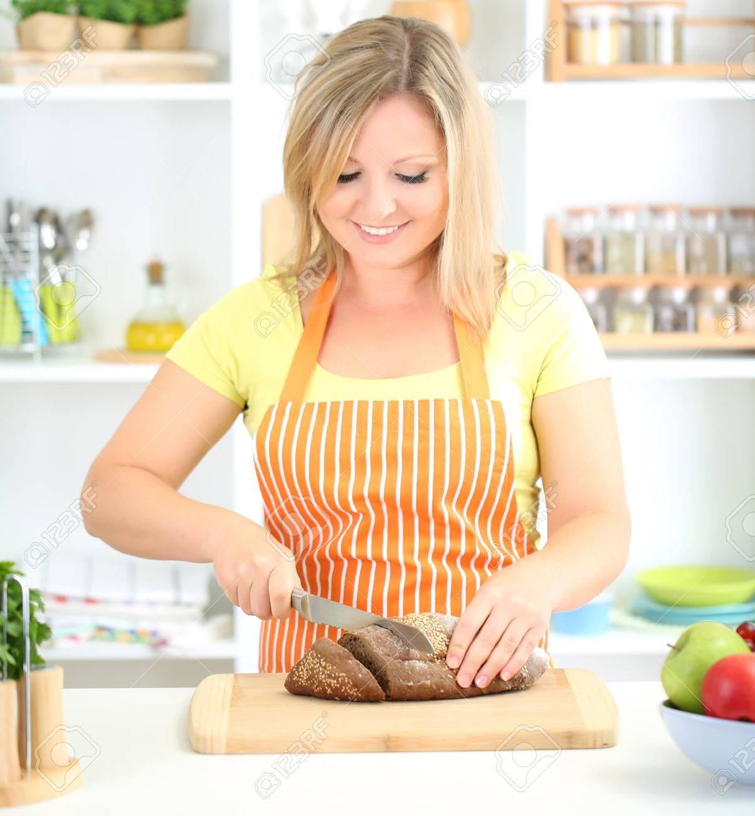
Instrumental: a case for tools
Russian:
Devuška režet xleb nožom
[Girl.NOM cuts bread.ACC knife.INS]
‘The girl cuts bread with a knife’

Slide 26
Other things you can do with an Instrumental case
path in space and time
movement of body parts and objects
groups
governance, leadership
passive agent
proximate location
label
filling, exchanging

Slide 27
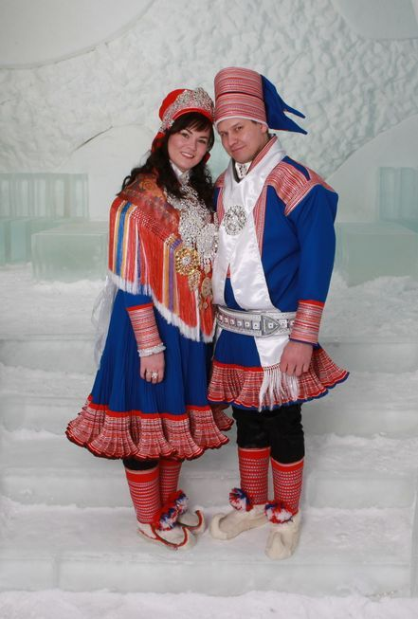
Comitative case: doing things together
Áhčči lea náitalan etniin, áddjá áhkuin ja vel mu eanu nai lea náitalan mu imiin.
[father.NOM be married mother.COM, grandfather.NOM grandmother.COM and furthermore I.GEN uncle.NOM also be married I.GEN aunt.COM]
‘Father is married to mother, grandfather to grandmother, and my uncle is married to my aunt.’
Oaččun go hupmat du etniin?
[get.PRS.1.SG PART speak you.GEN mother.COM]
‘Can I speak with your mother?’

Slide 28

Instrumental and Comitative can be conflated
The engineer is solving a problem with a computer.
Is the computer a tool or a collaborator?
With such excellent musicians, the conductor can play great music.
Are the musicians instruments or collaborators?

Slide 29
Questions and Comments?
Clip: Conlanging 39:20-43:54

Slide 30
Vocative: a case for calling people
Vocatives in Old Church Slavonic: Bože ‘God!’, Gospodi ‘Lord!’
“New vocatives” in Russian formed by truncation of a final -a (as in mam! ‘mama!’, Saš! ‘Sasha!’
New vocative in N. Sámi:
Gula, mánážan.
listen.imper.2s child.dim.nom.sg.px.1s
‘Listen, my little child.’
Largely restricted to names and kinship terms

Slide 31
Local cases, as in Finnish/Kven
Locative: in/at a place (no movement)
Adessive: near something
Allative: toward something
Ablative: away from something
Inessive: inside something
Illative: into something
Ellative: out of something
…

Slide 32
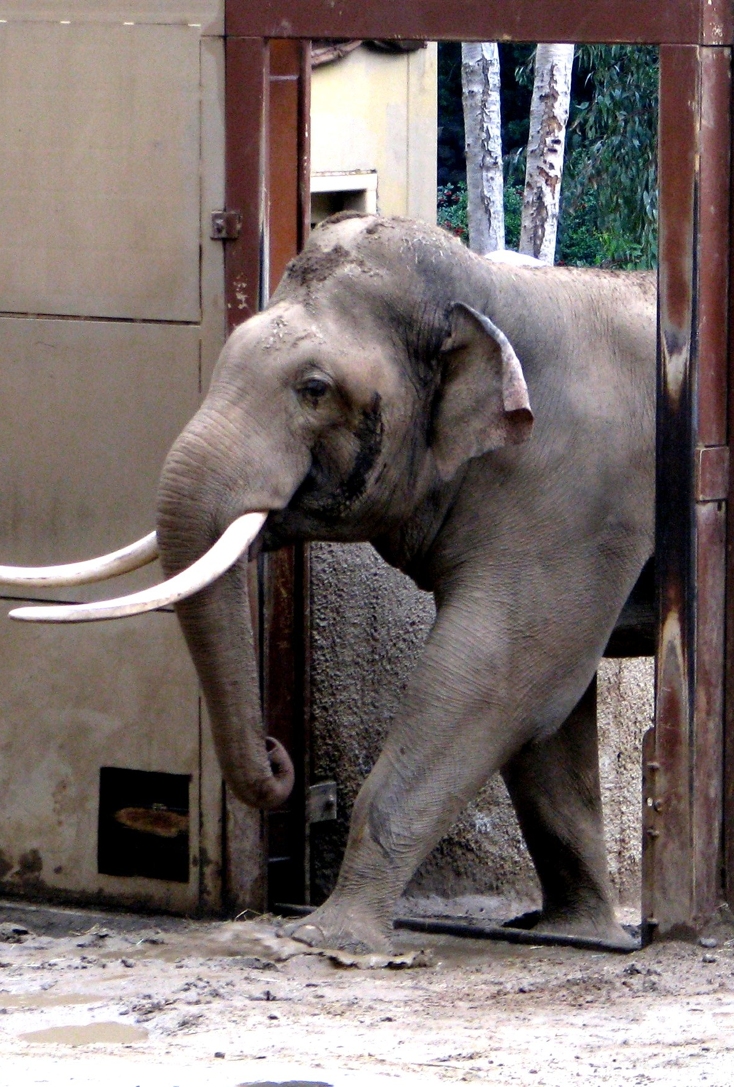
A prolative case in North Sámi?
ráigi ‘hole’ in North Saami
“the suffix –ráigge – originating in the genitive-accusative form of the noun ráigi ‘hole, opening’ – has many case-like features that make it look like a … prolative (‘along, through’) case”
uksaráigge ‘through the door’, bálggesráigge ‘along the path’
Mon ledjen boahtime Álaheajus siidii dan min boares jođáhatráigge
[1SG be.PST.1SG come.PROG Álaheadju.LOC camp.ILL it.GENACC 1PL.GENACC old reindeer.track.PROL]
‘I was returning back home from Álaheadju along the old reindeer track of ours’
Ylikoski, Jussi. (2014). Davvisámegiela ‑ráigge – substantiiva, advearba, postposišuvdna vai kásus?. – Sámi dieđalaš áigečála 2/2014: 47–70.

Slide 33
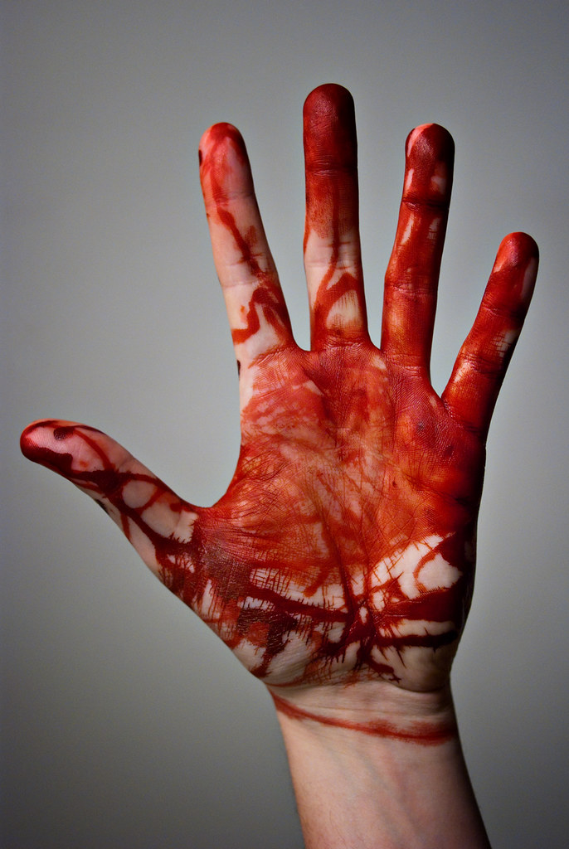
A contaminative case (adjective?) in North Sámi?
suffix –naga
  Giehta lea varranaga/málanaga/betoŋganaga
  [hand be.3SG blood/paint/concrete.NAGA]
  ‘the hand is stained with blood/paint/concrete’
varranaga tragediija [blood.NAGA] ‘bloody tragedy’, mihcamárnaga [Midsummer.NAGA] ‘with remnants of (having celebrated) Midsummer’
Ylikosi, Jussi. (2014). Davvisámegiela substantiivavuđot -naga-hámit giellaoahpa ja sátnevuorkká rájá alde. – Sámi dieđalaš áigečála 1/2014: 51–71.

Slide 34
Questions and Comments?

Slide 35
Exponence: how case meanings are expressed
case, adpositions (prepositions and postpositions), combinations of the two
Historically:
  adpositions (which might themselves be derived from nouns or other words) become clitics (the get attached to nouns) and then become case affixes
  affixes (especially suffixes) erode and get lost
  (new) adpositions step in and the cycle repeats

Slide 36
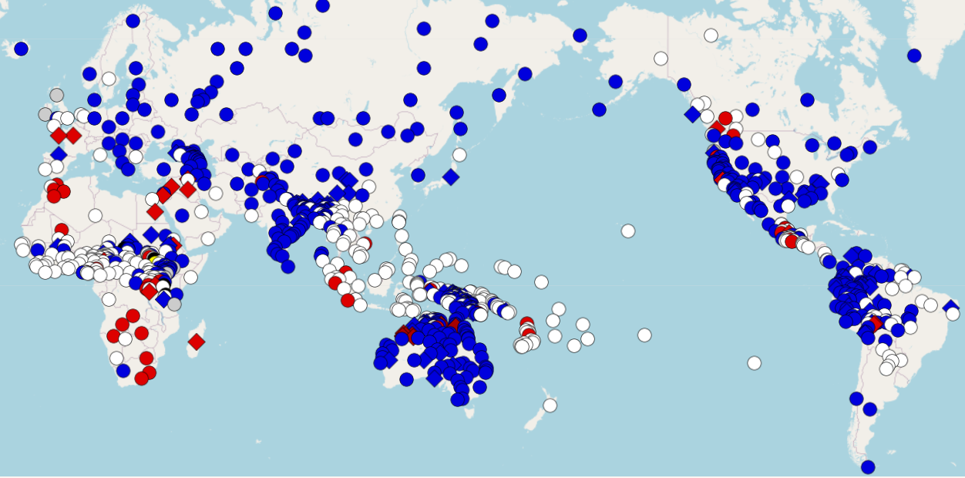
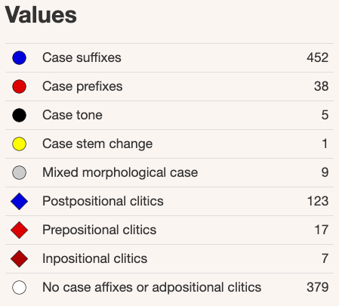
Feature 51A: Position of Case Affixes

Slide 37
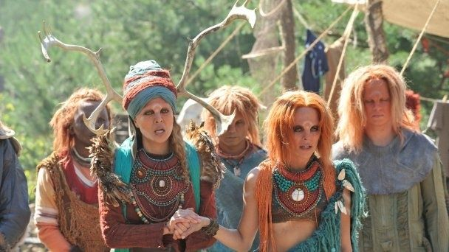
Irathient nouns

Slide 38
Irathient nouns have monosyllabic stems…
to which we add:
  Prefixes to express 18 word classes (genders)
    Prefixes distinguish neutral vs. dangerous for beings, animals, plants, objects, substances
    Prefixes also distinguish places/passive objects, abstractions, groups/collectives, actions
    Prefixes also distinguish animate vs. inanimate and diminutive vs. augmentative
  Suffixes for singular and plural
  Singular suffixes are specified by the word classes
  Plural suffixes are specified by relationship to the singular suffixes
Varying prefixes makes it possible to coin interesting related words like: ulluze ‘reason’ (object) vs. elluzu ‘excuse’ (dangerous object) and uttu ‘advice’ vs. ettu ‘criticism’

Slide 39
Questions and Comments?
Clip: Conlanging 27:13-34:54

Slide 40
Things that go with nouns
Pronouns
Adjectives
Numerals

Slide 41
Pronouns
Personal pronouns
1.sg = first person singular = I | 1.pl = first person plural = we
2.sg = second person singular = you | 2.pl = second person plural = y’all
3.sg = third person singular = he, she, it | 3.pl = third person plural = they
Variations on personal pronouns: dual, inclusive vs. exclusive ‘we’, case
Possessive pronouns: my, mine, your, yours, his, her, hers, their, theirs
Relative pronouns: who, which, that: The girl who/which/that I saw yesterday
Demonstrative pronouns: this, that, these, those

Slide 42
Adjectives: Not all languages have them
How can a language manage without adjectives?
Use verbs instead:
  I hunger (cf. Russian ja progolodalsja ‘lit. I became hungry’) vs. I am hungry (vs. French j’ai faim ‘lit. I have hunger’)
  Russian beleet parus ‘the sail shows white’ vs. belyj parus ‘white sail’
  the table that somebody broke vs. the broken table
  a machine that sews vs. a sewing machine
  the tree radiates beauty vs. the beautiful tree
  the idea that appeared recently vs. the new idea
Use phrases instead:
  a table of wood vs. a wooden table (vs. Norwegian et trebord)
  an accent from Greece vs. a Greek accent
  ideas inspired by religion vs. religious ideas
  an idea without hope vs. hopeless idea

Slide 43
Adjectives
Qualitative: new, beautiful
  Can have scalar values and antonyms
  Can form comparatives and superlatives
Relational: wooden, Greek
  Refer to a source or material
  Non-scalar
  Do not form comparatives and superlatives
Participial: broken, sewing
  verbal adjectives, can be more or less associated with the verb
  behave more like relational than qualitative adjectives

Slide 44
Comparison across types of Adjectives
 | Qualitative | Relational | Participial
Scalar value | very new, very beautiful | ?very wooden, ?very Greek | ?very broken, ?very sewing
Comparative | newer, more beautiful | *woodener, ?more wooden, *Greeker, ?more Greek | *brokener, ?more broken, *sewinger, *more sewing
Superlative | newest, most beautiful | *woodenest, ?most wooden, *Greekest, ?most Greek | *brokenest, ?most broken, *sewingest, *most sewing
Antonym | old, ugly | ?? | unbroken, ??
Predicative use | the tree is new, beautiful | the table is wooden, Greek | The machine is broken, *The machine is sewing

Slide 45
Participial adjectives can detach from verbs
Norwegian: I might have ubetalte regninger ‘unpaid bills’, but I can’t ubetale regninger ‘unpay bills’
English: Someone’s reaction might be unsurprising, but that doesn’t mean that s/he can unsurprise me.
Russian:
  učenyj lit. ‘learned’, ‘scholar’
  ljubimyj lit. ‘being loved’, ‘favorite’
  letučij as in letučaja myš’, lit. ‘flying mouse’ = ‘bat’, letajuščaja tarelka ‘flying saucer’, cf. letjaščij ‘flying’
  gorjačij ‘hot’, gorjučij ‘fuel’, gorjaščij ‘burning’

Slide 46
Numerals
See: Kamelåså:
https://www.youtube.com/watch?v=wGGX5gmwVbA
Cardinal numerals (‘1’, ‘2’, ‘3’...)
  not just base 10, and some languages have mixed systems
    Partial vigesimal systems in Danish, French, Basque, Georgian
  very large numerals often behave differently
Ordinal numerals (‘1st’, ‘2nd’, 3rd’...)
Collective numerals (‘pair’, ‘duo’, ’threesome’, ‘dozen’)
Indefinite numerals (‘many’, ‘some’, ‘few’)
Fractional numerals

Slide 47
Questions and Comments?

