Slide 1
Out of this world: constructing languages for fiction, film, and fun
Laura A. Janda
Structure of course
Introduction to conlangs
Cultures of conlangs
Introduction to language concepts and resources
February 3, 2023 Session A

Slide 2
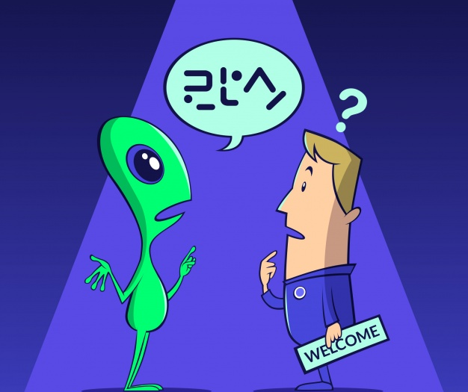
What we will explore in this course
The universe of constructed languages
Basic building blocks of language
Tools for constructing languages

Slide 3
Structure of the course
Including: fun facts, interactive activities, and free online resources (toys!) for you to enjoy
Date | Content
February 3 | Introduction, Culture, Lexicon, Sound Systems
February 10 | Scripts, Nouns and their orbit
March 3 | Verbs and their orbit
March 10 | Word Derivation, Language Evolution, Translation Challenges

Slide 4
Suggested format for each session
Approximately 45 minutes, then 5 minute break, then 40 more minutes
I will regularly open the floor for questions and comments at several points in each session
In the meantime, feel free to put questions in the chat

Slide 5
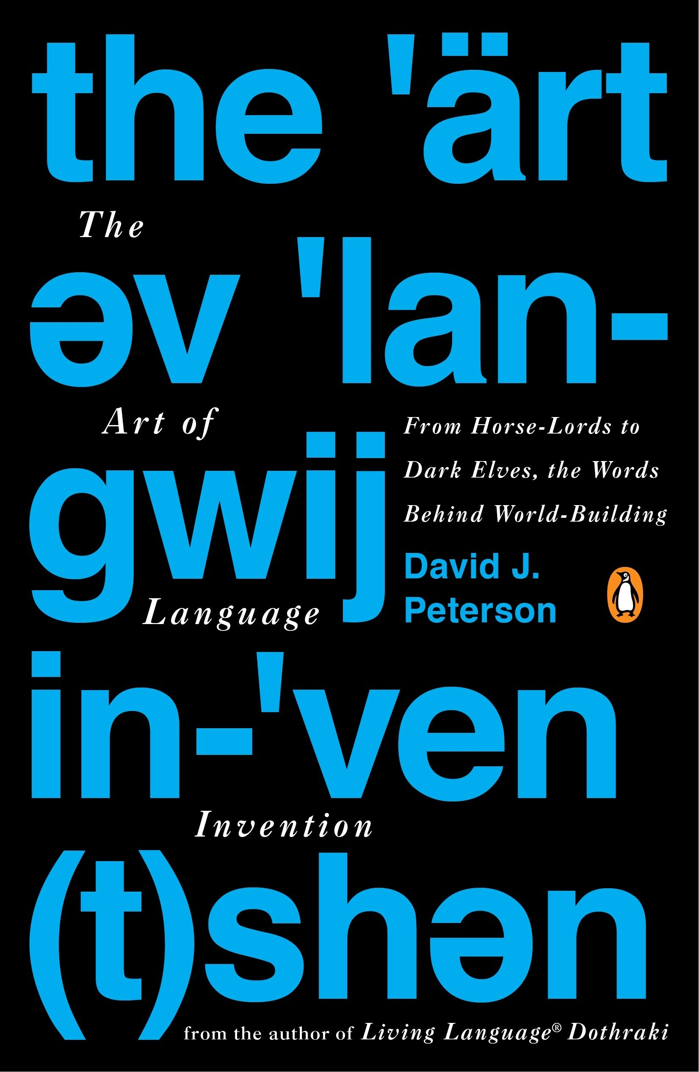
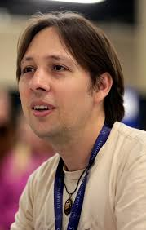
Materials
Peterson, David J. 2015. The art of language invention. New York: Penguin Books. (=DJP)
Annis, William S. 2014. A conlanger’s thesaurus. Fiat Lingua
IPA chart
Swadesh list
World Atlas of Language Structures
Films: Conlanging & Conlang-y-er

Slide 6
A little bit about you
What languages do you speak? read?
What are your expectations for this course?
Do you have any experience with conlangs?

Slide 7
A little bit about me
Pedigree
  Princeton class of 1979, PhD UCLA 1984
  Faculty positions at UCLA, U Rochester, UNC-Chapel Hill, UiT The Arctic University of Norway
What languages do I speak? read?
  I speak English, Russian, Czech, Norwegian, N. Saami, Spanish
  I read all other Slavic and Scandinavian languages
  Currently learning Persian and Ukrainian
Do I have any experience with conlangs?
  I analyzed a conlang in a Czech novel and I teach a full-semester course in conlangs at UiT The Arctic University of Norway

Slide 8
Some terms
So that we are all on the same page...

Slide 9
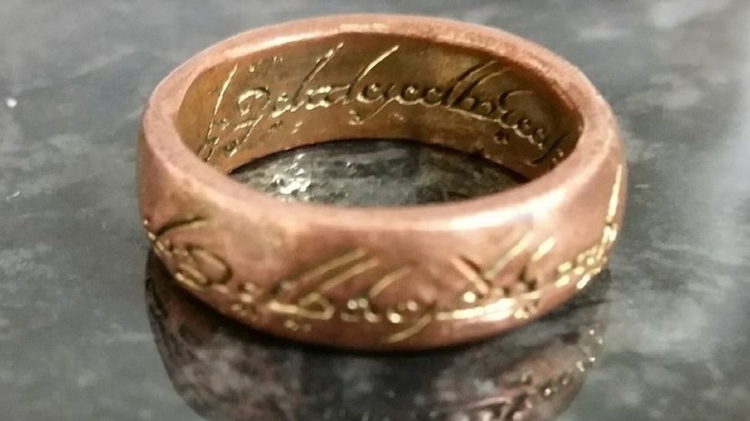
Conlang
A language that has been consciously created by one or more individuals in its fullest form
Includes auxiliary languages
Does not include revitalization projects (Modern Hebrew, Modern Cornish)
Does not include creole languages (Tok Pisin, Russenorsk)
Clip: Conlang-y-er 46:52-48:13

Slide 10

Natlang
A language that happens to exist in the world and evolved naturally
Includes
  all spoken languages (including creoles and revitalized languages)
  signed languages
  dead languages

Slide 11

Dialect
An instantiation of a language
Every human being speaks a dialect of their own language

Slide 12
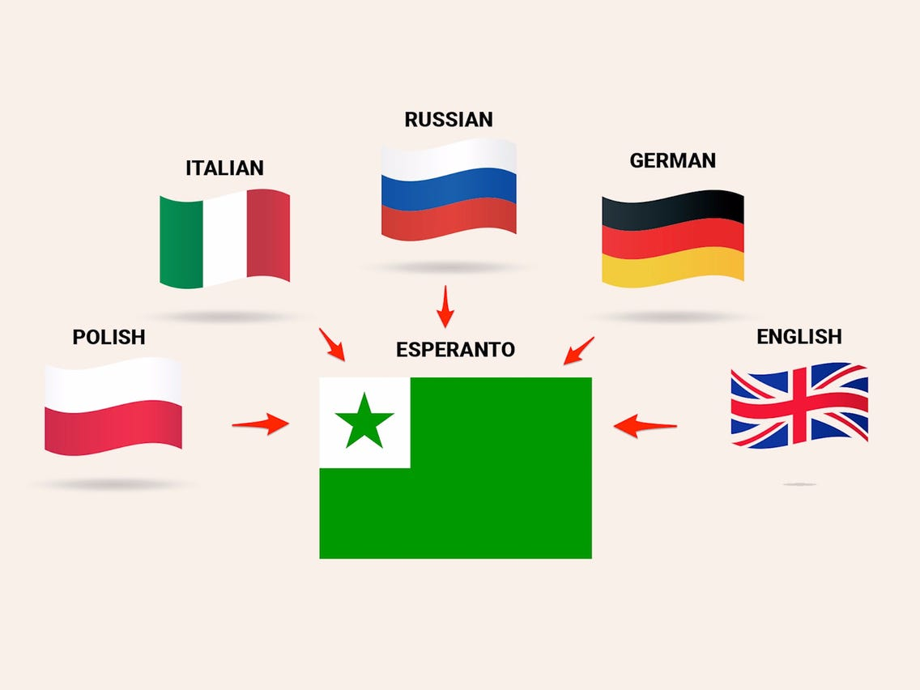
Auxlang
Auxiliary language
A conlang created for international or regional communication

Slide 13

Fictional language
A language that’s supposed to exist in a given fictional context
Includes both “full” languages and “sketches”

Slide 14

Real language
Any language that actually exists
Includes both natlangs and conlangs

Slide 15

Questions and Comments?

Slide 16
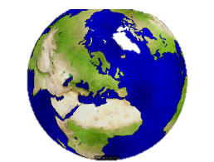
Now let’s tour the universe of conlangs

Slide 17
Starting from our world of natlangs
  Q: How many natlangs are there?
  A: 6000+
  Q: But how do we count? For example, do we know the difference between a language and a dialect?
  A: There is no scientific way to distinguish
  Q: So how do we know whether two people are speaking the same language or different languages?
  A: Ask them!
There are some parameters that we can measure, but the identification of a language is partly a sociopolitical construct

Slide 18
Many (most? all?) natlangs are partly artificial
Modern literary Czech – an “algebra of Old Czech morphological history”
Representations of non-standard language in fiction/online, cf. argot in Hugo’s Les Misérables; олбанский язык/язык падонкаф on Russian internet
Modern Hebrew revived after 1500 years; Modern Cornish
Any prescriptive norm in a standard language is somewhat artificial

Slide 19
What’s the difference?
Prescriptive grammar
Rules that tell us what is right and wrong in a language
Determined by a language academy
Learned in school and enforced by editors
Descriptive grammar
How people actually speak
What are some examples of prescriptive norms in the languages that you speak? How do people really say those things?
What is “real” language?

Slide 20
Back to the universe of conlangs
natlangs

Slide 21
Back to the universe of conlangs
Modifications and borrowings from natlangs and auxiliary languages
Mod/B
natlangs

Slide 22
Back to the universe of conlangs
Mod/B
Typ/N
natlangs
Typologically normal with respect to natlangs

Slide 23
Back to the universe of conlangs
Mod/B
Typ/N
Typ/U
natlangs
Typologically unusual with respect to natlangs

Slide 24
Back to the universe of conlangs
Mod/B
Typ/N
Typ/U
Mal
natlangs
Maladapted for use by humans

Slide 25
Back to the universe of conlangs
Mod/B
Typ/N
Typ/U
Mal
Not Hum
natlangs
Not useable by humans
Clip: Conlanging 56:35-59:30

Slide 26
Back to the universe of conlangs
Mod/B
Typ/N
Typ/U
Mal
Not Hum
natlangs
What’s the difference between BLUE and GREEN
in this diagram?

Slide 27
Back to the universe of conlangs
Mod/B
Typ/N
Typ/U
Mal
Not Hum
natlangs
BLUE shows “a posteriori”
languages, based on natlangs
GREEN shows “a priori” languages, not based on natlangs

Slide 28
Back to the universe of conlangs
Mod/B
Typ/N
Typ/U
Mal
Not Hum
natlangs
We will focus on typologically normal features, with some features from neighboring types

Slide 29
Back to the universe of conlangs
Mod/B
Typ/N
Typ/U
Mal
Not Hum
natlangs
Let’s look at some examples
from all parts of the conlang universe

Slide 30

Modifications and borrowings from natlangs
Natlangs
  Westron: English renamed in Tolkien’s works
Modifications of natlangs
  Nadsat: Russian-influenced English spoken by teenagers in Burgess’ A Clockwork Orange
  NewSpeak: English with simplified grammar and restricted vocabulary in Orwell’s 1984
  Glōbish (Global + English): a subset of the English language formalized in 2004 by Jean-Paul Nerrière for international business
Borrowings from natlangs
  Quenya and Sindarin: Finnish and Germanic elements, used by Elves in Tolkien’s works
  Khuzdul: Based on Hebrew, used by Dwarves in Tolkien’s works
Clip: Conlang-y-er 16:04-18:36

Slide 31
Auxiliary languages
1879-80 | Volapük: Based on English, German, French, created by a German Catholic priest (instructed by God), once had 1M users
1887 | Esperanto: Based on Romance, Germanic, Slavic, perhaps 2M users
1907 | Ido: A simplified version of Esperanto, 1K-5K users
1928 | Novial: A derivative of Ido, created by Danish linguist Otto Jespersen
1937-1951 | Interlingua: a “naturalistic” combination of Romance languages with some German and Russian elements

Slide 32
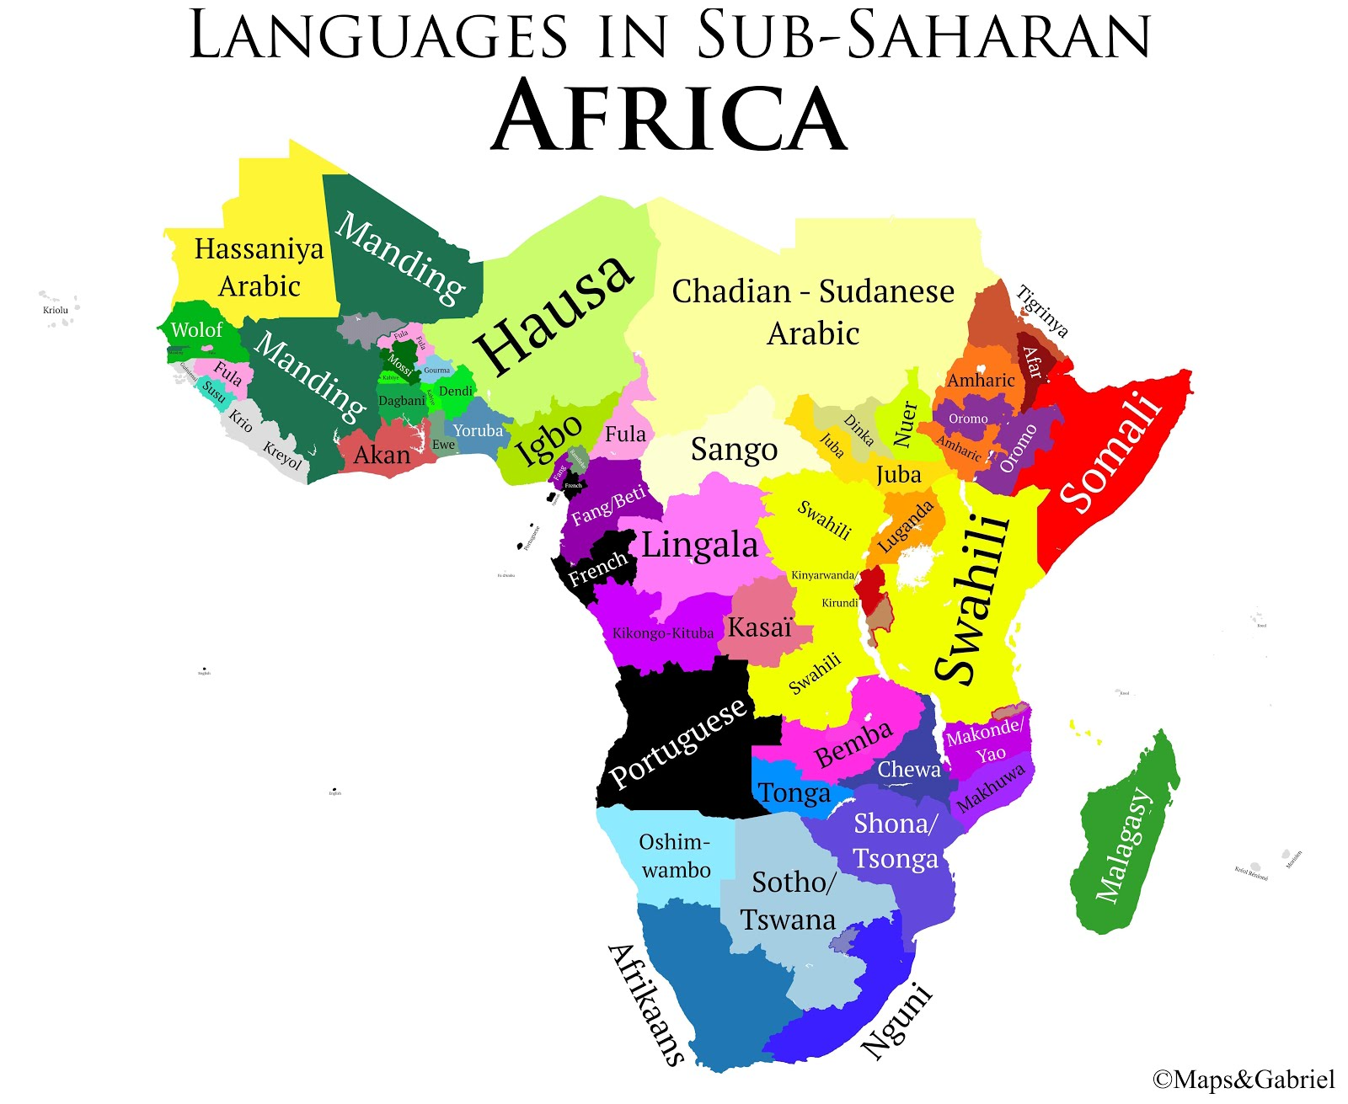
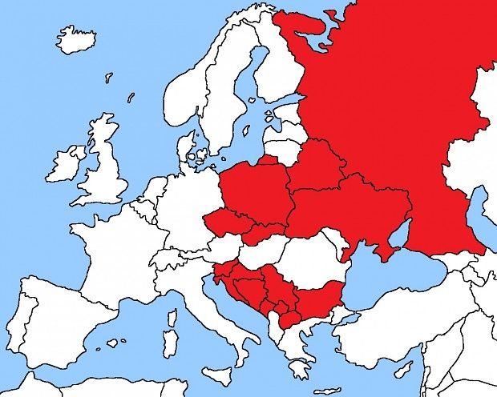
More auxiliary languages
Zonal Auxiliary languages
Afrihili: Derived from Swahili and Akan 1970 by Ghanaian historian K. A. Kumi Attobrah
Interslavic / Medžuslovjanski / Меджусловјанскы: Based on Slavic languages
Parody of Auxiliary languages
EuroPanto: A macaronic language with no fixed rules—merely a set of suggestions

Slide 33

Typologically normal with respect to natlangs
Not related to natlangs but typologically normal
Dothraki, Valyrian
Clip: Conlanging 3:14-6:52

Slide 34

Typologically unusual with respect to natlangs
Klingon:
many retroflex and uvular consonants
OVS word order is rare for natlangs
vocabulary heavily skewed toward warfare and space travel, making it awkward for ordinary use
Duolingo offers a course

Slide 35
Maladapted for use by humans
Ptydepe: Created by Václav Havel as a parody of bureaucratic jargon with no homonyms, words formed from least probable combinations of letters, all words must be 60% distinct, shorter words have common meanings, shortest is gh ‘whatever’, longest has 319 letters, a name for a fictional animal
Tlön: Created by Borges, a family of languages that allegedly lack nouns, with all words based either on verbs or adjectives
These are not “full” languages, only descriptions &/or a few words/phrases

Slide 36
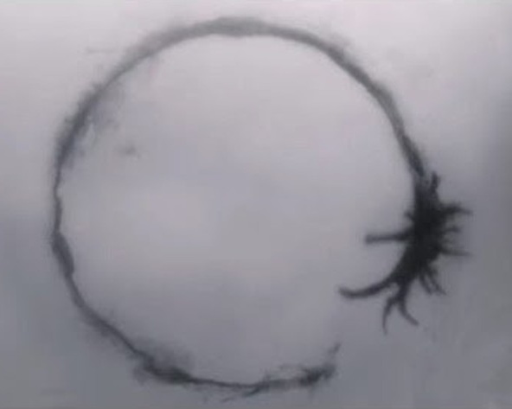
Not useable by humans
Heptapod: ink-blot patterns in the 2016 movie Arrival
His Master’s Voice: a neutrino signal from space that might be carrying messages in Lem’s Głos pana

Slide 37

Domains of languages
A.k.a. artistic languages or “artlangs”
Human communication: natlangs, auxiliary languages, revival languages
Fiction and film: The Hobbit, Lord of the Rings, Vyrozumění, “Tlön, Uqbar, Orbis Tertius“, Star Trek, Clockwork Orange, Arrival, Game of Thrones
Games: Dungeons and Dragons, Empire of the Petal Throne
Internet and fun: Олбанский язык/язык падонкаф, and many private conlangs

Slide 38

Ideologies of languages
Auxiliary languages: Facilitate communication
Ptydepe: Eliminate ambiguity
Tlön: Manipulate communication
NewSpeak: Manipulate thought
Láadan: Feminist perspective
Heptapod: Gift/weapon/tool
His Master’s Voice: ?

Slide 39
Questions and Comments?

Slide 40
What a conlanger needs to do to get started
If you want to make a conlang, start by defining these parameters:
  Type of your conlang relative to the universe of conlangs
  Domain of your conlang
  Culture of your conlang
DJP, p. 18: “What do I want to say with this new language that I can’t say in my native language – or any other language that currently exists?”
Clip: Conlangy-er 6:18-6:58;
Conlanging 26:12-27:13

Slide 41
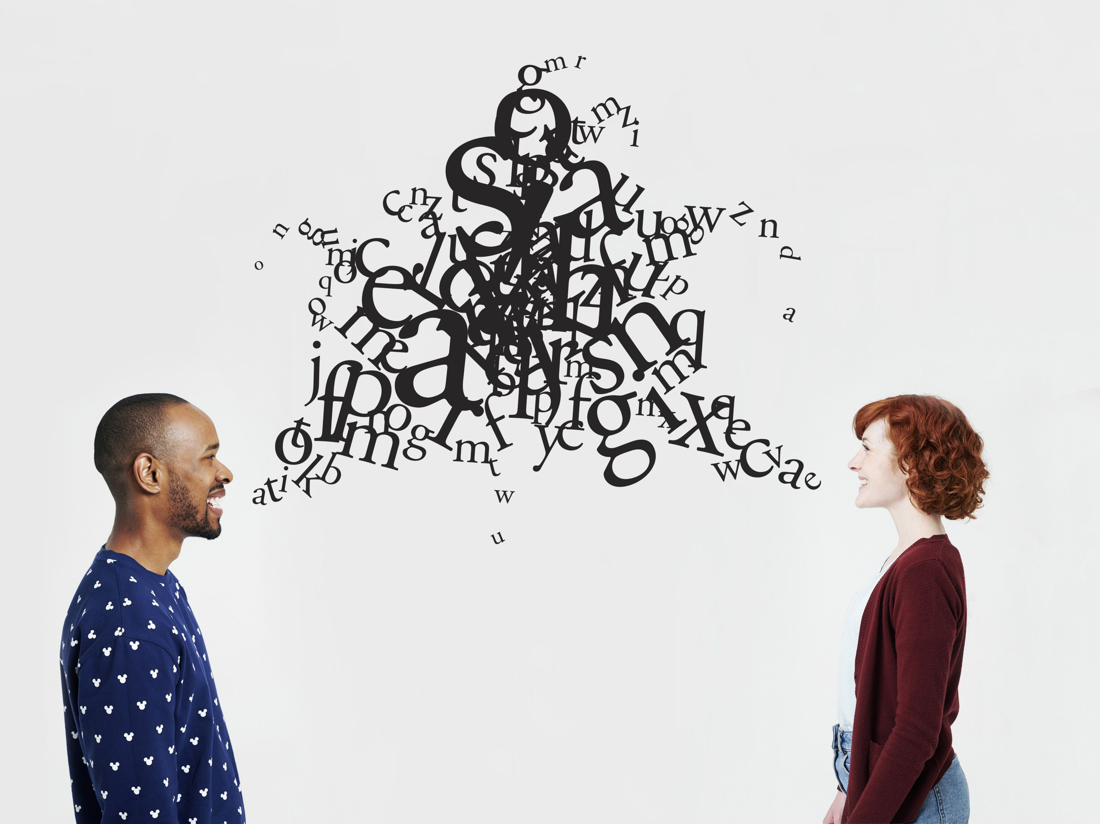
What is in a language?
Which of these is NOT an essential feature of a language?
Sounds
Words/Lexicon
Grammar
  Morphology
  Syntax
Script/Writing system/Orthography

Slide 42
Transcription
A rendering of the text of one language in a different orthography
Either
  a letter-mapping, usually a romanization, or
  a sound-mapping, usually with International Phonetic Alphabet
Important to remember that a script (orthography) is, strictly speaking, NOT a part of a language
A script is a tool for recording a language
A given language can be recorded using a potentially infinite number of scripts

Slide 43
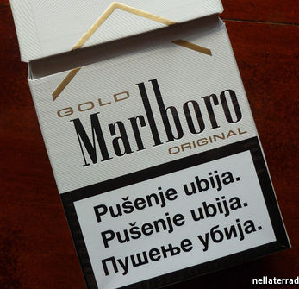
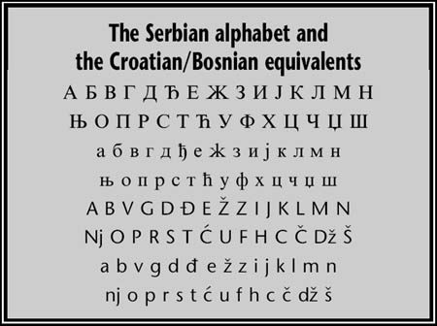
Clip: Conlanging 1:20:00-1:23:54

Slide 44
Some Tools
International Phonetic Alphabet:
  https://www.ipachart.com/
World Atlas of Language Structures:
  https://wals.info/
Subreddit: Constructed Languages for Language Geeks
  https://www.reddit.com/r/conlangs/wiki/resources/
Conlang Atlas of Language Structures:
  https://cals.info/

Slide 45
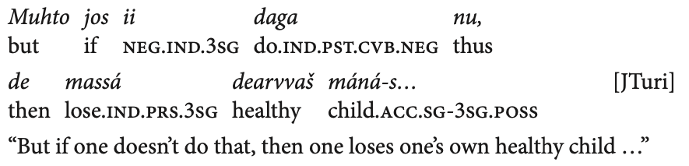
Gloss
Often inserted in a line between the original and a translation, and therefore called “interlinear”
A gloss should give a translation of each word, along with grammatical information, usually following Leipzig Glossing Rules
Interlinear
gloss

Slide 46
Questions and Comments?

